Slide 1
K-MOOCS
Possibilities and opportunities for online learning at Kent
Mark O’Connor, UELT
24th June 2015

Slide 2
K-MOOCs: Project background and overview
Beacon Projects
Why MOOCs?
Reputation
Outreach
Marketing
Enhancing the blend
Digital literacy
Income…?
Feasibility study
Desk study & consultancy
Pilot MOOC: Functional Programming with Erlang
‘Master Classes’
Final report & recommendations

Slide 3
Pilot MOOC: Functional Programming with Erlang
Original plan:
Kent undergraduates (either 2nd years revising, or 1st years looking ahead)
Contacts in Erlang community
~50 participants?
One tweet later…
500 participants – capped
> 50 countries
Beacon Projects focus
Public engagement ✓
Kent as the UK’s European University ✓

Slide 4
Pilot MOOC: Pre-MOOC survey
255 responses
Majority (87%) wanted “to learn Erlang”
36% “to prepare for future studies or improve career prospects”
34% “to supplement my existing studies”
22% “to learn flexibly around my other commitments”
18% “to try out a MOOC or online learning in general”
11% “no particular reason – just curious”
54% had taken a MOOC before; a further 17% had taken some other sort of online course
Age range
0-24: 11%
25-44: 66%
45-64: 22%
65+: 1%
95% male

Slide 5
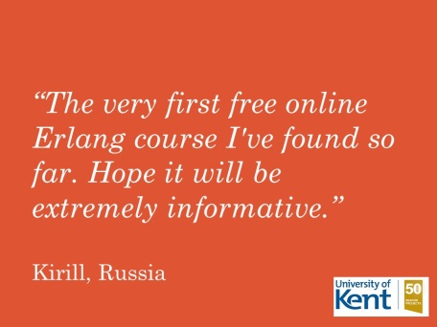
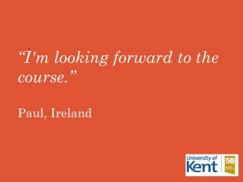
Pilot MOOC: Pre-MOOC survey

Slide 6
The MOOC
Functional Programming with Erlang, on External Moodle
YouTube videos
Master Classes

Slide 7
Pilot MOOC: Headline figures
500 signed up (plus a few more…)
Course open until end of June
372 have actually taken part
~150 completed first week (so far…)
~70 completed second week (so far…)
~35 fully completed (so far…)
In line with expectations

Slide 8
Pilot MOOC: Post-MOOC survey
~30 responses so far (course open until end of June)
79% completed “all” or “most”
48% of non-completers cited “time commitment” as main factor
73% intend to keep accessing the course
81% said the user experience of Moodle had no or only a “small” impact on their participation
Subject knowledge before and after:
Excellent: 7% 7%
Good: 10% 48%
Moderate: 28% 45%
Poor: 38% 0
None: 17% 0

Slide 9
Pilot MOOC: Post-MOOC survey
79% found MOOC navigation “very easy” or “somewhat easy”
19% preferred our pilot to previous MOOCs!
Others were spread between ‘neutral’, -ve, or first-time MOOCers
89% would recommend to friends / colleagues
89% would “definitely” or “probably” take the full 6-week course
Very slight preference for dedicated MOOC platform over Moodle
KentPlayer fared well in the comments:
“The video player presentation showing code and slides was superior to other MOOCs and very helpful.”
“The Kent Player was very good, showing the video, slides and time track. This fully integrated way to show the related information increases the ‘experience of learning’.”
“The features of the Kent player were very nice and useful.”
“The Kent's Player was really excellent, one of the best I've seen.”

Slide 10
Pilot MOOC: Post-MOOC survey
“Professor Simon Thompson did a very good job, with clear explanations. The exercises were well designed in order to show the concepts, and the live-coding was so nice! I really enjoyed this MOOC!”
“For the first time I am not intimidated by Erlang and am now eager to learn more. I haven't found a programming course this stimulating or well designed since SICP. Thank you!”
“I thoroughly enjoyed the course! Thanks to everyone involved for putting it together!”
“The course was wonderful, all material, lectures and complementary content is being great. Very good job, congratulations.”

Slide 11
Pilot MOOC: Post-MOOC survey
“Overall, the MOOC has been a positive and satisfying experience. Before the MOOC, about the only thing I could do in Erlang was add numbers. I learnt so much from attending this MOOC. I have such an improved understanding of functional programming in general. My knowledge in Erlang has taken a significant jump forwards. A big THANKS for making this online course available.”
“Please continue your work. Of course there are many things that could make your MOOC better. The good news are - these things doesn't matter that much. Your product core is build with love and that is what an attendee like me values more then any other aspect.”

Slide 12
The way forward
‘Academic’ – what courses?
Identifiably ‘Kent’
Clear link to on-campus provision
Potential for development as standalone / CPD
‘Technical’ – what platforms?
Moodle + KentPlayer / Vimeo / YouTube
FutureLearn
Others…?
Audience – who participates?
What if… not MOOCs?
Smaller, possibly paid-for, courses (e.g. CPD) on Moodle
Alternative model for on-campus courses e.g. to incorporate ‘flipped classroom’

