Slide 1
the digital classroom PROJECT
Dr. Silvia Colaiacomo and Jane Carne (University of Kent)
APT 2018 Conference, Greenwich, 3 July 2018

Slide 2
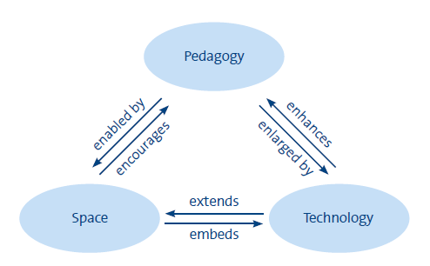
Future Learning Spaces Project
Project Aim and Plan
Investigate modern teaching spaces
Promote and support innovative teaching practices
2016 UCISA HE Learning Spaces Toolkit

Slide 3
Initial Consultation Forums in June 2016.
‘What would a modern teaching space look like?’
Interesting insights
Space
get the fundamentals right first.
furniture / lighting / room size - this is what students complain about.
Technology *
needs to be easy, quick and reliable.
very teacher focussed (little on student use).
Pedagogy
need to be able to work in small groups as required.
quite traditional.

Slide 4
UoK Digital Classrooms - features
We added more features to enable and promote a wider range of approaches and uses.

Slide 5
Digital Classroom Pilot 2017/18
Participants
16 academics
5 schools
Economics Business School
Film Studies Anthropology
UELT (PGCHE)
288 students
10 modules
Worked very closely with these academics
Support, training, adapting room / troubleshooting

Slide 6
Evaluations of the 10 pilot modules (November 2017 – March 2018)
Qualitative & quantitative data collection and analysis
Interviews (15 academics + 25 students)
Observations and field notes (10 hours)
Quantitative data
Areas explored
Types of activities
Impact of the rooms on teaching and learning
Advantages and barriers of using the rooms
Notes:
Cut areas explored

Slide 7
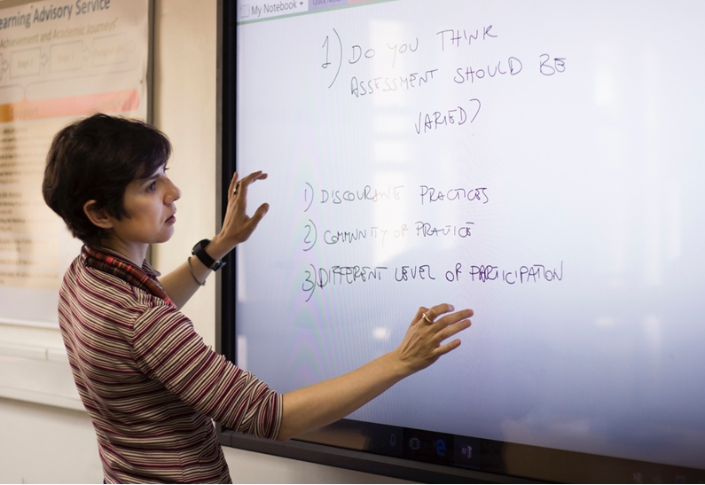
Evaluations: Key findings
Positive response (staff & students)
Flexibility of space and technology (accessibility)
Enhanced opportunities for interaction in and out the class
Soft skills training (e.g. presentation skills)

Slide 8
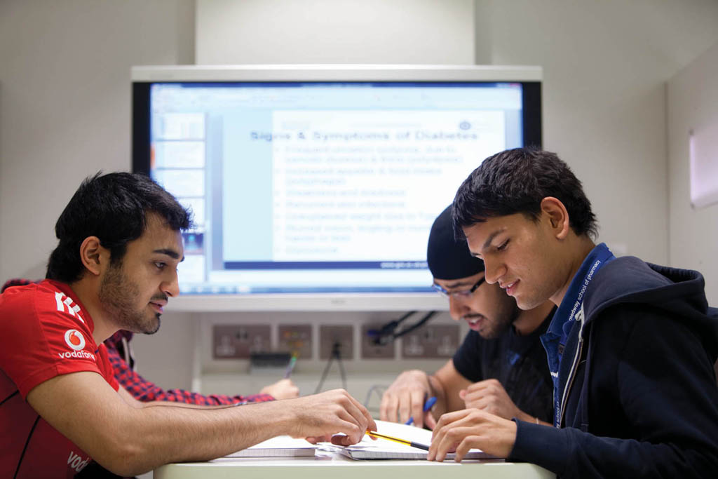
Theme I: The influence of space
‘Everybody enjoyed the space. I am not going back to other seminar rooms.’ (interview)
‘They learn to present differently, like in a real work place.’ (interview)
Student-tutor relationship
Quality of feedback
Group work
Focus and quality of work
Student voice
Notes:
Students outside class time

Slide 9
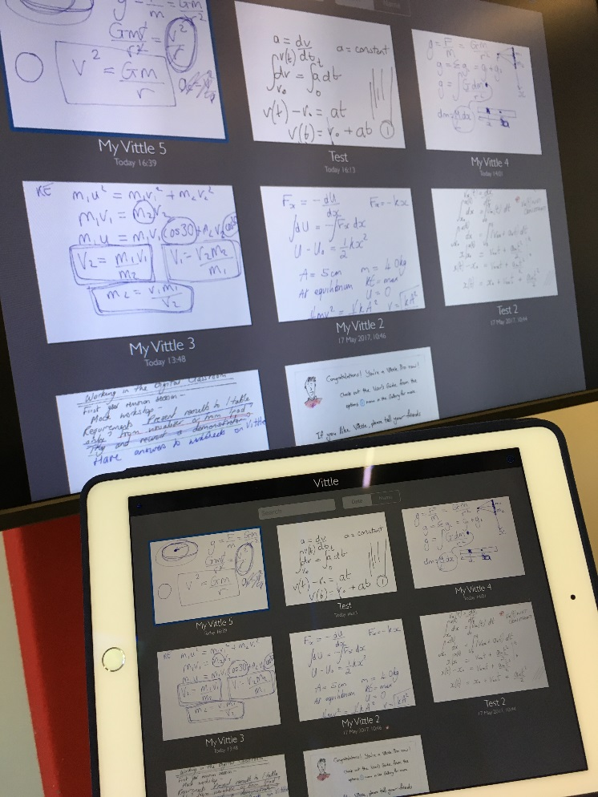
Theme II : Technology as enabler
‘The touch screen! Zooming in and out, we could not have worked as we did without it’ (interview)
‘Students use the space outside class time, it is not just the space, it is the way of working together that they have developed. We should have more of these screens in study areas around campus’ (interview)
Touch screen + OneNote
Repeater screens
BYOD
Core and non-core
Notes:
Something doesn’t work

Slide 10
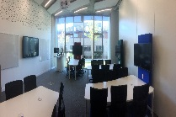
Reflecting on what we have learnt
Space
Fundamentals important: comfort, visibility, ease of use, flexibility
Has real impact on the student learning experience
Technology
Student use and control of technology is highly valued
BYOD (students & staff) & digital competence – expect surprises
Both enables and inspires pedagogic innovation
Pedagogy
Group work / active learning enhanced
Academic desire to explore different approaches is key
Provide opportunity to explore a range of room features
Lecture or seminar – adaptation of academic practice
Importance of collaborative approach
Stakeholders: 4 professional services, plus academics & students
Trust and support is key to success
Notes:
Victoria
Interesting anecdotal staff

Slide 11
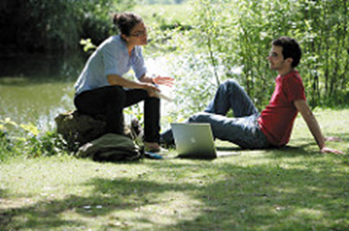
Next steps 2018/19
More uptake, supporting returners
Revisit aspects of the room & explore the wider potential
Explore moving beyond the lecture / seminar model
Investigate different subject use
Further engage students as partners
Implement this collaborative approach to other innovation projects

Slide 12
Notes:
This

