Slide 1
Where next for the UK Welfare State?
Peter Taylor-Gooby, Benjamin Leruth and Heejung Chung
University of Kent

Slide 2
Social Spending per capital in the United Kingdom, 1979-2013
Source: UK Public Spending (2015)

Slide 3
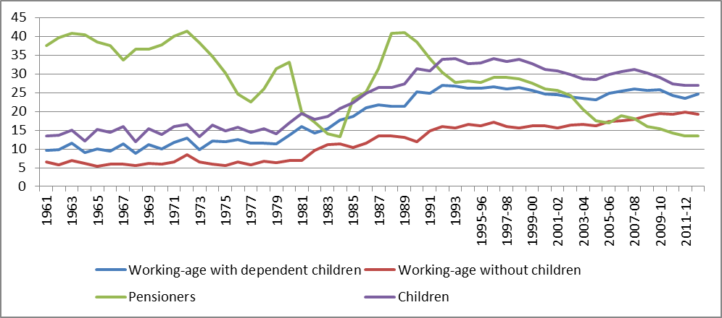
Percentage of people in low-income households in the United Kingdom, 1961-2012
Source: Joseph Rowntree Foundation (2015)

Slide 4
Percentage of people at risk of poverty or social exclusion in Europe, 2005-2013
Note: persons at risk of poverty are defined by the European Commission as ‘a process whereby certain individuals are pushed to the edge
of society and prevented from participating fully by virtue of their poverty, or lack of basic competencies and life-long learning opportunities,
or as a result of discrimination’ (source: Eurostat 2015)

Slide 5
Objectives of this paper
Assess the evolution of the politics of the British welfare state over time, based on the country’s political characteristics, policy responses advocated by political parties, and public attitudes;
Structure: past (1970s – 2008), present (2008 – 2015), future (2015 –);
Theorising the new welfare directions (based on Streeck and Thelen) Convergence Structured Diversity ‘Beyond Continuity’
Notes:
While the paper extensively discusses past issues and the evolution of the British welfare state from the 1970s to the Great Recession, this presentation mostly focuses on the outcome of the 2015 General Election and future scenarios, due to time constraints.
Convergence: Similarities in context and structure between European Welfare States will lead them to develop towards a common model, such as neo-liberalism or social investment;
Structured Diversity: Real differences will be sustained over time, enabling us to group welfare states as in regime theory (or varieties of capitalism)
‘Beyond Continuity’: National Policy directions may diverge as policy reforms cumulate in difference ways in different contexts, and as resistance to/support for changes develop.
This leads us to focus attention on national processes of welfare state politics, their outcomes and their future directions.

Slide 6
Policy response | Policies | Cleavages | Solidarities
Retreat from Interventionist State
Neo-liberalism | Cutbacks, privatisation | Advantaged groups vs. disadvantaged | None
 | Prioritise pensions, health care, not working age benefits | Intergenerational | None
 | Prioritise wage supplements and low income tax, not benefits | Worker vs dependent | None
 | Prioritise social insurance vs. means-tested welfare | Secure vs precarious | None
Individualism | Privatisation | Middle-class vs people at risk of poverty | None
New Forms of Interventionism
Neo-Keynesianism | Welfare spending to maintain demand from the poor |  | Class alliance between working class and middle-class groups
Social Investment | Prioritise training and family support | Groups whose engagement in work or skill level can be enhanced vs. others | Groups marginal to the labour market
Predistribution | High minimum wage, rent and utility price control, better job opportunities | Low-waged vs. high-waged | Across lower-wage groups
Fightback | Anti-austerity measures, increasing benefits, corporate tax |  | Solidarity of disadvantaged
Welfare Chauvinism | Residence and citizenship tests; immigration control | Denizens vs. immigrants | Nationalism
Notes:
Across Europe, six policy responses to austerity predominate. Two of them imply a retreat from interventionism, while four provide new forms of interventionism. We argue that such policy responses tend to undermine existing solidarities and create new social cleavages.
Neo-liberalism promotes a politics of limited and targeted welfare spending, privatisation and incentive-based work-centred benefit systems. It is reinforced with an individualism in politics which centres on the interests of the individual citizens and ignores possible solidarities.
Neo-Keynesianism focuses on counter-cyclical state investment and spending on benefits to promote economic activity, since the poor are least likely to save any money they have.
Social Investment makes a case for welfare state activity that can be shown to help promote economic growth, either by mobilising labour (for example, subsidised child care) or by improving the quality of labour (for example, training, public health).
Predistribution acknowledges the constraints on tax and spend welfare but seeks to pursue welfare ends by regulation, for example, high minimum wage, rent and utility price controls, requirements for employers to provide child care, parental benefits, sick pay and so on. This subverts the logic of the market.
Fightback includes straightforward returns to a traditional universalist redistributive framework, abandoning the neo-liberal commitment to budgetary restraint have been promoted.
Finally, Welfare Chauvinism argues for the restriction of access to welfare state provisions to the native population, and is mostly advocated by right-wing parties. We may distinguish two forms of chauvinism: some political parties have adopted a ‘hard’ chauvinism, which requires the exclusion of would-be immigrants. Others have pursued a softer approach, calling for temporary restrictions on access to welfare provision for immigrants.

Slide 7
The impact of the great recession and responses to it
Under Gordon Brown’s government: increase in spending on unemployment and low pay benefits (neo-Keynesian response)
2010-2015: Coalition between Conservatives and Liberal Democrats (led by David Cameron), and neo-liberal response to the Recession - Main objective: eliminate the budget deficit through major reforms (4/5 cuts, 1/5 taxation); - Welfare benefits were cut sharply despite rising demand; - Reduce immigration (soft chauvinism); - Increase VAT from 17.5 to 20% - Focus on pensions, but serious cuts in local government spending, health care and education

Slide 8
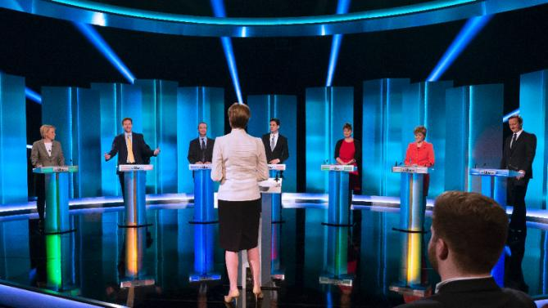
The 2015 General Election
Campaign focused on deficit reduction, welfare, immigration, Europe, and coalition partnerships
High visibility for smaller parties (SNP, UKIP, Plaid Cymru, Greens) -> moving away from bipartisanism favoured by a first-past-the-post electoral system?
Notes:
The numbers of over 65s receiving local authority social care services fell from 1.22 million in 2008-9 to 1.06 million by 2010-11 and to 0.85 million by 2013-14
There is considerable concern that the weakness of social care leads to bed-blocking in the NHS as hospitals are unable to discharge frail older people. The numbers on waiting lists for more than 18 weeks rose from about 2.5 to about 3 million between 2010 and 2015

Slide 9
 | Conservative | Labour | Lib Dems | SNP | Plaid Cymru | UKIP | Green Party
Neo-liberalism | Balance the budget; £12 billion welfare cuts; Cut household benefit caps; Increase tax credit; Prioritise benefits for the elderly | Balance the budget; Cap structural welfare spending; Prioritise benefits for the elderly; Increase tax credit | Balance the budget; Prioritise benefits for the elderly; Increase tax credit | Prioritise benefits for the elderly | Cut business rates for small and medium sized businesses | Balance the budget; Restrict child benefit to two children; Cut benefit caps; Increase tax credit; Cut business rates for small businesses | N/A
Individualism | Privatisation in various sectors | N/A | Encourage further private sector investment in various sectors | N/A | N/A | Encourage the use of private health services; Stimulate private energy investment | N/A
Neo-Keynesianism | N/A | Scrap the bedroom tax; | Increase benefit cap for two years; Reform the bedroom tax | Scrap the bedroom tax; Back increase of at least the cost of living in benefits | Scrap the bedroom tax | Reform the bedroom tax | Introduce a maximum 35-hour working week
Social Investment | Create 3 million apprenticeships | Increase access to childcare; Apprenticeship for every school leaver who gets the grades | Expand apprenticeships; Develop national colleges for vocational skills | Continue free university education in Scotland | N/A | N/A | Scrap university tuition fees

Slide 10
 | Conservative | Labour | Lib Dems | SNP | Plaid Cymru | UKIP | Green Party
Predistribution | Increase minimum wage | Increase minimum wage; Retain the triple lock on pensions; Control on rent and utility prices | Retain the triple lock on pensions | Increase minimum wage; Retain the triple lock on pensions and protect the winter fuel allowance | Living wage for all employees by 2020 | No tax on minimum wage | Create jobs that pay at least a living wage; Provide 500,000 social homes for rent by 2020 and control rent levels
Fightback | N/A | Tax on bankers’ bonuses; Mansion tax | Extra corporation tax on banking sector | Oppose austerity and increase spending; Tax on bankers' bonuses; Mansion tax and crackdown on tax avoidance | Oppose austerity and spend on infrastructure; Oppose a ‘welfare cap’; Oppose NHS privatisation | End austerity by leaving the European Union | End austerity and restore the public sector
Welfare chauvinism | Four-year wait before EU migrants can claim benefits; Lower immigration; EU referendum | Two-year wait before EU migrants can claim unemployment benefits | Phase out child benefit for children living outside the UK; Language tests for benefit claimants | N/A | N/A | Five-year wait before migrants can claim benefits Point-based system capped at 50,000 skilled migrants/year; EU referendum; Prioritise social housing for people with local connections | N/A

Slide 11
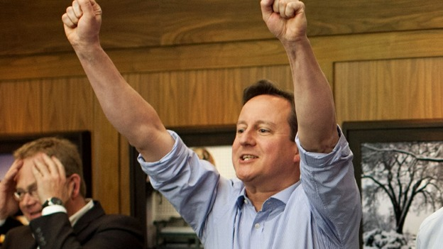
Outcome
Against all odds: outright Conservative majority government
Welfare Work and Reform Bill
Measures to reduce immigration and benefits for migrants
EU Referendum
Privatisations (e.g. Royal Mail, Royal Bank of Scotland, etc)
Notes:
Welfare cuts totalling £12 billion (just over ten per cent of budget for working age welfare) were introduced. The maximum amount any household could claim was reduced from £26,000 to £20,000. A Citizens’ Advice Impact Assessment of the draft legislation confirms a leaked Department for Work and Pensions memo showing that this measure will penalise about 400,000 children and 150,000 adults (Citizens’ Advice 2015).
Other measures include limiting child tax credit to two children, a four year benefits freeze, a commitment to train a further three million apprentices and the abolition of Employment and Support Allowance Work-Related Activity Component.
The party also sought to gain welfare chauvinist support through plans to limit the welfare available to non-EU immigrants and to negotiate with Brussels on restricting EU immigration.

Slide 12
The future – public attitudes
Further intergenerational solidarity issues, with welfare policies favouring older people
Priorities for Extra Spending on Social Benefits, 1983-2014 (Source: BSA 1983-2014)

Slide 13
The future – public attitudes
Attitudes have hardened against unemployed people
Perception of level of benefits for unemployed people and workless poverty, 1983–2014 (Source: BSA 1983-2014)

Slide 14
The future – public attitudes
Restricting benefits for immigrants (i.e. welfare chauvinism)
Immigrants are a strain on our welfare system (% agree) | Immigrants receive more than they contribute (% agree) | Immigrants should only obtain the same rights to social benefits and services as citizens already living here after working and paying taxes for at least a year, or once they have become a citizen (% agree) | Immigrants contribute less in taxes than they benefit from health and welfare services (% agree) | Social benefits/services encourage people other countries to come live here (% agree) | Immigrants take jobs away from people who were born in Britain (% agree)
51.8% | 56.7% | 79.9% | 51.0% | 76.0% | 50.6%
Source: European Quality of Life Survey 2011 | Source: European Social Survey 2008 | Source: European Social Survey 2008 | Source: Eurobarometer 71, 2009 | Source: European Social Survey 2008 | Source: British Social Attitudes 2013
Welfare chauvinism in the United Kingdom

Slide 15
Conclusion
Population ageing, growing inequality and more intense global competition have all tended to promote deeper divisions in policy objectives and outcomes;
Neo-liberal and chauvinist responses predominate;
All parties prioritize benefits and services for older people, who constitute an important electoral force;
BUT entrenched division between right and left on the size of the state, the role of the private sector, the extent to which government should seek to ensure that the living standards of families on benefits fall below those of the lowest paid worker and the extent of inequality.
Notes:
We suggest that UK welfare futures will be located somewhere between two scenarios: a contracting welfare state equilibrium, in which the political capacity to resist pressures towards greater inequality and declining provision for the working age population is weakened by the politics of inequality and by the fact that low productivity reinforces a low return to much of the working class; and a more broadly-based equilibrium, in which price, rent, wage and labour market regulation sustain living standards at the bottom and in which human, social and physical capital investment reinforce higher skill and a more equal spread of productivity.
This would strengthen the interests supporting working age welfare state and contain but not reverse pressures towards greater individualism and towards inequality. The risk for the first model is that welfare provision is caught in a downward spiral that eventually destroys solidarity and weakens even the capacity to provide for older groups. The risk for the second is that higher labour costs undermine competitiveness making the system unsustainable.

