Slide 1
WEB DEVELOPMENT TEAM / USER-CENTRED OVERVIEW
Notes:
Introduction

Slide 2
What we do
Design and develop websites and services, primarily for central sites e.g. courses, news, student guide…
Work closely with our partner team, Web Solutions, to provide departments with web resources
Skills include Web Development (coding, mark-up, testing) and User experience (discovery, design, testing)
Notes:
The Web Development Team creates web products primarily focusing on central sites for EMS and CC – we work closely with our colleagues, Web Solutions.

Slide 3
Focusing on the user
User centered design
Accessibility
User experience principles to improve content
Focus on the user
Inspire
Resources wherever you are
Design for inclusivity
Keep content simple
Keep it efficient
Notes:
We want to create products which are useful for the intended users. To ensure we don’t simple implement ‘ideas’ dreamed up in a boardroom, we challenge the assumptions by following a user-centred design approach.
This is a design process where user feedback is included in the design and development throughout the design process.
This helps validate if features that are being developed truly add value to the user or are not necessary – it creates an efficiency by challenging our assumptions and designing products which are truly useful for the people using them.
Key to developing good content is building it in a way that is it accessible to as many people as possible.
How do people with different mobile, auditory, visual or cognitive accessibility needs user our information – accessible content is good for everyone and should be our default,
We are now following industry guidelines to ensure content is developed to standards.
We also want to make great content that frames our brand in the best way possible – to help give us direction we follow the University’s UX principles.
Go through principles.

Slide 4
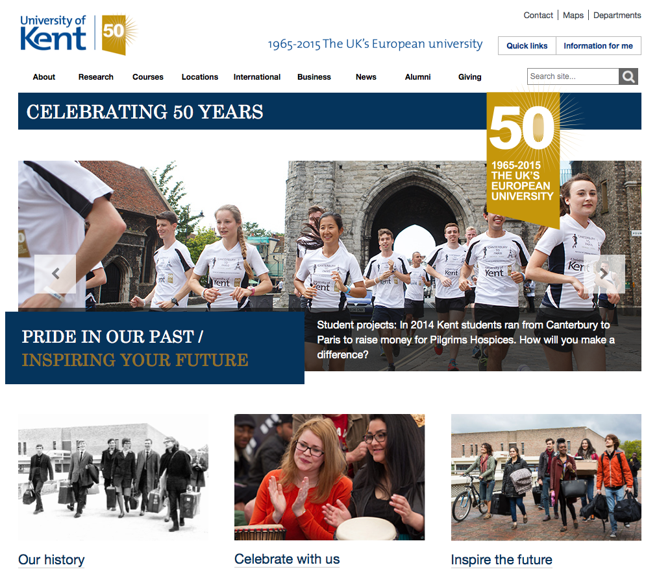
Examples
Notes:
Here we can see the news centre and 50th design which show a different to visual language.
We want to freshen up the online visual language and bring it closer in line with the brand and modern trends.
Here you can see some examples where we are using principles of
- Simplicity
- User-focus, user feedback has helped us refine the content
Digital design across all sectors is showing a move towards simplicity based on offering content to users in a way which is relevant to them.
Over the past year we’ve been exploring approaches to refresh the University web theme towards these principles of clarity and openness.
This has led to a simpler, lighter design aesthetic which emphasises:
space
bold, high quality imagery
clear typography
plain English
simple, content-rich layouts

Slide 5
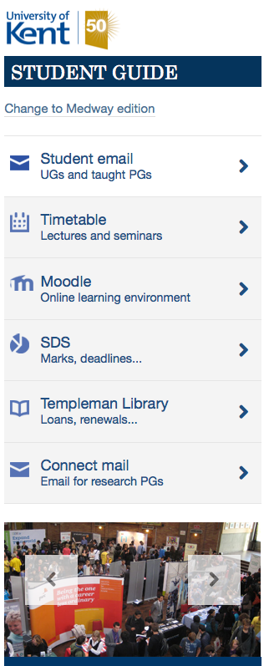
Examples
Notes:
Here is an example of designing a responsive sites based on understanding the context of the user.
Users of any online service increasingly want to access content directly, quickly, without fuss, on a range of different devices, and in different contexts

Slide 6
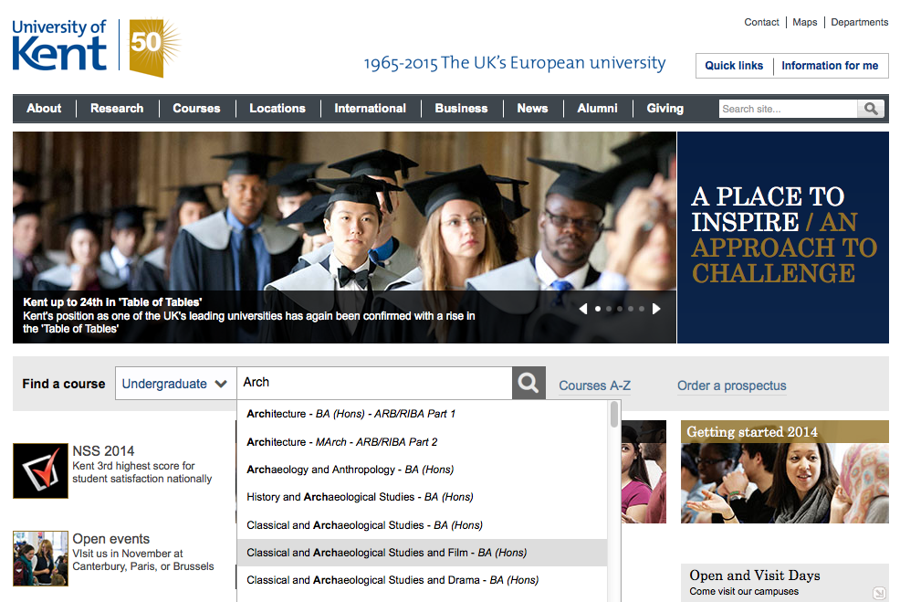
Examples
Notes:
Course page example
We tested with a visually impaired student who uses a screen reader.
Based on his feedback we experimented with new coding techniques (WAI ARIA) to make the autocomplete search work for him.

Slide 7
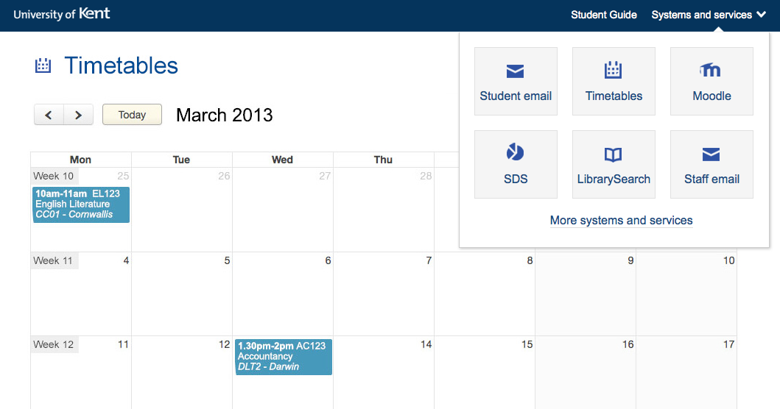
Examples
Notes:
We also try to better understand the current student and are working to improve the applications they use creating a more unified, cohesive experience for them.
Give overview of navbar.

Slide 8
Questions?
is-webdev@kent.ac.uk
http://blogs.kent.ac.uk/webdev/

