Slide 1
COMPARATIVE LITERATURE/ AT KENT

Slide 2
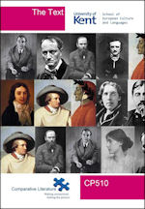
What we study
European, Latin American, North American, Asian, African, and texts from other traditions
Our focus is LITERATURE, not language
We read all literary texts in translation
Students do not have to learn a second language (although we encourage them to do so)
We focus on literature and film across
national and geographical borders
historical borders
linguistic borders
cultural borders
media boundaries

Slide 3
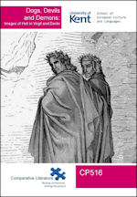
We focus on:
Literary themes and motifs (love, death, madness, dreaming, etc.)
Literary figures (Odysseus/Ulysses, Antigone, Hamlet, Faust, Don Juan, etc.)
Literary forms and genres (drama, the novel, autobiography, the sonnet, the fantastic, horror fiction, science fiction, crime fiction)
Literary movements (Classicism, Romanticism, Modernism)
Literary relations (influences, affinities, adaptations)
Literary contexts (the cultural and historical factors that affect the forms that literature takes)

Slide 4
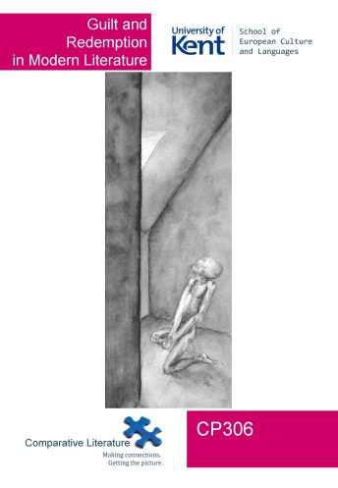
How we study
In Comparative Literature, you study literature from the classics to the modern age, and works written in English alongside European and other literatures, comparing genres, movements and styles across different periods and continents.
We also teach World Literature which enables you to develop a global perspective on literature and its cultural contexts. The focus is more explicitly on non-Western literary traditions, such as Arabic, Asian and African works, which are studied alongside English, American and European texts.

Slide 5
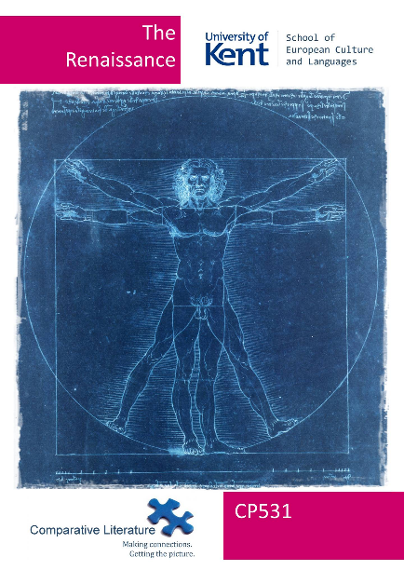
Your degree programme I: compulsory modules
Each year our students study one core module:
Stage 1:
The Tale: Short Fiction from the Ancient Greece to the Present
Stage 2:
The Text: Approaches to Comparative Literature
Stage 3:
Final-Year Dissertation

Slide 6
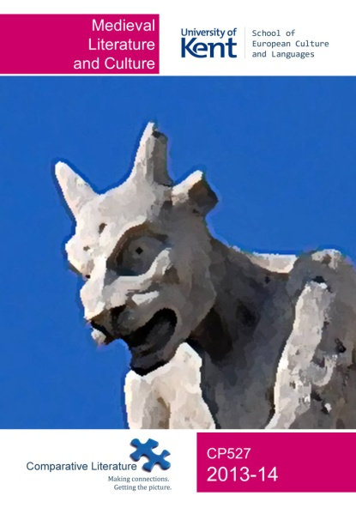
Your degree programme II: optional modules
We offer modules covering the major historical periods
and literary movements:
Classical Literature
Medieval Literature and Culture
Upheaval of the Mind: European Romanticism in Context
Postcolonial Images of Africa, Asia and Latin America
We offer modules that cross media:
The Book and the Film
Medieval Literature and Culture
Don Juan and Casanova: The Art of Seduction in Literature, Music and Film
The Shoah in Literature, Film and Culture
Playfulness, Games and Literature
Note: Some modules may not run every year and the offer of individual modules is subject to change

Slide 7
Your degree programme III: optional modules
We offer modules on various literary genres:
Travel Literature
Crime Fiction
Tragedy
Writing Literature: Creative and Analytical Approaches
We offer modules that cover specific national literary traditions or geographic areas or transcend them:
World Literature: An Introduction
Latin-American Fiction
Postcolonial Images of Africa, Asia and Latin America
Note: Some modules may not run every year and the offer of individual modules is subject to change

Slide 8
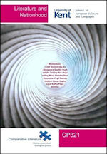
Your degree programme IV: optional modules
We offer modules on various literary themes:
Prize Winners
Childhood and Adolescence in Modern Fiction
Rethinking Gender: From the Brontё Sisters to Eimear McBride
Don Juan and Casanova: The Art of Seduction in Literature, Music and Film
Freedom and Oppression in Modern Literature
Guilt and Redemption in Modern Literature
Fiction and Power
Creatures of the Night: Vampires in Literature and Film
Shakespeare’s Afterlives
The Shoah in Literature, Film and Culture
In Search of Shelter: Refugee Narratives and the Politics of Displacement
Note: Some modules may not run every year and the offer of individual modules is subject to change

Slide 9
How we teach
Weekly seminars
Usually a group of 20 students
Discussing the texts
Student presentations
Group work
Lectures
Lectures supply important background information
We give one-to-one feedback on essays
All students are assigned an Academic Adviser

Slide 10
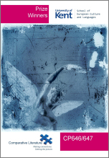
Developing your skills
In addition to learning about world literature, history and culture, you will also develop:
Generic skills:
Interpretative skills: close reading and comparative analysis
Engagement with the issues of translation and a general theory of literature
Transferable skills:
Writing skills
Presentation skills
Communication skills
Organisational skills
Intercultural competence
You will also:
Hone your potential for critical thought and expression
Develop your self-confidence

Slide 11
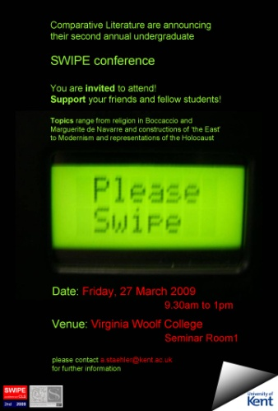
Your future
We offer opportunities to prepare you for possible future careers:
Student Work in Progress Exposition (SWIPE) undergraduate conference
And you can also take ‘Wild Modules’ from other Departments

Slide 12
Opportunities: Spend a year abroad
A unique opportunity:
To experience cultural diversity at first hand.
To develop intercultural competence.
To benefit from the exposure to different approaches to the study of Comparative Literature.
To acquire an extra dimension for your CV.
Languages:
A foreign language is not required as the teaching language is English.

Slide 13
Opportunities: year abroad destinations
Destinations are in Europe, North America and Asia and include:
America
Canada
Czech Republic
Denmark
France
Germany
Italy
Spain
Switzerland
Turkey
Hong Kong
Ireland
Portugal
Netherlands
Singapore
South Africa
Taiwan
(These destinations are subject to change)

Slide 14
Joint honours programmes
In addition to our Comparative Literature Single Honours programme, we also offer
Joint Honours degrees in:
Comparative Literature and …
Asian Studies
Classical and Archaeological Studies
Drama
English Language and Linguistics
English Literature
Film
French
German (with a Year Abroad)
Hispanic Studies
Italian
Cultural Studies

Slide 15
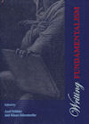
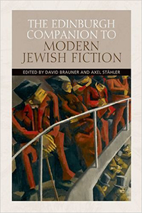
Our academic staff
You will be taught by academics with international reputations for the high quality of their research
They regularly publish major books and articles in their fields of expertise which feed directly into their research-led teaching
Our staff are also very friendly and supportive …

Slide 16
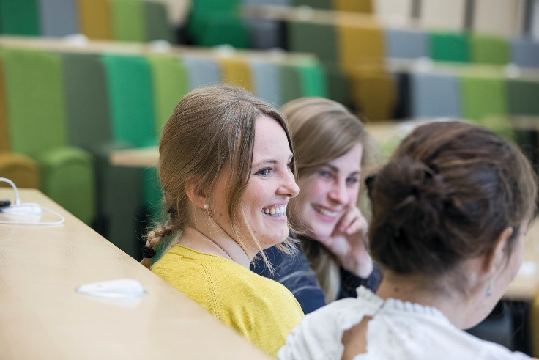
High quality teaching
Comparative Literature at Kent has excelled in the National Student Survey, over 90% of our students have expressed satisfaction with the teaching on their course and 100% reported overall satisfaction with the quality of their course.
This is a higher level of satisfaction than can be found for Comparative Literature at any Russell Group university.

Slide 17
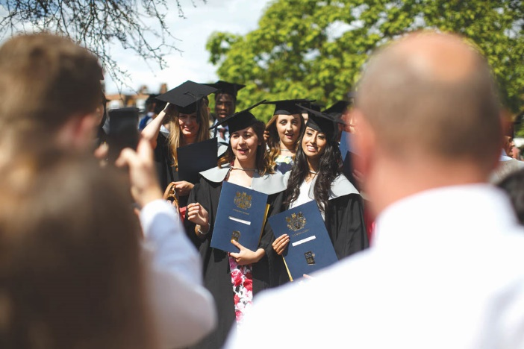
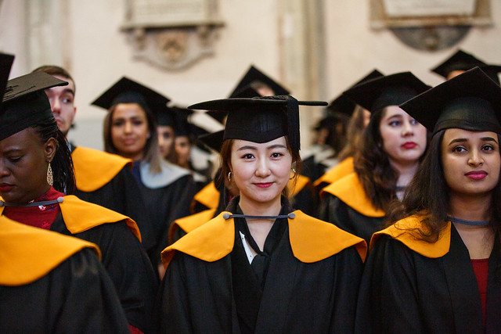
Graduate destinations
Our graduates go on to careers in:
Teaching
Journalism and the media
The Civil Service
Creative writing
Academia
Communications
100% of Kent 2017 Comparative Literature graduates who completed a national survey were in work or further study within six months. (DLHE)

