Slide 1
Should fiction be censored?
Dr Angelos evangelou
Comparative literature, University of kent

Slide 2
- Does fiction have any power?

Slide 3
- With power comes…

Slide 4
- Should authors be censored?
- Should authors be allowed to write anything they want?

Slide 5
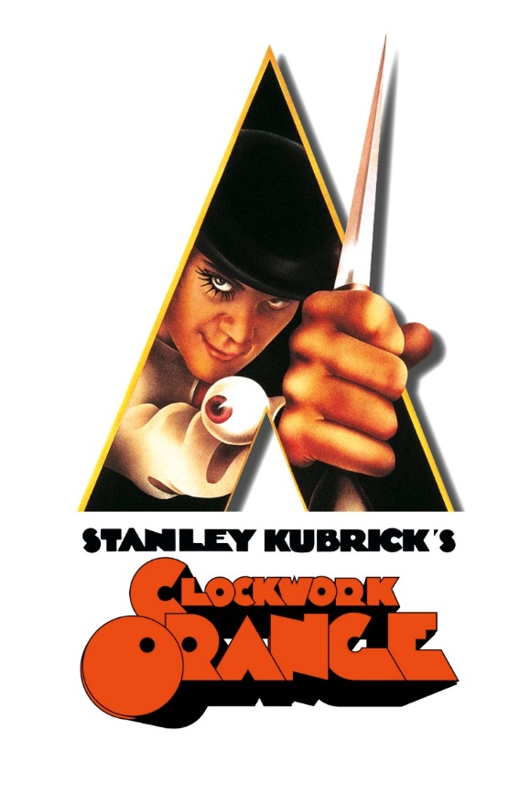
Self-censorship
    Stanley Kubrick’s A Clockwork Orange (1971) based on Anthony Burgess’ novel (1962)
    provoked acts of violence and was withdrawn from the UK by the director himself for many years.
“The crimes could be scenes from A Clockwork Orange: a boy beats a homeless man to death for a few pennies; a 16-year old dressed like Alex and his droogs savagely beats and kicks a 15-year old; a 17-year old Dutch girl is gang raped by a group of Lancashire boys as they sing Singin’ In The Rain”.
But these weren’t scenes from Stanley Kubrick’s masterpiece – they were events that occurred in the real world a year after its release. The film, a smash hit, immediately got the attention of moralizers and puritans, who were shocked and appalled at the way Kubrick mixed sex and violence, and the seductive way that he portrayed Alex’s life of delinquency. When these crimes started happening – crimes that one judge explicitly said were part of a "horrible trend which has been inspired by this wretched film'' – the outcry against A Clockwork Orange grew louder.
Kubrick had stood steadfast by his film, but something about these crimes troubled him. He met with Warner Bros and they came to a decision: the movie would be pulled from release in the United Kingdom”. (Devin Faraci: http://birthmoviesdeath.com/2013/08/01/the-disappearance-of-a-clockwork-orange)

Slide 6
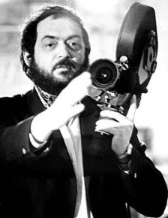
Stanley Kubrick
“No one is corrupted watching A Clockwork Orange any more than they are by watching Richard III... The film has been accepted as a work of art, and no work of art has ever done social harm, though a great deal of social harm has been done by those who have sought to protect society against works of art which they regarded as dangerous.
There has always been violence in art. There is violence in the Bible, violence in Homer, violence in Shakespeare, and many psychiatrists believe that it serves as a catharsis rather than a model. […] I know there are well-intentioned people who sincerely believe that films and TV contribute to violence, but almost all of the official studies of this question have concluded that there is no evidence to support this view. […] But the people who commit violent crime are not ordinary people who are transformed into vicious thugs by the wrong diet of films or TV. Rather, it is a fact that violent crime is invariably committed by people with a long record of anti-social behavior. […] Immensely complicated social, economic and psychological forces are involved in the individual's criminal behaviour. The simplistic notion that films and TV can transform an otherwise innocent and good person into a criminal has strong overtones of the Salem witch trials. […]”.

Slide 7
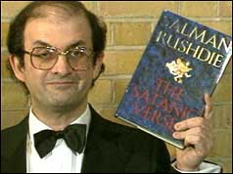
The Rushdie Affair (1988)
    Salman Rushdie, The Satanic Verses (1988)
    Publication of this novel resulted in a fatwah (death sentence) being issued against its author for blasphemy against Islam.

Slide 8
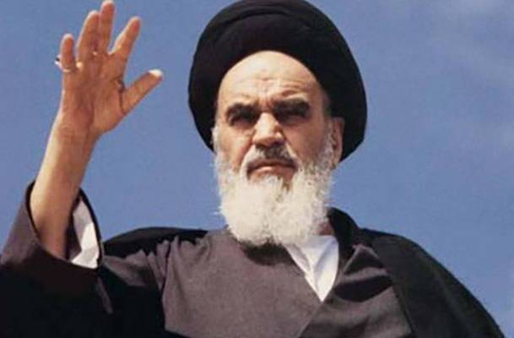
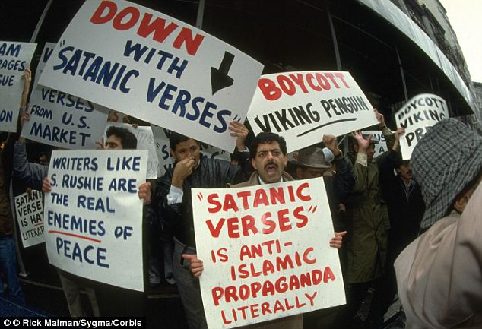
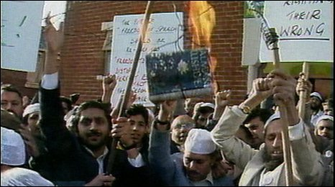
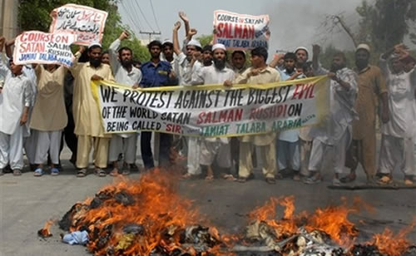

Slide 9
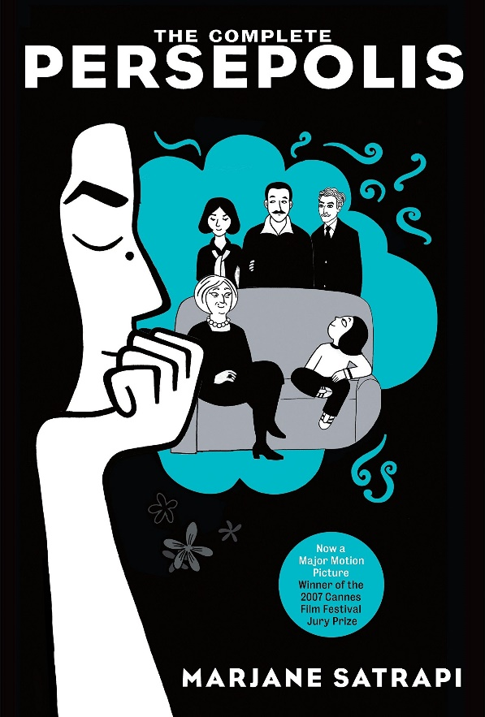
From Marjane Satrapi’s Persepolis (2003)

Slide 10
Who do you agree with?
Markus or Marjane?

Slide 11
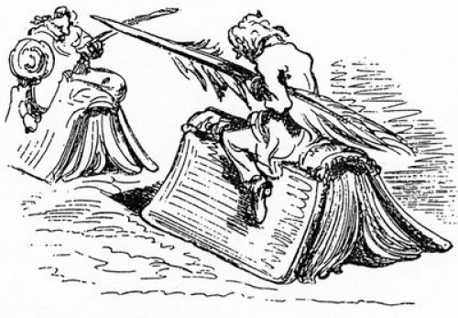

Slide 12
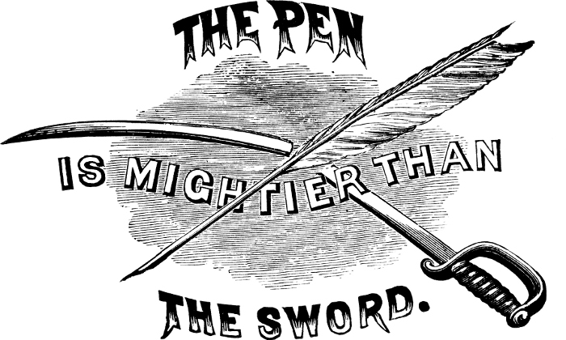

Slide 13
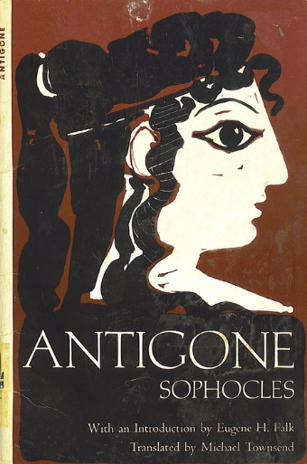
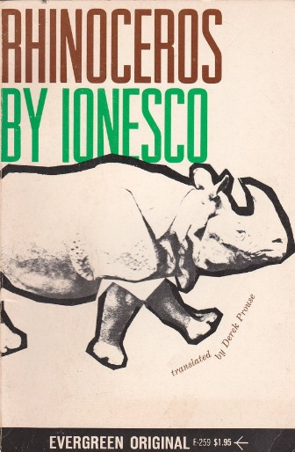
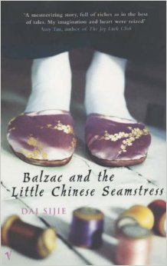


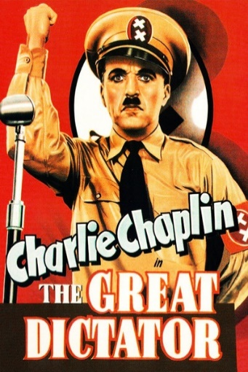
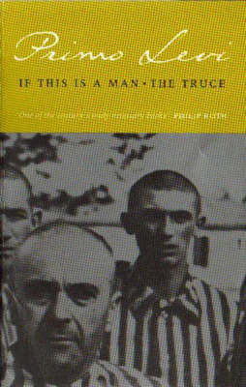
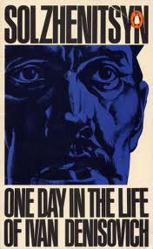
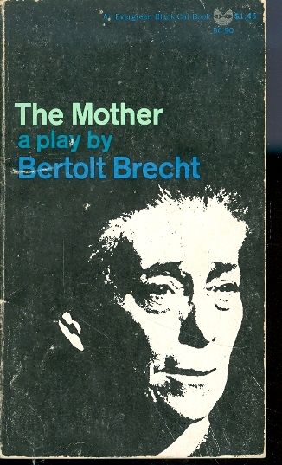
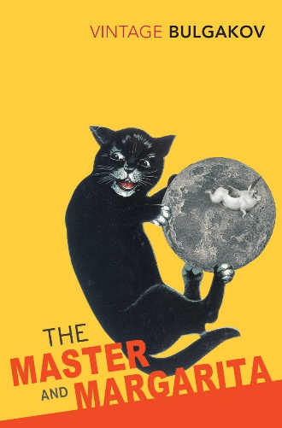
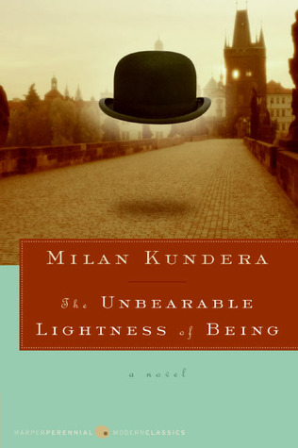
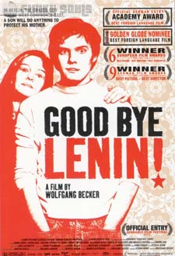

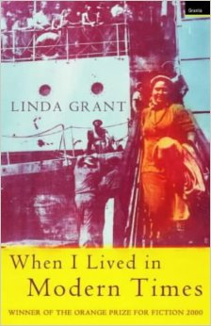

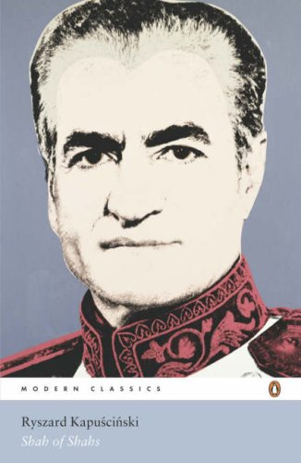
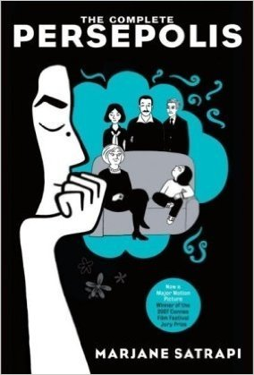
fiction and power 2019-20

