Slide 1
CP311: The Tale
Telling and re-telling Tales
Dr Joanne Pettitt
Notes:
NOTE:
To change the image on this slide, select the picture and delete it. Then click the Pictures icon in the placeholder to insert your own image.

Slide 2
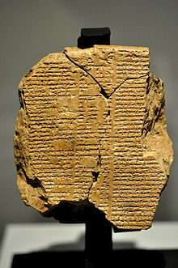
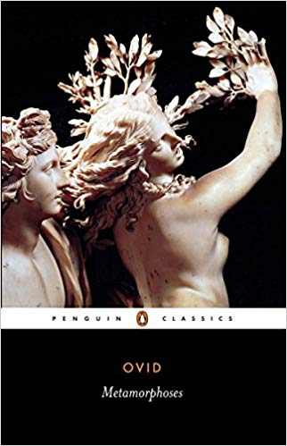
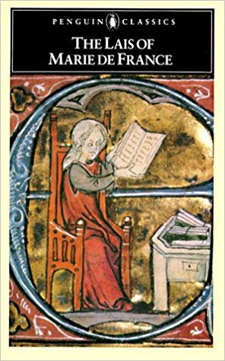
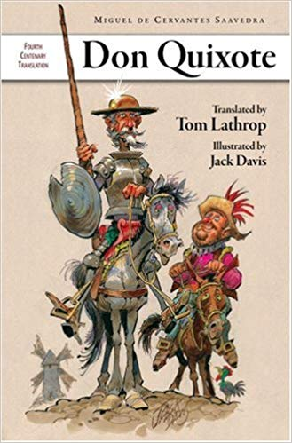
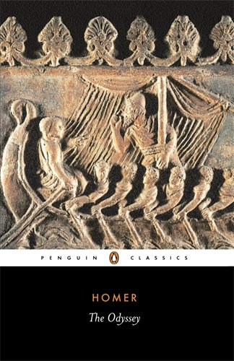
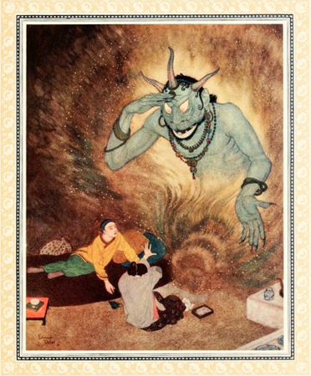
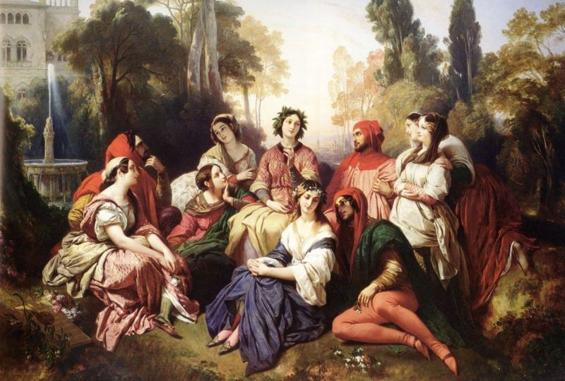
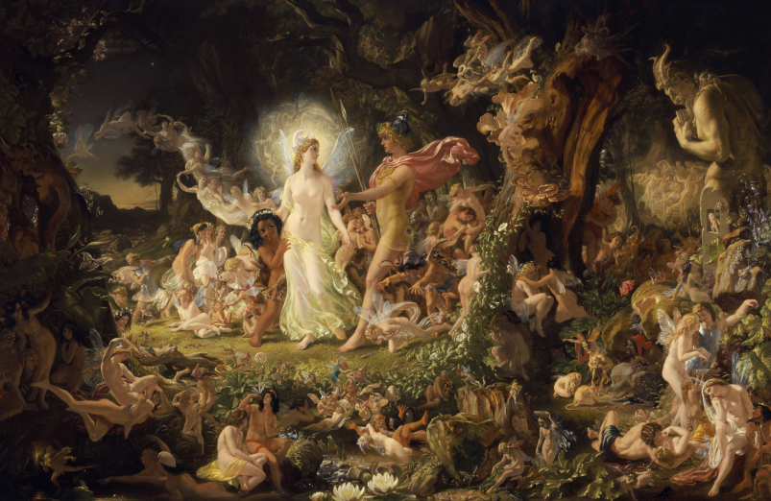
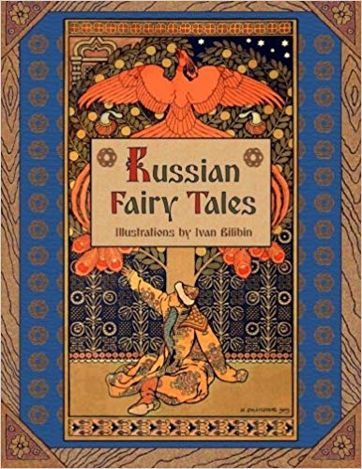
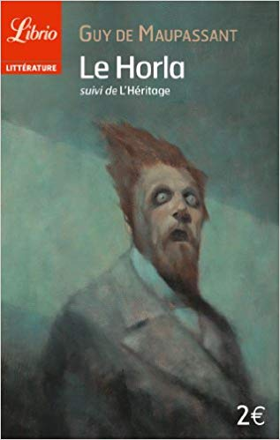
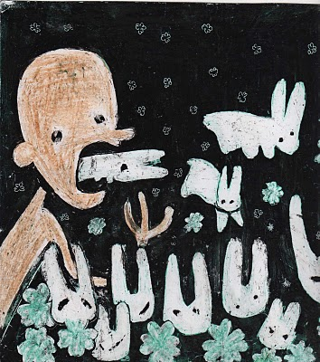
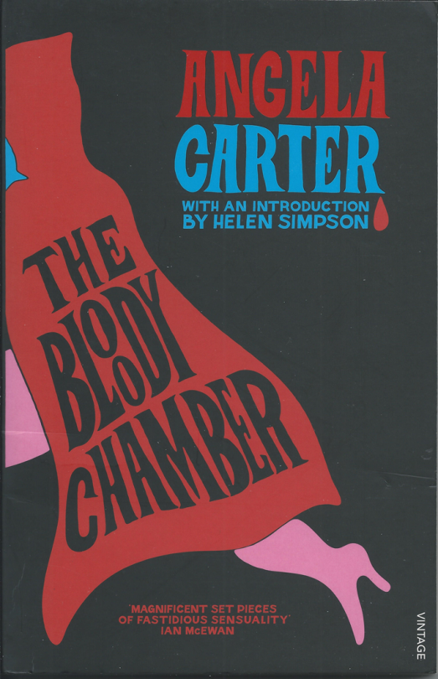
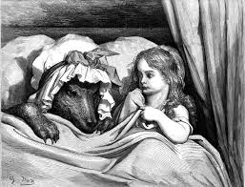
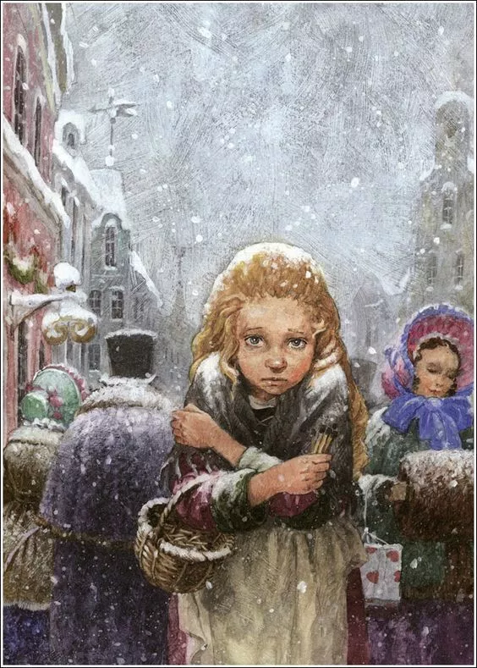
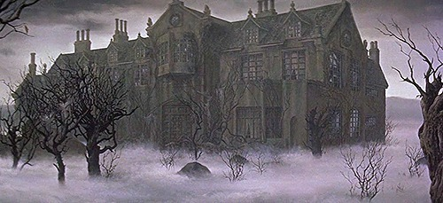
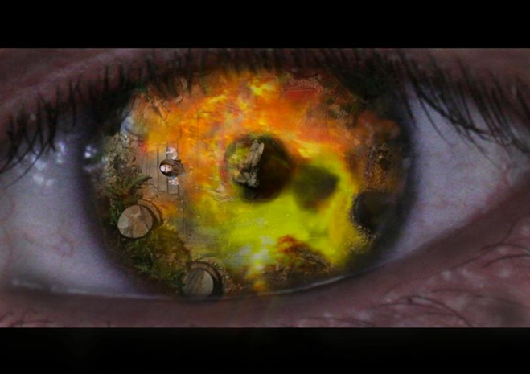
Module Structure
The Epic of Gilgamesh
Metamorphoses
The Lais of Marie de France
Don Quixote
The Odyssey
The Arabian Nights
Chaucer and Boccaccio
A Midsummer Night’s Dream
Fairy Tales:
Perrault & The Grimms
Poe
Borges
Russian Fairy Tales
Cortázar
Carter
Andersen and Wilde
Maupassant and Todorov
Notes:
Vastness of reading list. Extracts. Connecting theme of story telling.

Slide 3
Storytelling through the Ages
Storytelling as a means of immortality
E.g., Gilgamesh, Odysseus, Ovid
Storytelling as a life-affirming or life-saving source
E.g., The Arabian Nights
Social or political function of stories
E.g., Marie de France, fairy tales, Cortázar
Evolution of the story over time and across cultures
E.g., fairy tales
Literature and perception
E.g., Don Quixote, Borges
Notes:
Idea of immortality – relevant to the idea of the meaning of life. Most obvious in the classics. Don Quixote – literature changes the way he sees the world (idea of perception and role of literature in shaping ideas)

Slide 4
Technical considerations
Importance of narrative technique
E.g., Frame narrative, mise en abyme, stories within stories
Theoretical models
E.g., Psychoanalysis, socio-historical approaches, reader response (especially in Todorov’s Fantastic)
Genre or modes of writing
E.g., Breton Lais, fabliaux, the Gothic, the short story

Slide 5
Intertextuality: some theory
Julia Kristeva, developing previous ideas of Mikhail Bakhtin, coined the term in ‘Words, Dialogue and Novel’ (1966).
‘[The literary word] is an intersection of textual surfaces rather than a point (fixed meaning), as a dialogue among several writings’ (65).
‘The concept of intertextuality requires, therefore, that we understand texts not as self-contained systems but as differential and historical, as traces and tracings of otherness, since they are shaped by the repetition and transformation of other textual structures’ (Alfaro, 1996: 268).
Texts are not isolated but are constantly interacting with other texts. Texts ‘talk back’ to pre-existent and/or future texts.
Conventions and presuppositions play a role in creating intertextual spaces; e.g., Consider the role of the “Once upon a time…” structure. (Culler, 1976)
Think also about parody, allusion and translation

Slide 6
Comparative Literature
“For K. Anthony Appiah, comparative literature is […] a dialectic of subject matters [and] human concerns […] whose historical interconnectedness sets the study of texts deemed central to Europe's high culture alongside a broader set of multilingual cultural histories.” (Ungar, 1997)
Notes:
In some ways, comparative literature extends the idea of intertextuality (as well as the latter being a central part of its composition): it is about the interconnectedness of literature but, also, of history, culture and language.

