Slide 1
Whither the “Cusp” University?
What challenges will research-intensive universities outside the Russell Group face across the next five years?
Professor Stephen Shute

Slide 2
The Challenges (and Opportunities) for the “Cusp” University

Slide 3
Competition, Brand, Scale, Costs (i)
“Cusp” universities are heavily reliant on student fees.
But student recruitment is volatile.
And student expectations for the delivery of their education are changing.
And we have to cope with the legacies of the pandemic.
And the challenge of maintaining market share.
Universities in the “squeezed middle” are vulnerable to changes in intake tariffs at the top of the hierarchy.
And perceptions of brand quality are changing too, and not necessarily to the advantage of the “cusp” universities.
It’s are continuous challenge to be able to delineate our distinctiveness.
And the effects of the cost of living crisis cut deeper in smaller institutions with less financial resilience.

Slide 4
Competition, Brand, Scale, Costs (ii)
Larger cross subsidies into research (and science teaching) than in Russell Group institutions.
Cost of delivering degree apprenticeships.
Lack of any real (TRAC) margin from teaching home undergraduates.
Small cohorts at home PGT level.
Lack of critical mass which can easily support a world-recognised brand.
Will small/medium sized research universities be able to leverage advantage from the Lifelong Learning Entitlement?
In sum, small or medium-sized research intensive universities are operating in a challenging environment and some are facing significant difficulty

Slide 5
Financial Challenges

Slide 6
Income and Cost
UG home tuition fees grew to £9,000 in 2012 but this was offset by a massive fall in teaching grants.
Regulated UG fees now frozen at a maximum of £9,250 up to and including the 2024-2025 academic year.
Fee income had been falling in real terms by more than 3% per annum; but this reduction is greater now inflation is at much higher levels and has reached a 30-year high.
Little likelihood of a significant increase in regulated fees any time soon.
Pay costs could rise by up to 20% by 2025/2026:
  Salaries paid on incremental scales and under national pay bargaining for all academic staff under professorial level
  Pension scheme costs and benefits.
Government Response to Augar: likely change to funding for Foundation Years (£5,197 fee cap)?
Minimum Entry Requirements? Robert Halfon said to be against.
Student Number Control for England “still under discussion” (THE 10 February 2023).
Compare the big beast: the University of Manchester’s total income in 2021-2022 increased by £116.8m (10.6%) to £1.217 billion. Only 53% of its total income is tuition fees. 22% of its income (£270.6m) is research grants and contracts. Its “underlying staff costs” (excluding USS pension adjustment) are £597.3 million. Its adjusted operating surplus for the 12 months to 31 July 2022 was £119.7m (9.8% of income), up from £61.4m (£5.6% of income) in 2020/21. But it nonetheless has a “programme of activities aimed at improving the financial strength of the University”.

Slide 7
Capital Investment
From 1997, universities received capital grants for teaching and research from the government. These made a large contribution to estates funding
Since 2008, successive changes have removed meaningful government contributions to teaching and research capital. Universities have therefore had to find other ways to finance new buildings and estates projects
The sector is now reliant on:
  Generating surpluses
  Cash balances from previous surpluses
  Philanthropy and matched funding: in practice only top 10 HEIs
  Loans
  Working with third parties

Slide 8
Current Financial Health (1)
Regulating the financial sustainability of higher education providers in England,
National Audit Office, 9 March 2022
Proportion of registered HEIs with an in-year deficit (even after adjusting for the impact of pension deficits) has increased from 5% in 2015/2016 to 32% in 2019/2020
The number with an in-year deficit of 5% or more of income has grown each year too: from 1/133 (1%) in 2015/2016 to 37/244 (15%) in 2019/2020

Slide 9
Curent Financial Health (2)
The population of registered HE providers has increased following the registration of many smaller providers, but the recent trend of rising in-year deficits also applies to providers for which there are continuous data over the whole period from 2015/2016.
20 of the 80 providers with in-year deficits in 2019/2020 have been in deficit for at least three years.

Slide 10
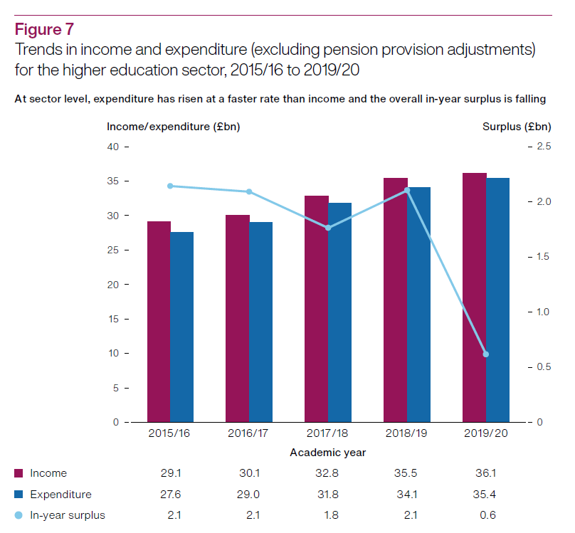

Slide 11
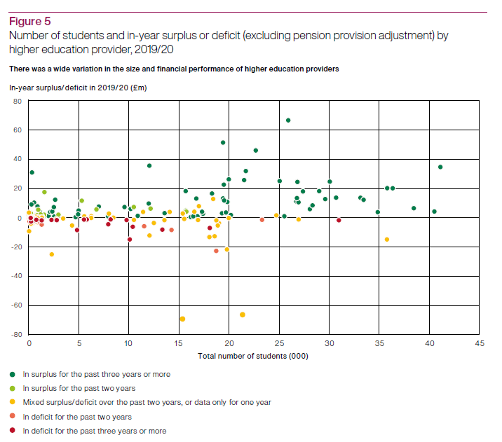
19/20: 80 in deficit,
20 +3-yrs

Slide 12
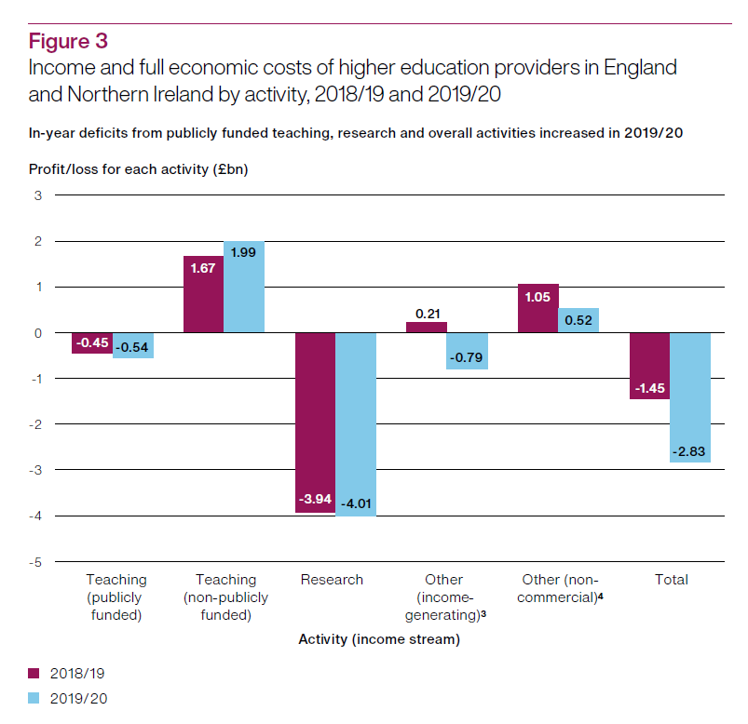

Slide 13
Market for Students; opportunities and threats

Slide 14
Open Market for Student Recruitment
Following incremental interventions, a total removal of student number caps came into effect in 2015
By 2030 changes in demography alone will lead to 50K more English domiciled UG Students entering UK Universities
If participation levels increase at the average of the previous 15 years, a further 350K UG Students will enter UK Universities
So potentially more students but also greater competition

Slide 18
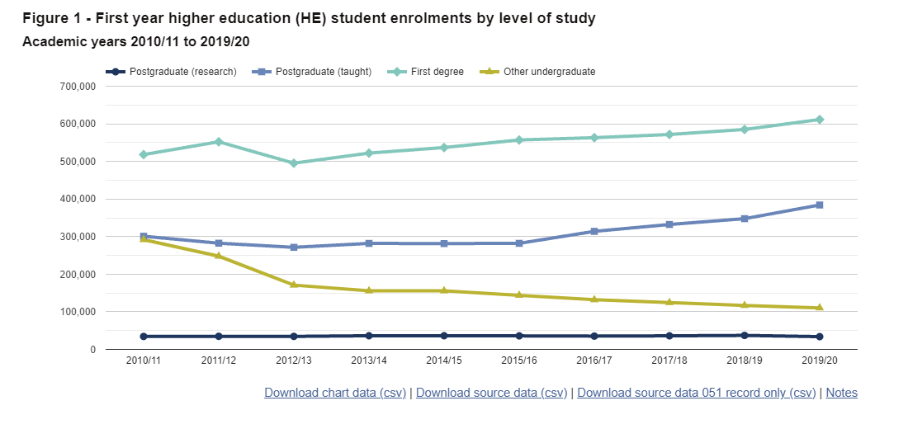

Slide 19
Responding to the Competition

Slide 20
Enhancing Student Recruitment
Putting students first
Chasing International Students for our campuses
  HEPI and UUK (2021): 273,000 first-year international students entered UK HE in 2018/19, a 54% increase since 2006/07
  Net economic effect of £25.9m
New Foundation Years (but a possible fee cap)
Improve both digital marketing and physical presences in international recruitment
Online Distance Learning

Slide 21

Transnational education
c.700,000 students are studying for a UK degree overseas.

Slide 22
International students make up...
20% of the total student population. | 14% of all undergraduates. | 36% of all postgraduates.

Slide 23
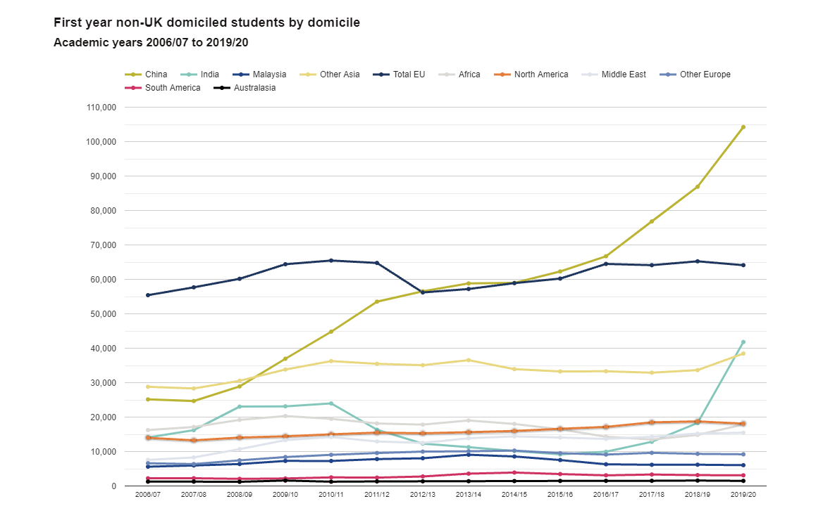

Slide 24
28% of c.500k International Students
Social Studies
9% of c.500k International Students
11% of c.500k International Students
Business and Administrative Studies
Engineering and Technology
48% of International Students

Slide 25
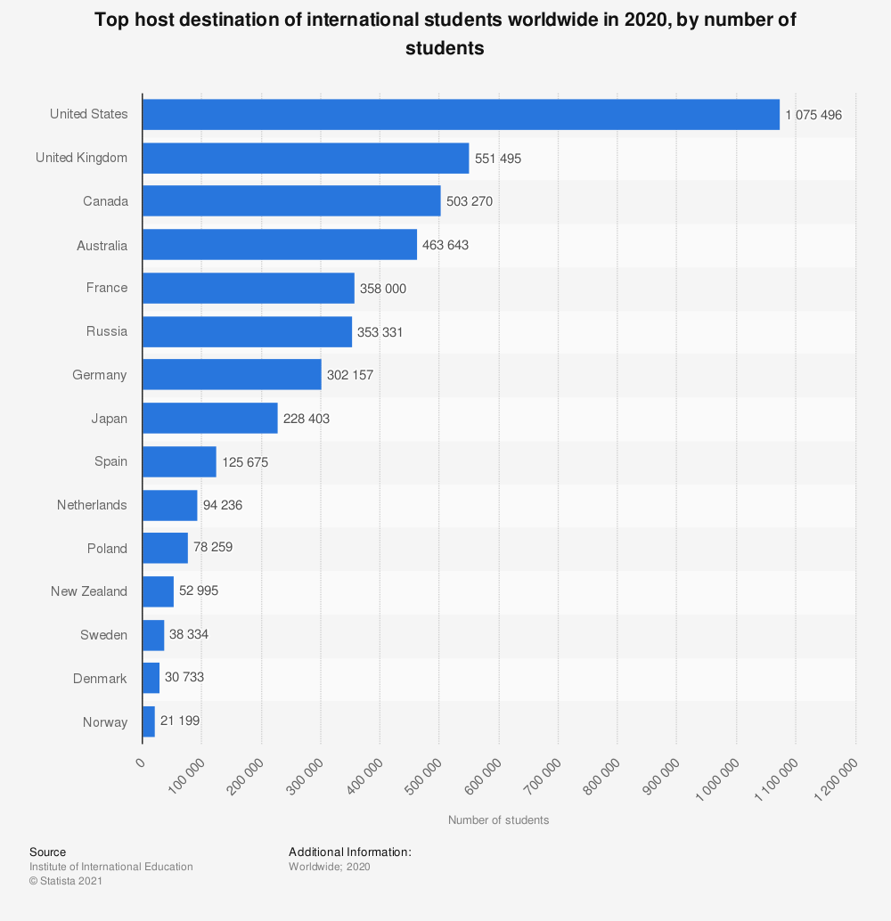

Slide 26
Other Responses
Size and Shape Discussions
Portfolio Review and Curriculum Reforms
Reform of Pedagogy

Slide 27
University of the Future
Long Term: A Radical Reinvention?
Future of the Residential Model
Remote Working/Remote Study
Use of the Estate
Delivering More with Less

Slide 28
Questions
Thank you for listening.
Any questions?

