Slide 1
Presentation title slide
Creating a strategy to translate
research to societal impact
Alistair Quaile
Research Impact Manager (Medicine and Health), University of Leeds

Slide 2
How to display schools and/or Faculties in your slides
FACULTY OF MEDICINE AND HEALTH
Medicine and Health research at Leeds
4 Schools (Medicine, Healthcare, Dentistry, Psychology)
948 researchers
786 professional, administrative and technical staff
Current research portfolio of 978 live grants with a total value of £371.6 million

Slide 3
How to display schools and/or Faculties in your slides
FACULTY OF MEDICINE AND HEALTH
The Balanced Scorecard
Most organizations are good at developing strategies, but not so successful at implementing them.
The Balanced Scorecard is a framework for translating the vision and strategy of an organization into action.
Strategy map
Describes the overall business logic and direction
Scorecard
Describes how success will be tracked and measured
Implementation plan
Describes how team, tasks, and time are organised

Slide 4
Text hierarchy and formatting information slide
FACULTY OF MEDICINE AND HEALTH
Why use this approach?
Communication: to implement a strategy successfully, everyone needs to understand what the organization is trying to achieve. Each individual also needs to know how they can contribute to achieving that strategy. The BSC sets out the strategy in a form that everyone can understand and see their role.
Measurement: The BSC helps you track progress against the objectives you set and the actions you think will help.
Alignment: for a strategy to be successful, all parts of the organization need to work together to achieve it. The BSC enables you to ‘cascade’ objectives down and across different clusters and function – so it will work at a whole organization, region and operational level.
Accountability: the organization strategy needs to achieve results for stakeholders – internal and external – especially beneficiaries and funders. The BSC helps to create a culture of accountability, learning and improvement – all essential to mission success.

Slide 5
Text hierarchy and formatting information slide
FACULTY OF MEDICINE AND HEALTH
Developing a strategy map
The BSC organizes your strategy into a number of perspectives.
Objectives show what activity must take place in each perspective to deliver an overall vision.
The sequence in which you organize the perspectives is important.
Organizing the perspectives properly ensures that the strategy focuses both on external ‘outcomes’ (e.g. societal impact, academic excellence) and internal ‘inputs’ (i.e. what needs to be done within the organization to achieve the outcomes, what skills are needed).

Slide 6
Text hierarchy and formatting information slide
FACULTY OF MEDICINE AND HEALTH
“Strategy implies the movement of an organization from its present position to a desirable but uncertain future position. Because the organization has never been to this future position, its intended pathway involves a series of linked hypotheses.”
Kaplan and Norton
The objectives in each perspective need to be connected to others in a cause-and-effect logic – creating a linked narrative.
Strategy maps encourage you to follow the logic of your ‘theory of change’.

Slide 7
Text hierarchy and formatting with an image slide
FACULTY OF MEDICINE AND HEALTH
The FMH Impact Strategy Map
Impact represents the translation pipeline from research to societal impact
Culture gives the blueprint for creating a healthy impact environment
Methods identifies the cross-cutting research methods in which we excel
Missions are the health challenges we aim to address that align with our research strengths and funder priorities

Slide 8
Text hierarchy and formatting information slide
FACULTY OF MEDICINE AND HEALTH
Turning the strategy map into a BSC
The BSC captures the way in which you track the impact of initiatives – activities – on delivering the objectives in the strategy map.
You place a number of initiatives or actions in the scorecard, designed to deliver the objectives. Normally there is an initiative for each objective in the map.
There are four main components in the scorecard which answer different questions:
Objectives | Indicators | Targets | Initiatives
What do we need to achieve? | How will we measure success? | How much do we plan to improve? | What do we need to do to get there?

Slide 9
Text hierarchy and formatting information slide
FACULTY OF MEDICINE AND HEALTH
Perspective | Objectives | Indicators | Targets | Initiatives
Culture | 1. Create opportunities for collaboration in research priority areas | 1.1 Workshops | Quarterly | Set up workshops that bring stakeholders together
 | 2. Coordinate strategic partnerships that help researchers co-produce impact with end users | 1.2 Funding | Set by annual research income plan | Identify potential funding sources
 | 3. Ensure impact support across Faculty | 1.3 Impact working groups | Impact working groups set up by 2022 year end | Set up impact working groups in each School/Institute

Slide 10
Text hierarchy and formatting information slide
FACULTY OF MEDICINE AND HEALTH
Realizing your vision through an implementation plan
The final part of the process is an implementation plan which sequences the initiatives.
This often takes the form of a GANTT chart combining:
Team: who will deliver the initiative
Task: the initiative itself
Time: how long the initiative will take to deliver
Objective | Indicator | Initiative/Task | Person responsible for activity | Requires additional support (e.g. Marketing/ Communications) | Status | Date completed | Result of activity (to be filled in immediately after activity completed) | Evidence of activity results (e.g. publications, meeting reports, presentations, news articles, emails, etc.) | Budget (GBP)

Slide 11
Text hierarchy and formatting information slide
FACULTY OF MEDICINE AND HEALTH
What’s next?

Slide 12
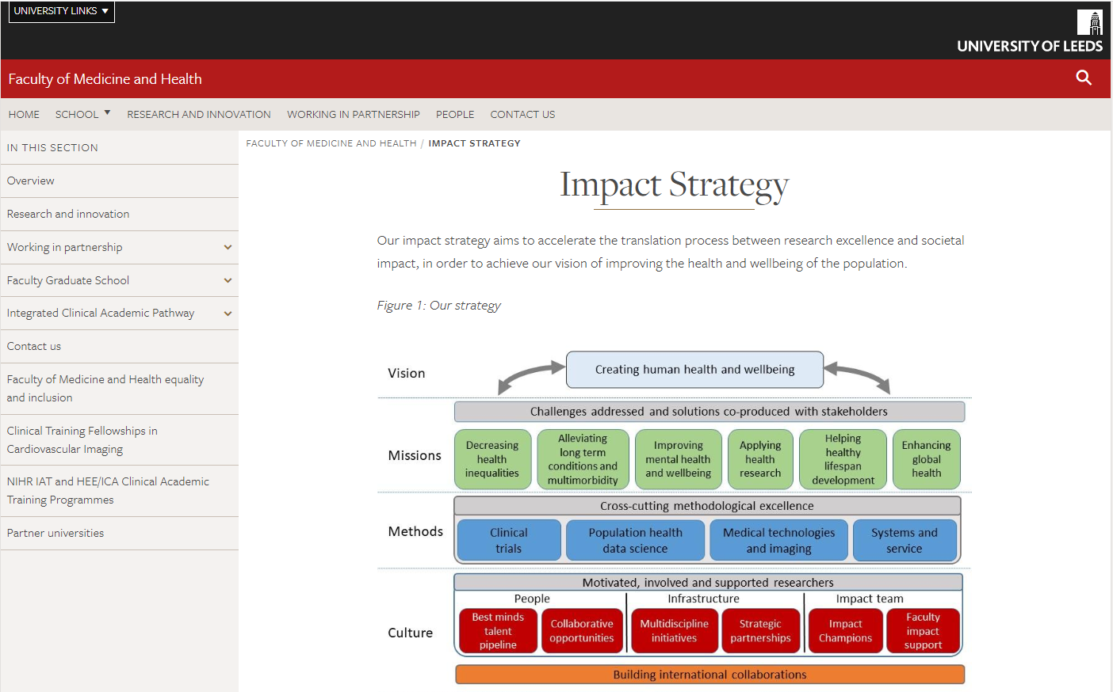
Text hierarchy and formatting information slide
FACULTY OF MEDICINE AND HEALTH
Thank you
Alistair Quaile
Research Impact Manager
Faculty of Medicine and Health

