Slide 1
DocExplore: Historical Manuscripts in the Digital Age
Cressida Williams
Canterbury Cathedral Archives
Knowledge Machines

Slide 2
DocExplore
‘A free, open-source, cross-platform software suite enabling anyone to create rich interactive digital books’
Collaborative project
InterReg funding
www.docexplore.eu

Slide 3
Project agendas
Research impetus from computer scientists
EDA: building on Canterbury-Rouen links
MEMS: book, manuscript and material culture
CCA: opening up collections
Rouen Libraries: illuminated manuscripts

Slide 4
Exploring documents
Interpretation
Sharing learning
Encourage engagement
Exploration
Animation

Slide 5
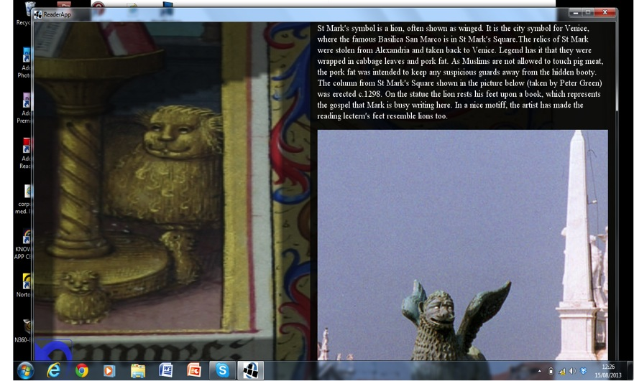

Slide 6
Project audience
Different communities of users
Academic community
Non-academic community
Internet community
Fellow professionals

Slide 7
Challenges
Project complexities
Multiple research interests
Materiality and the undigitisable
‘A virtual archive’?

Slide 8
Comparison: Findmypast
Market led
Focussed on specific audience
Index-based research
Subtracting detail
Convenience tool

Slide 9
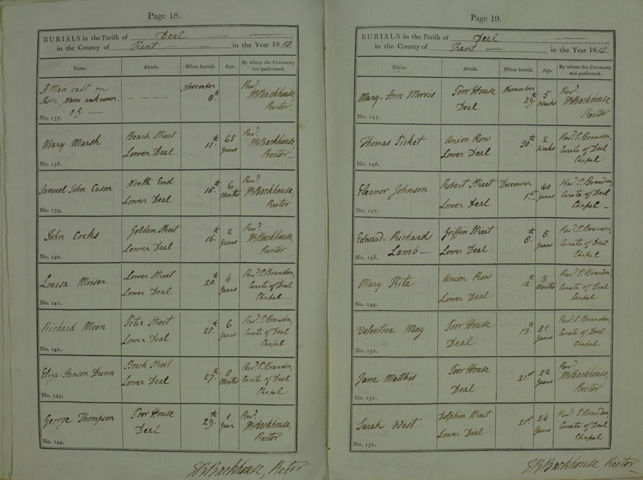

Slide 10
Conclusions

