Slide 1
How should the evidence hierarchy be developed?
Evidence and Causality in the Sciences
Jacob Stegenga
University of Toronto

Slide 2
There should be no evidence hierarchy.
Four arguments (in five minutes)

Slide 3
1 Hierarchies are poor methods of using diverse evidence.
Russo and Williamson (2007), Illari (2011), La Caze (2011)

Slide 4
2 Different types of hypotheses need different types of evidence.
This intervention will work for us. (Cartwright 2007)
This intervention is harmful. (Osimani, 3:00 p.m.)

Slide 5
3 Trouble at the top.
Randomization does not guarantee homogeneity. (Worrall 2002)
Meta-analysis is not all it’s made out to be. (Stegenga 2011)
Many RCTs are methodologically flawed. (Hartling 2011, Moher 2008)
Many RCTs produce results which are simply false. (Ioannidis 2005)

Slide 6
4 Hierarchies are crude quality assessment tools.
Hierarchies are constrained to ordinal rankings based on few parameters.
Better to evaluate evidence with richer scales based on more parameters.

Slide 7
Quality assessment tools (QATs)
A scale or checklist for properties of medical studies
Dozens now in use to assess medical evidence
As weighting factor in meta-analysis
As inclusion criterion for systematic reviews
To test relation between quality and other properties of studies

Slide 8
Jadad QAT
1. Was the study described as randomized? (1 point)
method of randomization (1 point)
2. Was the study described as double blind? (1 point)
method of blinding (1 point)
3. Was there a description of withdrawals and dropouts? (1 point)
5 points total

Slide 9
Chalmers QAT
30 items in four forms
Descriptive summary
Study protocol (weight: 0.6)
Statistical analysis (weight: 0.3)
Presentation of results (weight: 0.1)

Slide 10
Cho & Bero QAT

Slide 11
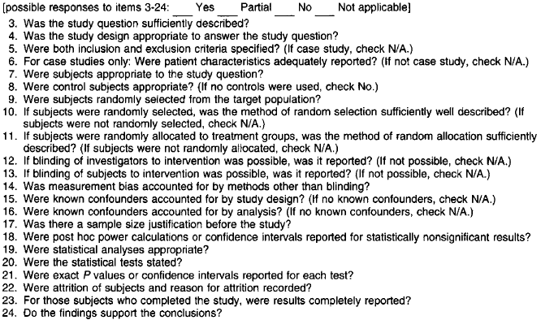

Slide 12
Six QATs
Scale | Number of Items | Weight of Randomization | Weight of Blinding | Weight of Withdrawal
Jadad (1996) | 3 | 40.0 | 40.0 | 20.0
Chalmers (1981) | 30 | 13.0 | 26.0 | 7.0
Cho & Bero (1994) | 24 | 14.3 | 8.2 | 8.2
Reisch (1989) | 34 | 5.9 | 5.9 | 2.9
Spitzer (1990) | 32 | 3.1 | 3.1 | 9.4
Linde (1997) | 7 | 28.6 | 28.6 | 28.6

Slide 13
QATs: buyer beware.
QATs have low inter-rater reliability and low inter-tool reliability.
QATs “lack a focused theoretical basis” (Jüni et al. 1999)

Slide 14
ἱεραρχία
rule by priests?
partially ordered set?

Slide 15
We can do better.
Structural metaphors
evidence pyramid (Cartwright)
evidence network (Bluhm)
evidence matrix (Borgerson)
Principles
principal of total evidence – in medicine (Leuridan)
Russo-Williamson thesis
Tools
QATs
…

Slide 16
Thank you for your attention.
Jacob Stegenga
University of Toronto

