Slide 1
Evidence for Complex Causes
Evidence and Causality in the Sciences
University of Kent
5-7 September 2012
Sandra D Mitchell
Department of History and Philosophy of Science
University of Pittsburgh
Notes:
Title: Evidence of Complex Causes
Abstract: Complex causal structures pose special problems for standard methods of eliciting causal knowledge from experiment and observation. In this talk I will outline several such problems stemming from robustness and the role of "context" in the the dynamic stabilization characteristic of causation in complex biological systems.

Slide 2
Complex causality
Multiple contributing causes (at multiple levels)
Interactions among causes
Self-organization (feedback and feed forward)
Inhibition and excitation
Robustness
Context sensitivity (contributions of non-modeled causes)

Slide 3
Complex causality
Multiple contributing causes (at multiple levels)
Interactions among causes
Self-organization (feedback and feed forward)
Inhibition and excitation
Robustness
Context sensitivity (contributions of non-modeled causes)
'robustness is a property that allows a system to maintain its functions against internal and external perturbations.’
Kitano 2004

Slide 4
Robust AND Fragile
Robust output/functional stability in response to to large variations in environment and component parts
at the same time…
Fragile, often catastrophically so, to cascading failures events
Notes:
The HOT model argues that systems that have evolved to have a higher level of complexity are optimized for specific perturbations but, at the same time, are also inevitably extremely fragile against unexpected perturbations (Carlson and Doyle, 1999, 2002).

Slide 5
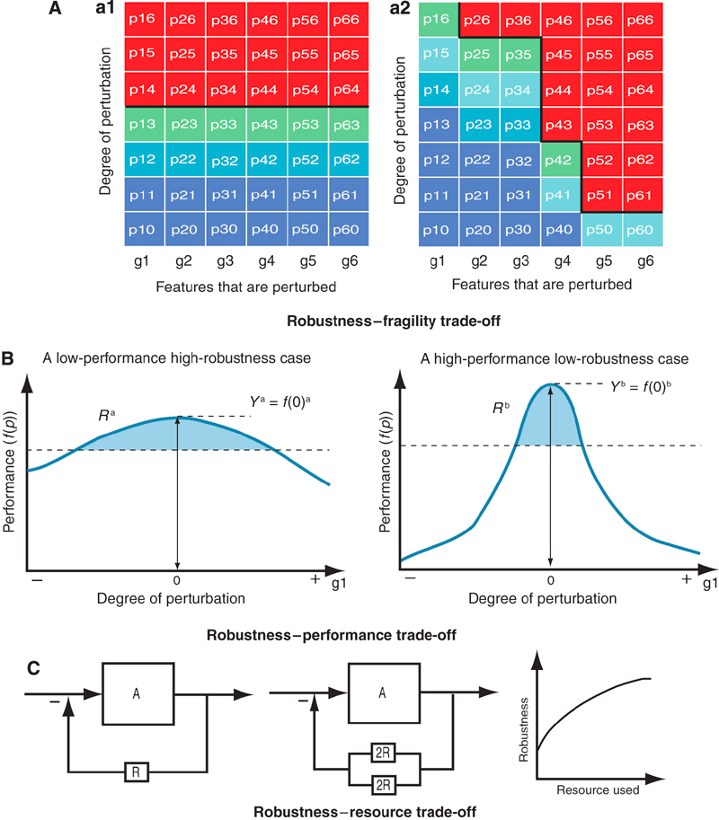
Robustness Trade-offs
Notes:
Robustness trade-offs. (A) If robustness is strictly conserved, then any increase in robustness for specific perturbation shall be compensated by increase in fragility elsewhere. Left panel is a profile of robustness of a hypothetical system that responds equally to perturbations of each feature (from g1 to g6). Now, if the system is tuned to cope better with perturbations of a subset of features (g1, g2, and g3), then robustness against other subset of perturbations are significantly reduced (right panel). Total robustness of both systems over this perturbation space remains equal. (B) If the robustness-performance trade-off holds, a system that is tuned to attain high performance might be less robust than a system with moderate performance but a higher level of robustness. Let's assume Yª=fª(0) for system A where f(0) is the performance of the function of the system under perturbation '0' (no perturbation) and Rª is the robustness of the system over some defined perturbations. Although the figure simply refers to the colored areas for ease of understanding, the exact Rª needs to be calibrated based on Equation (1). The horizontal dashed lines indicate the threshold under which the system fails to perform the function considered. A robustness-performance trade-off would then imply that YªRª=Y^{b}R^{b}. (C) Identical circuits with slightly difference resource use are shown. Both use NFB loop, but one uses only one resistor in the loop, whereas the other one uses two resistors in parallel. Parallel use of components significantly improves robustness of the system against component failure, but requires more resources. Here, the probability of degradation of system function can be computed using basic equations from reliability engineering so that the difference of robustness can be derived for simple example like this one

Slide 6
Robustness is achieved by building barriers to cascading failures
This often requires complicated internal structure, layers of feedback, signaling, regulation…
Greater genetic complexity = more parts, more structure, more interactions
Molecular biology has focused on biological simplicity, what are the entities (genes) and how do they individually contribute to causing a phenotype.
Systems biology focuses on biological complexity, what are the networks, what are alternative pathways with alternative entities generating the same outcome.
Notes:
Robust systems can have sloppier parts.

Slide 7
Loss of Protein
Function
Network
failure
Cell
Death
Unfolded Proteins
Aggregates
Temp
cell
Folded Proteins
Temp
environ

Slide 8
Loss of Protein
Function
Network
failure
Cell
Death
The cell builds “barriers” to stop this cascading failure event.
Unfolded Proteins
Aggregates
Temp
cell
Folded Proteins
Temp
environ

Slide 9
Refold denatured
proteins
Heat shock response involves complex feedback and feedforward control.
Unfolded Proteins
Temp
cell
Folded Proteins
Temp
environ

Slide 10
Complexity and Robustness
Notes:
How complex systems are less fragile to high-order perturbations. Biological processes are often modeled as networks of interacting components that
generate output responses based on input conditions. For a trivially simple system with a single pathway and no feedback, removing a single node will eliminate all
output, so applying additional deletions will yield no synergistic responses. Networks that have more redundancy provide opportunities for synergy because cutting off
alternative pathways or feedbacks can lead to lower output levels. If we monitor the output response as well-chosen nodes are successively removed from the network,
the output should be only weakly affected until it reaches a ‘combination order of fragility’ (COF), where all available alternative pathways have been blocked.

Slide 11
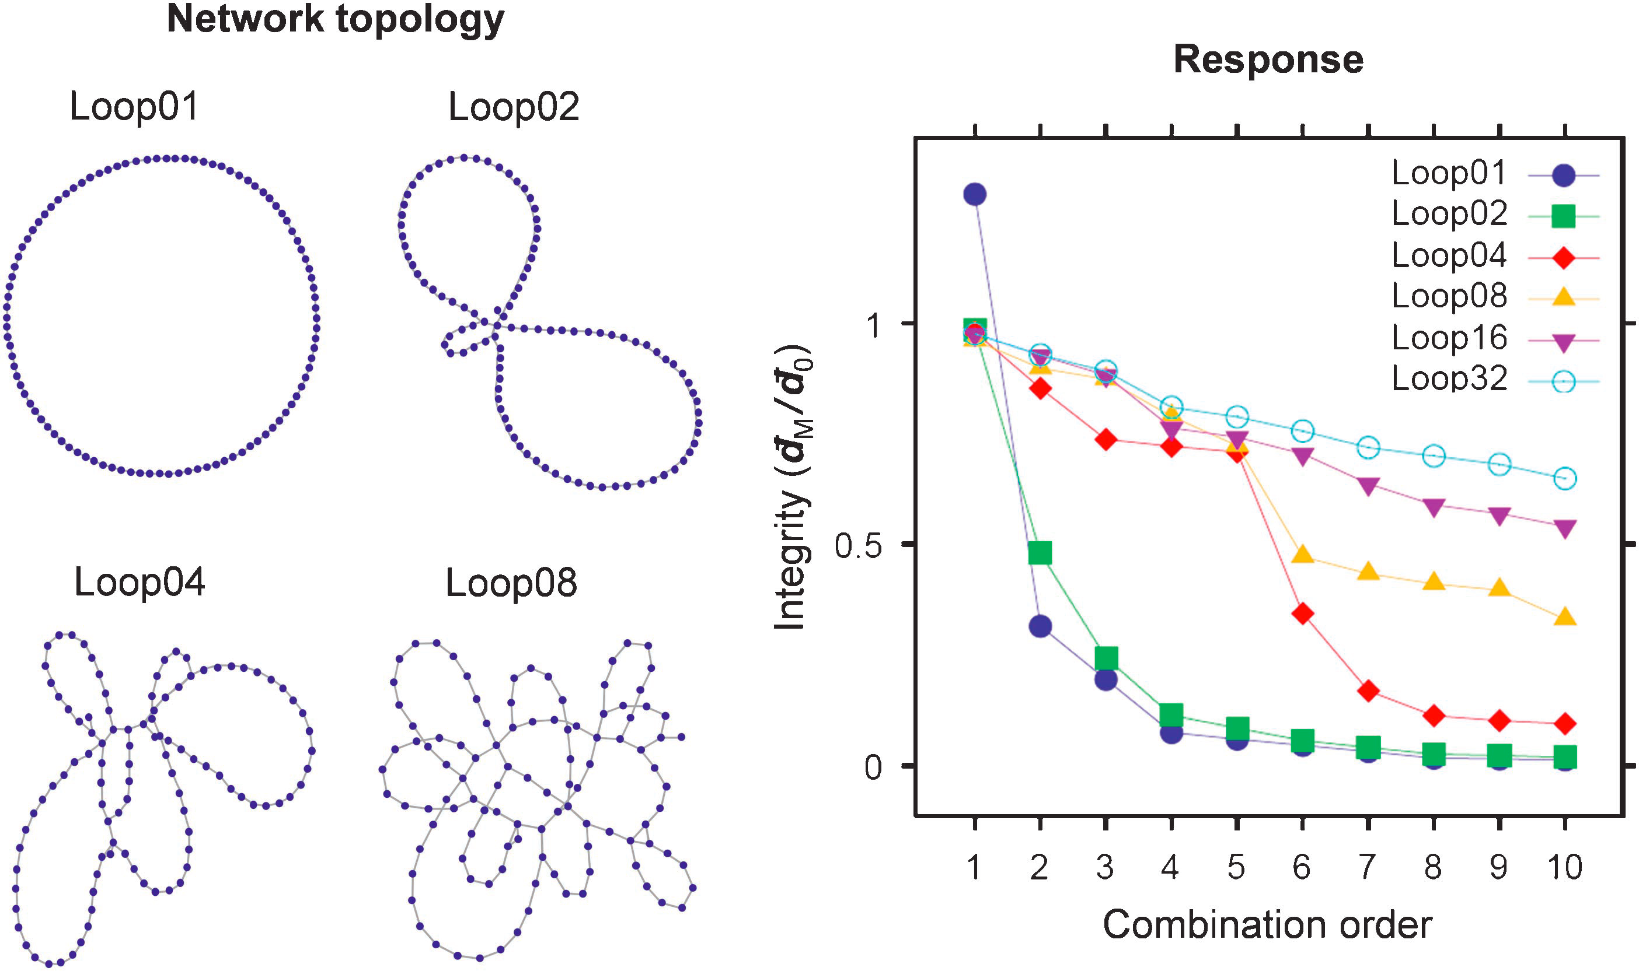
Notes:
sampling to make the most of dose responses (Greco et al, 1995). A factorial design, where all permutations of serially diluted single-agent doses are tested, makes very few assumptions about the response surface shape, but is prohibitively expensive for high-order combinations. A more
efficient format is to test fixed dose ratio responses, by mixing the component drugs at a high concentration (e.g. twice
their 50% effective concentrations, or the highest achievable concentration for singly inactive compounds) and serially
diluting that mixture. If response curves are collected for all submixtures of any high-order combination as part of a
systematic experiment, there will be sufficient information to fully describe most high-order synergies and antagonisms.
Most synergy measures compare a combination’s response to those of the constituent single agents (Greco et al, 1995). For
genetic interactions, synergy is measured by comparing the combined effect to a model that represents the expectation for
non-interaction (Anastassiou, 2007; Mani et al, 2008). For chemical combinations, synergy can be measured either as a
high concentration effect boost using one of the genetic interaction models, or as a potency shift at a chosen effect level
(Chou and Talalay, 1984; Leha´r et al, 2007). These definitions generalize readily to high-order combinations and can be used
to quantify the ‘absolute synergy’ of a combination compared to its single agents (see Figure 2). Although there is
considerable debate concerning which null-interaction modelis most generally applicable to biological contexts (Chou and
Talalay, 1984; Greco et al, 1995; Leha´r et al, 2007; Mani et al2008), all of them permit the calculation of an absolute synergy
score as described here. At high order, it is also useful to consider the ‘differential synergy’ (Figure 2) that measures the
extra benefit gained by increasing the combination order.Differential synergy can be calculated from the differences
between an mth order combination’s synergy score and t hose on its (m1)th order submixtures, and should peak at the
combination order where the system becomes fragile and the absolute synergy increases most rapidly.
Finally, efficient sampling methods are needed to explorethe vast space of possible high-order combinations. Comprehensively
testing all pairs of 10 perturbers and their singleagents would require only 55 tests, but that number grows to
845 up to sixth order, and for 20 perturbations there are over60 000 permutations up to sixth order. High-throughput
experimental testing should enable screens on that scale(Zimmermann et al, 2007), but it will be some time before
comprehensive coverage at higher order or for more than 20 agents is feasible. It is still possible, however, to sample such
high-order spaces using informed searching methods. For example, one strategy is to employ an iterative maximal
damage search (Agoston et al, 2005) where each perturber is first tested alone and the most effective agent is combined and
tested with all the other agents. Higher orders are tested by Box 1 To illustrate how the combination order of fragility (COF) depends on system complexity, we used a simple simulation of graphs with looped topology. A family of networks with the same number of nodes but increasing numbers of loops can be created using a modified attachment algorithm (Baraba´ si and Albert
1999), starting with a single closed loop and randomly connecting both ends of fixed-length linear ‘pathways’ to the existing network. Such networks can be tested for vulnerability to dismemberment by deleting a set of nodes M and measuring the average distance dM . Pfi;jg di;j=N between nodes in network fragments, where N is the number of distinct node pairs {i,j}, and di,j is the number of steps along the shortest path between nodes i and j, excluding node pairs acros s fragments. The integrity of perturbed network can be assessed by calculating the ratio betweend¯ M and the correspondingd¯ 0 for the unperturbed network. Using
this procedure to generate 100-node networks with 1 through 32 loops (left), and applying a maximal damage algorithm that selects the most disruptive node at
each order for the next set of combined deletions (Agoston et al, 2005), the robustness to high-order perturbations shows a clear trend with system complexity.
Simple networks are rapidly disrupted by second- or third-order combinations, whereas networks with many loops are steadily eroded at slower rates. Networks
with intermediate levels of complexity are able to maintain integrity under low-order attacks, but are rapidly dismembered once the combination order exceeds a
critical level related to the network’s level of redundancy. Note that these networks are robust not only to the removal of random peripheral nodes but also to the
removal of the highly connected central nodes until the COF has been exceeded. More realistic simulations would require a biologically relevant modeling
approach (e.g. flux balance analysis; Segre` et al, 2005), but are likely to find similar trends.
Box 1 How fragility to combined perturbations depends on system complexity
Synergy and robustness
J Leha´r et al
& 2008 EMBO and Nature Publishing Group Molecular Systems Biology 2008 3

Slide 12
Robustness and Woodward causes
Invariance
Is a relation between purported cause variable and effect variable over some range of values of the cause variable (not necessarily universal)
Modularity or Separability
Is a relation of independent disruptability or contribution to overall effect of casual components of a system with multiple invariant causal functions.
Insensitivity
Stability of causal relation across variations in background, context, or conditions external to system.

Slide 13
Modularity
“..this is implicit in the way people think about causation…this sort of independence is essential to the notion of causation. Causation is connected to manipulability and that connection entails that separate mechanisms are in principle independently disruptable.” (Hausman and Woodward 1999)
What if they are not?

Slide 14
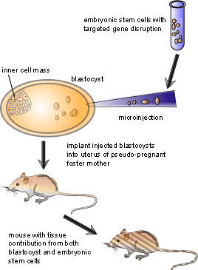
Genetic knock-out experiments
Notes:
Principle assumption: normal function of a gene can be inferred directly from its mutant phenotype.
“If you give me a gene, I could knock it out and tell you what its function is”
Mario Capecchi (co-developer of knock out technique)

Slide 15
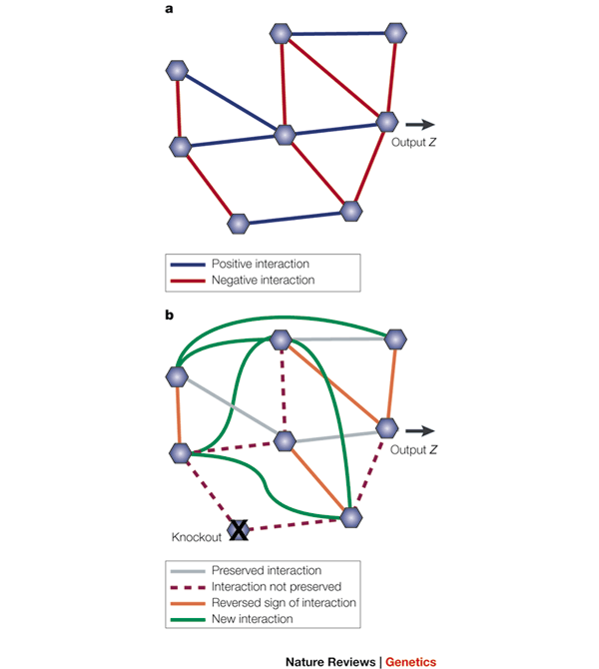

Slide 16
What does the evidence support? What is the cause of a phenotype Z?
Is the gene the wrong entity to identify as the cause of the phenotype?
Sometimes the very presence of a particular gene is what makes the difference!
Sometimes the presence of a particular gene makes no difference at all – rather it is the robust network of multiple pathways – the system – that is the cause.
If independent disruptability is essential to causality – then evidence says – the gene is not a cause.
But in Robust Causation – get phenotype by means of alternative pathways making up the networkn– the gene IS part of a the network.

Slide 17
Robustness and Mechanism Causes
“Mechanisms are entities and activities organized such that they are productive of regular changes from start or set-up to finish or termination conditions” MDC
In robust gene regulatory networks –what are the entities and what are the activities?
How regular are the changes?

Slide 18
Mechanism and Organization
“Organization is the final element in the explanation. We identify a phenomenon to be explained, and discover the entities and activities relevant to that phenomenon. Finally we discover what kinds of relations the entities and activities stand in that produces that phenomenon.”
“The overall conclusion of this paper is that the kinds of parts that should be sought, and the kinds of relations among them that explain phenomena, are empirical discoveries. Much detail about relevant parts and relations will be particular to a domain, or particular to a mechanism.” Illari and Williamson

Slide 19
Robust Networks
What does the empirical evidence support?
Entities = genes
Activities = transcription, translation
Organization = ? Which diagram? Both?
Mechanism approach places the “entity” at the center of causal explanation – Robustness makes the entity non-essential to causal production.

Slide 20
Robust Causality
Single controlled experiments can fail to isolate the entities whose presence/activity cause the phenomenon of interest.
Robustness is a feature of a system that demotes entities from causal priority and replaces them with a network of
Multiple alternative pathways
Dynamic responsiveness to perturbation

Slide 21
Evidence for Robust Causation
Empirical evidence supports robustness –but it is hard to get.
Double and triple knock out experiments – can begin to determine network structure.
There is a “growing appreciation that biological systems are best manipulated not by targeting a single protein, but by modulating the set of many nodes that can selectively control a system's functional state.”
Notes:
Mol Syst Biol. 2008; 4: 215.
Published online 2008 August 5. doi: 10.1038/msb.2008.51
PMCID: PMC2538911
High-order combination effects and biological robustness
Joseph Lehár,^{1,2,a} Andrew Krueger,² Grant Zimmermann,¹ and Alexis Borisy¹

Slide 22
Why is Robust Causation important?
Clinical experience shows that drug combinations can be more effective than single agents, especially for resistant bacteria, viruses, and many cancers, where combinations have become the main treatment strategy.
In vitro studies of resistant bacteria show that third-order combinations are more effective than drug pairs, and clinical regimens for resistant tuberculosis or AIDS infections routinely require more than two drugs together.
Notes:
agents (Zimmermann et al, 2007) (Walsh, 2000) (Bonhoeffer et al, 1997(Dancey and Chen, 2006) \
(Bhusal et al, 2005)

Slide 23
Conclusion
Robust causation presents conceptual challenges for both Woodward causal explanation and Mechanism causal explanation
Role of evidence is not neutral – i.e. not JUST an empirical matter what role organization plays in causal explanation.
Woodward Causes – if stick to modularity requirement – causal pathways that are PART of robust network are not causal – not independently disruptable
Mechanism Causes – if E+A+O generates a cause – then robust networks have MANY causes – many mechanisms – this does not capture the evolution, maintenance and intervention on robust systems.

