Slide 1
If You Aren’t Dong Arguments, You Aren’t Doing Evidence
Kent Conference on Evidence and Causation
Nancy Cartwright, UCSD & Durham University

Slide 2
Aim: A theory of evidence for domains where rigor is supposed to matter, like science and EBP.
The Argument Theory of Evidence:
Evidence =
facts recorded in good arguments.

Slide 3
As empirical evidence for a fact h in science and EBP we want…
True facts
that
speak for
the policy.

Slide 4
True facts
We do not want to support our build an argument for a policy or scientific claims on shaky grounds.

Slide 5
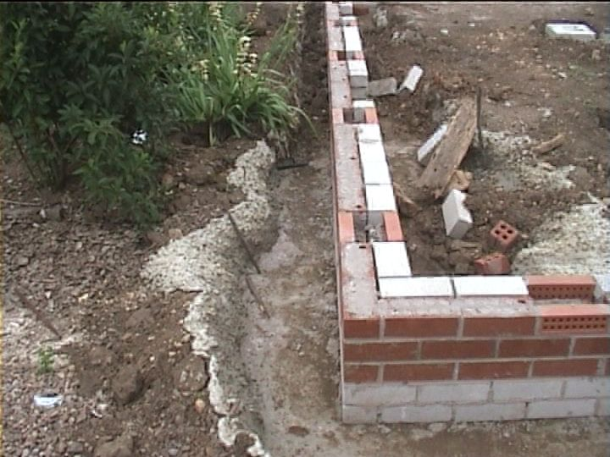
Speak for = relevant
No matter how sturdy
this foundation:
It won’t support these houses:

Slide 6
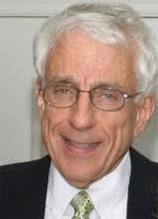
Two going theories of relevance – that don’t work
Achinstein’s evidential relevance = explanatory relevance
Probabilistic accounts
Esp. Roush, where relevance = f(liklihood)
Achinstein’s catches more cases;
Roush’s has the ‘right idea’
Peter Achinstein

Slide 7
Sherri Roush
P(h/e) is high
Leverage: P(e/h)/P(e/-h) > 1
P(e) is high

Slide 8
My enterprise = Roush’s enterprise
Roush’s theory of knowledge ≠ Roush’s theory of evidence.
Theory of knowledge has to do with what ensures our entitlement to take claims as true.
Theory of evidence has to do with what ensures that claims are true.
Roush: ‘...the notions of evidence that I am aiming for are objective in the following sense. That e is evidence for h is understood as holding in virtue of a factual relation between the statement e’s being true and the statement h’s being true, not in virtue of anyone’s believing that this relation exists.’ [p 156]

Slide 9
The use of evidence
I want an account of evidence that tells us what evidence for h is.
So that, when I want to know about h…
I can use this account to ascertain whether e would be evidence for h were it to hold.
So that I can then decide how much, if anything, to invest in trying to learn e in order to come to know about h.

Slide 10
Evidence is a not a 2-place
What’s wrong with the 2 standard accounts
They both expect a criterion that will
Look at h
Look at e
Decide if e is evidence for h.
But this won’t work because there is no such feature.
but a 3-place relation
E is evidence for h relative to A.
What is A?
A is a good argument.
……….

Slide 11
Explanatory relevance best case – causal relevance
Is the occurrence of a cause of h evidence for the occurrence of h (s’posing h did occur)?
Suppose the following are true
The principle ‘Es (can) cause Hs’
An E-type event (e) occurs
An H-type event (h) occurs
But in this case not e but something else caused h.

Slide 12
Then the answer is NO
What secures the relevance of ‘e occurs’ to ‘h occurs’ is the additional fact
F: ‘e causes h’.
Why should F make it the case that the occurrence of e speaks for the occurrence of h anymore than…
any other fact F’ s.t. if F’ holds then if e occurs h occurs?

Slide 13
Suppose it is a fact that
F’: if e occurs, h occurs 10 minutes later.
Then e’s occurring is just as sure a guarantee that h occurs as it is given F (‘e causes h’).
Perhaps it is more difficult to learn F’ than F. (Is it?)
If so, maybe it is more difficult to know that e is evidence for h.
But that doesn’t affect whether e is evidence for h.
And, it can be just as difficult to learn e, or to learn that e is evidence for h, as it is to learn h ‘directly’.
But that too has to do with knowledge, not with evidence.

Slide 14
The theory, in two versions
Material mode: One fact, f_{e} , is evidence for a second, f_{h}, iff f_{e} is a necessary member of a set of facts sufficient to ensure f_{h} obtains.
Formal mode: e is evidence for h iff e is a necessary premise in a (deductively) valid and sound argument for h.

Slide 15
What about probabilities?
Here Roush has the right idea, in endorsing what she calls ‘Bayesianism’, which for her does not mean a subjective interpretation of probability. Rather….
‘The Bayesian makes the idealizing assumption that all statements of the language in question possess probabilities. This is in contrast to the approach of classical statistics in which it is denied, for instance, that hypotheses have probabilities.’ [p 155]
But for the objective notion of evidence that Roush and I both intend, it cannot be probabilities of statements that matter but rather probabilities of facts.
I do not see that there generally are such probabilities.

Slide 16
Probabilities for facts arise from chance set-ups
Suppose it is a fact that e:
the ball in your hand is drawn from an urn with 8 red balls and 2 black
each ball has an equal probabiliy of being drawn
and nothing ‘untoward’ happens to affect the colour of the ball as it is drawn (no ‘finks’, etc).

Slide 17
Subjective probabilities belong in epistemology, not in a theory of evidence.
Then (I allow) there is a probability (of .8) for
h: the ball you hold is red.
So maybe e speaks for the truth of Pr(h) = .8
This is my preferred choice.
Maybe you think e speaks for the truth of h.
If so, then modify the theory appropriately.
But only where, as Roush too demands, there are objective probabilities.

Slide 18
Lots of objections
E speaks for itself.
Me: Yes, very loudly.
False claims never have evidence.
Me: Of course we very often think they do.
A&B is evidence for both A and B.
Me: Yes indeed, very good evidence.
Any 2 true facts are evidence for each other.
Me: Yes, but only relative to the right arguments.
None are real problems unless…
evidence is trafficking with epistemology.

Slide 19
Summary
Keep epistemology out of evidence.
Why?
So that you know what counts as evidence.
Then you can decide whether you can learn it, at what cost and what it will entitle you to.
The Argument Theory
Evidence is a 3-place relation:
e is evidence for h relative to A iff
A is a good argument for h in which e is an essential premise.

Slide 20
Of what use is the argument theory?
Now we can talk of entitlement.
We can police claims that there’s evidence in support of h.
Claims that e is evidence for h are enthymemes: e is evidence for h relatve to a good argument A.
Standards of rigor and explicitness expected in science and EBP → A be made explicit.
Then we can check just how good A is – what are the chances the other premises are true.

Slide 21
So….. A Closing Injunction
Claims that e is evidence for h need backing up…
It ain’t evidence unless
there’s evidence it’s evidence.

Slide 22
Thank you!

