Slide 1
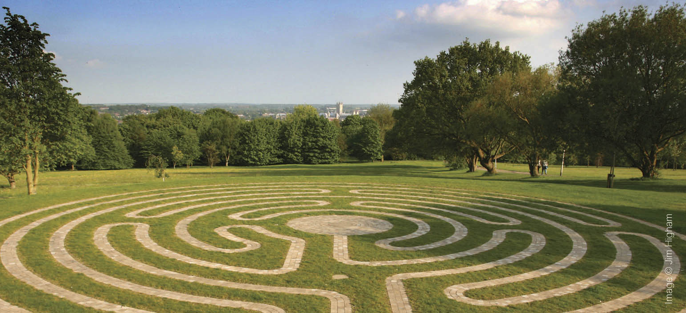
FINISHING STRONG
Finishing your degree and preparing to graduate
Notes:
Working our your degree result
Study skills advice
Employability
Preparing to graduate
Life after university
Summer Schools and PG study
Graduation
Prizes
NSS

Slide 2
There is everything to play for…
How is your degree classified?
There are two methods:
  Average
  Preponderance
We compare the results of both of these methods, and use whichever gives you the better result to determine your final degree classification.
Notes:
I’m going to rattle through this, but if anyone has any questions, please stop me.

Slide 3
The ‘Average’ method
Based on the weighted average of your final module marks from Stages 2 and 3:
Stage 2 contributes 40%
Stage 3 contributes 60%
Degree class | Required average
First Class | 70 and above
2(I) - Upper Second | 60 to 69.9
2(II) - Lower Second | 50 to 59.9
Third | below 50
Notes:
Why 40:60? Because this way we recognise that you are a whole year more experienced at being at university in your final year.
We recognise that you will have that much more understanding of the School’s expectations of your work, of what you need to do for your exams, and that your academic ability in general is that bit higher in Stage 3 than in Stage 2.
The technical term for this is ‘exit velocity’ – you get better and better and being at university the longer you are here, so we recognise that in the way we classify your degree.

Slide 4
An example of the ‘Average’ method
Stage 2 modules |  | Final module mark | Stage 3 modules |  | Final module mark
HI5055 | 30 credits | 57 | HI6024 | 60 credits | 62
HI5075 | 30 credits | 59 | HI605 | 30 credits | 65
HI5035 | 30 credits | 58 | HI6012 | 30 credits | 62
PO555 | 15 credits | 55
PO623 | 15 credits | 45
Stage 2 average |  | 56.00 | Stage 3 average |  | 62.75
 |  |  | WEIGHTED AVERAGE |  | 60.05
 |  |  |  |  | 2(I)
Notes:
This is a clear example of why it is all to play for. This hypothetical student was let down by those Politics wild modules, and you might think that a 2(I) is out of reach. However, they evidently stepped up a gear, worked really hard on their Special Subject and dissertation, and as a result of Stage 3 being weighted more than Stage 2, was above to get their programme average into the 2(I) band.

Slide 5
The ‘Preponderance’ method
The preponderance method applies if your programme average is within 3% of the next highest degree class, and you have at least 120 credits in that class:
Class | Number of credits in class or above | Average mark over all contributing modules
First | 120 | 67
2(I) - Upper Second | 120 | 57
2(II) - Lower Second | 120 | 47
Third | 240 | n/a
Notes:
The preponderance method is intended to recognise those students who have shown that they are clearly able of really good work, but their programme average doesn’t carry them into that higher degree class.
Essentially, if you achieve at least half of your credits over Stages 2 and 3 in the higher degree class, and your average is within 3% of that class, that is the degree you are awarded, rather than the classification the pure programme average would have given you.

Slide 6
An example of the ‘Preponderance’ method
Stage 2 modules |  | Final module mark | Stage 3 modules |  | Final module mark
HI5055 | 30 credits | 68 | HI6040 | 60 credits | 71
HI5075 | 30 credits | 71 | HI605 | 30 credits | 70
HI5035 | 30 credits | 63 | HI5056 | 30 credits | 67
EN555 | 15 credits | 65
FR523 | 15 credits | 62
Stage 2 average |  | 66.38 | Stage 3 average |  | 69.75
 |  |  | WEIGHTED AVERAGE |  | 68.40
Notes:
Here is a good example. This student, again hypothetical, did well in Stage 2, stepped it up in Stage 3, and achieved a very strong 2(I) programme average. However… [CLICK]

Slide 7
An example of the ‘Preponderance’ method
Stage 2 modules |  | Final module mark | Stage 3 modules |  | Final module mark
HI5055 | 30 credits | 68 | HI6040 | 60 credits | 71
HI5075 | 30 credits | 71 | HI605 | 30 credits | 70
HI5035 | 30 credits | 63 | HI5056 | 30 credits | 67
EN555 | 15 credits | 65
FR523 | 15 credits | 62
Stage 2 average |  | 66.38 | Stage 3 average |  | 69.75
 |  |  | WEIGHTED AVERAGE |  | 68.40
 |  |  |  |  | First
Notes:
This student has 120 credits in the First class range, and their average is within 3% of 70.0. As a result, the preponderance method is used to classify their degree result, giving them a First.
Before we move on, is everyone clear on these two methods?

Slide 8
Study skills
Speak to your Academic Advisor, dissertation supervisor, Special Subject convenor etc.
Student Learning Advisory Service (SLAS)
  www.kent.ac.uk/learning/ - SLAS run a range of workshops:
    Writing well
    Learning from feedback
    Essay writing
    Referencing
    Planning a dissertation
    Effective revision
    Successful exam technique
  Book to attend these sessions via the SLAS website
Exam feedback
  You can request feedback on any of your Stage 2 exams from your module convenors during the last four weeks of this term (13th March – 7th April).
Notes:
So, clearly, it is all to play for. But how can you to step up to that higher level?
Obviously, the School’s staff are here to help you, and you should make the most of their advice. All members of staff hold office hours, and you can also make an appointment to go along with a specific question in mind to discuss. They are here to advise you on how you can achieve your best work – obviously, that will mainly involve setting up a camp in the library and reading stacks of books, but if you would like some support or advice on a particular skill don’t hesitate to speak to someone in the School.
There are also the workshops run by the Student Learning Advisory Service, if you’d like some really targeted skills training.
I would also strongly encourage you to get feedback on your Stage 2 exams before the end of this term. You’ll receive an email from Rob about this later on in the term, but during the last four weeks members of staff will be asked to be available to go through your exam scripts from last year. If you want feedback on a specific exam, email the relevant module convenor, and they will arrange a time with you to sit down and go through your script.

Slide 9

Employability – the final six months
CES nominated for ‘Best University Careers/Employability Service in the UK’
Get your CV up to date with all your skills, activities and experience
Careers and Employability Moodle Award – test the skills you will need when you enter the job market
Speak to a Careers Advisor: careerhelp@kent.ac.uk
Look up summer jobs fairs in your area: https://www.prospects.ac.uk/events
See the blog for more information:
blogs.kent.ac.uk/history-employability
Notes:
The final six months of your degree are a critical time not just for your degree, but also for your employability development and plans for the future.
Whether you have already found and applied for a graduate scheme, or you are looking for a summer internship before coming back for an MA or going on to other courses, or if you simply want to make sure your CV is the best representation of your skills and experience, the School and the University are here to advise you. You can get in touch with me whenever you like, or email the Careers and Employability Service to make an appointment to see one of their advisors.
Fortunately, you have access to one of the best support services in the country. Four years ago the CES was short-listed for ‘Most Improved Careers/Employability Service’ by the National Undergraduate Employability Awards, and this year it has been short-listed for best employability service in the country. They are a great team and work tirelessly to give you the best possible advice and opportunities, so make use of them.
Thinking of your CV, the CES is running a competition at the moment, which closes at the end of February. Submit your CV, and if it is an example of really good practice and presentation, you can win work experience and up to £300 funding to help you do it. See the School’s blog for more information about that.

Slide 10
Employability – events this term
Dozens of CES Bitesize sessions
Teach First and Schools Direct applications now open
Humanities for Hire
  Writing for a Living
  Applying for Teacher Training
  Graduate Schemes – How? Why? Where?
  Choosing the right job for you
More ‘Careers in…’ sessions
  A second ‘Careers in Security and Defence’ talk has been arranged for Wednesday 1st March, 1pm-2pm, GS8
Volunteering opportunities throughout this year
Student Research Assistants – three roles now open
Keep an eye on the employability website for events and opportunities
Notes:
There is loads coming up over the course of this term. The employability blog is probably the busiest it has ever been, with new items going up almost every day of the last week and a half. These are just a few of the workshops and opportunities coming up.
Due to the popularity of the Careers in Security and Defence last term, the School of Politics and International Relations has organised a second talk by members of the Civil Service, which will be held on Wednesday 1st March. A reminder about that and the other ‘Careers in…’ talks will be posted on the website.
There have already been several volunteering opportunities advertised through the employability website:
Volunteer researcher - Visiting and Revisiting the Western Front
Internship – Commonwealth War Graves Commission Centenary
Digitisation Assistant – Minster Gatehouse Museum
And more are on the way.
I’d also like to highlight the Student Research Assistant scheme. This is a School scheme which gives you the opportunity to be hired as research assistants to work with academics in the School on their research projects. At present, Dr Emily Manktelow is looking for three SRAs to work on her project on memorials related to the British Empire in Canterbury Cathedral. This work would take place throughout the Spring and Summer terms, and is paid at the National Living Wage. The advert and job description is on the employability website, and the deadline to apply is midnight on Sunday.
I would encourage you to keep an eye on the website, and get in touch with me if you are looking for any extracurricular work or activities to bolster your CV over the next six months.

Slide 11

Notes:
This was passed on to me just yesterday, and I thought I would mention it as well. The University sponsors the Brompton Academy, and they are currently looking to recruit Kent students to teach History, among other subjects, through the Schools Direct route. There are information days on campus over the next two weeks – if you are interested in this opportunity, or going into teaching as a career generally, please get in touch with me.

Slide 12

Notes:
Launched last year, you now have the option to add a Year in Computing to your degree. You can add this on to the end of your degree, and you would take a bespoke set of modules in the next academic year designed to start you off from scratch, and give you some extremely useful skills in coding languages, website development, and database management, amongst others. We are well and truly in the digital century, and having knowledge of these sorts of skills will absolutely help you stand out when you start applying for jobs. Get in touch with me or the School of Computing if you would like to know more about this.

Slide 13
Employability – life after graduation
Careers and Employability Service
  All CES services are available to alumni for three years after you graduate
    Guidance interviews, CV checks, mock interviews and application assistance plus a great resources library
    10.30am-12.30pm and 2pm-4pm drop-in every day, or email careerhelp@kent.ac.uk for 1-1 sessions
    Careers Building can be found next to Keynes College
University alumni network – KEW-NET
  Find a mentor in the field you are interested in
    Mentors offer advice, work shadowing, CV reviewing, potentially internships etc.
  Act as a mentor to current students and recent graduates
  www.kent.ac.uk/ces/student/kew-net
Notes:
The employability advice doesn’t end with your degree. You can take advantage of all the CES services for three years after you graduate, and the University’s alumni network is set up to help put you in touch with students who graduated before you and get advice. And, in time, when you have successful careers you can mentor current students and new graduates yourselves.

Slide 14
European Summer Schools
The University runs Summer Schools in Canterbury and Paris during July and August, which are available to Stage 2 and 3 students.
www.kent.ac.uk/summerschools/
History – Medieval Canterbury and Kent, 3rd-14th July
For Summer Schools in Paris, scholarships are available, covering the cost of tuition, accommodation, lunch each day, and travel around Paris.
Deadline for scholarship applications: Friday 3rd March
Notes:
These final six months need not be the end of your time with Kent. The University runs Summer Schools here in Canterbury and in Paris to which you can apply even though you are finishing in June. These Summer Schools cover a range of different areas – the one on the theme of Revolutions in Paris is particularly interesting – and give you the opportunity to cover something you otherwise wouldn’t. The School of History is running a Summer School on Medieval Canterbury and Kent, and will include a host of visits to important sites around the city and the county, and give you the opportunity to learn about aspects of medieval life you would otherwise not touch on.

Slide 15






Taught MA Programmes in the School of History
Modern History,
1500-2000
War, Media
and Society
Science
Communication
History of Medicine
and Health
Imperial History
First World War Studies
Notes:
There is also the opportunity for PG study. I won’t linger on this, except to say that applications for PG study are now open, both in the range of taught programmes and to complete an MA by research.
Also, the School’s sister centres in American Studies and Medieval and Early Modern Studies also run both taught and research MA programmes.

Slide 16
Funding Opportunities
University scholarships
  www.kent.ac.uk/scholarships/postgraduate/
  10% discount on tuition fees if you continue from UG into PG study
School scholarships
  The School of History is offering TWO MA scholarships for 2017/2018 - www.kent.ac.uk/history/postgraduate/funding/
  Covers all tuition fees for the programme, plus £1,000 for study costs
  Deadline to apply: Monday 13th March.
PG student loans
  Available for taught and research MAs
  Government-backed loans of up to £10,000
  Non-means tested
  Repaid at 6% of your annual income over £21,000
  Available to UK nationals and EU students
Notes:
Again, I won’t linger on the funding options available for PG study.
The University will give you a 10% discount on your tuition fees if you carry on straight from UG to PG study, and the School is offering a pair of scholarships which cover your full fees plus £1,000 to help with the costs of studying.
Independent of scholarships are the PG student loans made available by the Government. These were introduced last year, and do exactly as they say here. Rather than go to a bank for a Career Development Loan, as you had to do in the past, you can borrow up to £10,000, and you only start repaying it once you earn over £21,000, as with your UG student loans. I can go into more details about this at the end if you would like.

Slide 17
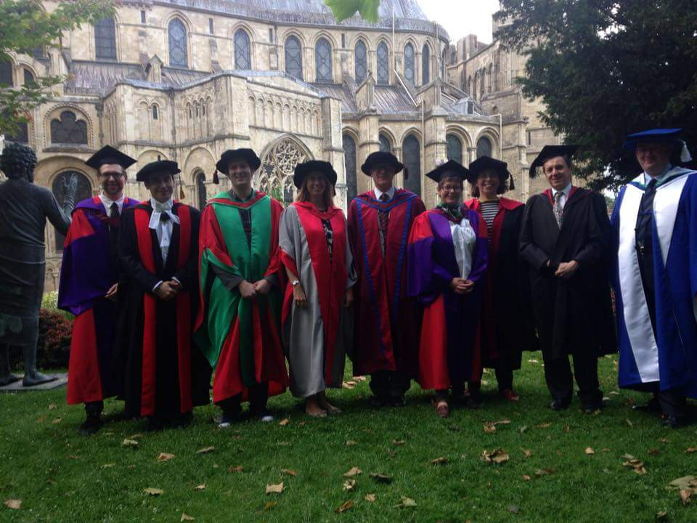
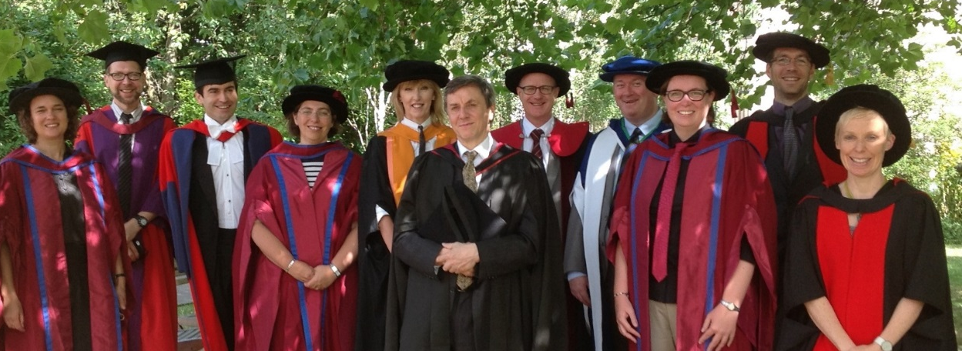
Graduation
The School holds a party on the day of our ceremony:
  Friends and family are very welcome
  More Pimm’s and scones than you can possibly eat and drink
  School prizes are awarded
  The sun *always* shines on our graduation party!
History’s graduation ceremony: 19:30, Thursday 13th July
www.kent.ac.uk/congregations/
Notes:
The School’s graduation ceremony will be in the evening of Thursday 13th July – if you are a joint-honours student whose programme is owned by another School, you should check the Congregations website for your date and time. You will be contacted by the University to confirm that you are attending the graduation ceremony and book your robes and tickets later on this year. Look at the Congregations website for more information.
For the past four years, the School has held a party on the day of graduation to celebrate your achievements, and to give you the opportunity to see your lecturers in their fabulous floppy PhD hats. We will be sending out invitations to the party later on in the term.
The Congregations Office has put together small packs with loads of information about the preparations for graduation, how things run on the day, where to get your gowns from, and many other things. Grab one of the lanyards from the front before you go if you weren’t able to go to their talk last Friday in the Venue.

Slide 18
School Prizes
The School awards a number of prizes to final-year students, recognising those who have shown particular excellence:
  Best Degree Result
  Stage 3 Achievement Award – the 2nd to 5th highest degree results
  Greatest Improvement between Stages 2 and 3
  Dissertation prizes:
    Best History Dissertation
    Best War Studies Dissertation
    Best Dissertation on the History of Medicine
    Best Dissertation on Imperial/non-Western History
    Copley Prize for Best Dissertation in colonial, religious, intellectual or cultural history
Notes:
As the last slide said, we give out our prizes at the graduation party. What are these prizes, you ask?
They are either cash or an Amazon voucher, but really the prize is the recognition that you are amongst the best students of your cohort.

Slide 19

The National Student Survey
Notes:
One final thing to cover – the National Student Survey.

Slide 20
The NSS
The National Student Survey is taking place now.
It covers all publicly funded universities.
UG students in their final year of study are included.
Results are posted on the Kent website and on the UCAS Coursefinder website – i.e. results are available to the public.
The NSS enables comparative analysis of how good universities are at teaching.

Slide 21
The NSS
What has NSS feedback done for you?
A ​​​re-written and simplified Student Handbook | ​​​​​​​Improved online essay feedback
Much greater support for your employability development | ​​More modules, covering a broader chronological and thematic sweep of history​
​Mandatory one-to-one essay feedback | Online-only essay submission
A better way of handling Special Subject registration | ​​More dedicated Military History modules
Notes:
Why complete the NSS? Because it is your chance to tell the School and the University what you think about your time at Kent, and to help improve everything we do. These are just some of the changes the School has made to aspects of your student experience in the past few years as a direct result of NSS feedback.

Slide 22
Completing the NSS
Head to www.thestudentsurvey.com
You will be asked to grade each question on this scale:
1
2
3
4
5
✓
- This was awful
✓
- This wasn’t great
✓
- No thoughts one way or the other
✓
- This was good
✓
- This was great
Notes:
There are eight sections, each asking questions about a different aspect of your experience at Kent. There are 27 compulsory questions, and then some optional questions on things like personal development. The NSS should take you about 10-12 minutes to complete.

Slide 23
1. The teaching on my course
Staff are good at explaining things.
Staff have made the subject interesting.
Staff are enthusiastic about what they are teaching.
My course has challenged me to achieve my best work.

Slide 24
2. Learning opportunities
My course has provided me with opportunities to explore ideas or concepts in depth.
My course has provided me with opportunities to bring information and ideas together from different topics.
My course has provided me with opportunities to apply what I have learnt.

Slide 25
3. Assessment and feedback
The criteria used in marking have been clear in advance.
Marking and assessment has been fair.
Feedback on my work has been timely.
I have received helpful comments on my work.
Notes:
This is an important section.
We are required to return work within 3 weeks, and that is adhered to – except of course in extreme circumstances.
Also remember our standards are comparable to other quality universities.

Slide 26
4. Academic support
I have been able to contact staff when I needed to.
I have received sufficient advice and guidance in relation to my course.
Good advice was available when I needed to make study choices on my course.

Slide 27
5. Organisation and management
The course is well organised and running smoothly.
The timetable works efficiently for me.
Any changes in the course or teaching have been communicated effectively.
Notes:
The problem with the timetable is that when it works properly, nobody notices.
A couple of errors – and everyone is up in arms.
The timetable has been constructed with some basic guidelines to help you. We try to start at 10.00, rather than 9.00. We try to avoid Wednesday afternoons, we try to avoid bringing you in for just 1 or two widely spaced classes, we make sure there is a lunchbreak, we know that many of you work part time, so we try to arrange one or more a free days/mornings/afternoons.

Slide 28
6. Learning resources
The IT resources and facilities provided have supported my learning well.
The library resources (e.g. books, online services and learning spaces) have supported my learning well.
I have been able to access course-specific resources (e.g. equipment, facilities, software, collections) when I needed to.

Slide 29
7. Learning community
I feel part of a community of staff and students.
I have had the right opportunities to work with other students as part of my course.

Slide 30
8. Student voice
8. Student Voice
I have had the right opportunities to provide feedback on my course.
Staff value students’ views and opinions about the course.
It is clear how students’ feedback on the course has been acted on.
The student’s union (associate or guild) effectively represents students’ academic interests.
Overall, I am satisfied with the quality of the course.

Slide 31

Thank you!
Why complete the National Student Survey?
Make your voice heard! Shape the university experience of the students that come after you.
Complete the NSS by Monday 13th
February and the University will give you a
£10 Amazon Voucher.
  Once you have completed the survey, email your competition receipt to nssawards@kent.ac.uk by midnight on 13th February.
School of History prize draw for a £100 Amazon voucher – complete the NSS by midnight tonight! Copy in history@kent.ac.uk in to your email to nssawards to enter.
Notes:
Particularly important – you have to copy in history@kent.ac.uk into your email to the nssawards address in order to be entered into the prize draw.

Slide 32
Find more about employability in the School of History at: https://blogs.kent.ac.uk/history-employability
Complete the NSS at www.thestudentsurvey.com
Tell us what you think and claim your £10 Amazon voucher before 13th February!
Notes:
Now, I know there is a packed schedule of events today, so I won’t take up any more of your time. But if anyone has any questions, I think we have time for a few now.
[QUESTIONS]

