Slide 1
Global Challenges Research Fund (GCRF) &
Global Challenges Doctoral Centre (GCDC)
Staff Briefing, 5 November 2019
Dr Andrew Massoura
Deputy Director, Research Services
Dr Beth Breeze
Director, Global Challenges Doctoral Centre, University of Kent

Slide 2
Goals for this briefing
Introducing the GCRF and the GCDC
What opportunities exist for academic staff?
GCRF funding
Staff-led PhD projects
Supervision of Student-led PhD projects
PostDoc awards
The application process
Any questions?

Slide 3
2030 Agenda for Sustainable Development United Nations, New York 25/9/15

Slide 4
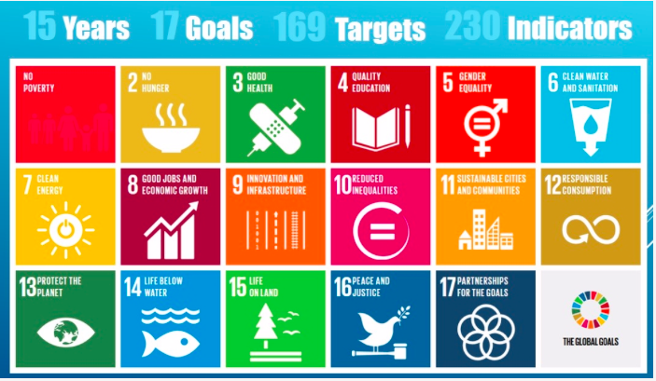

Slide 5
Global Challenges Research Fund
A £1.5 billion fund announced by the UK Government in late 2015 to support cutting-edge research that addresses the economic and social challenges faced by developing countries.
Challenge-led disciplinary and interdisciplinary research, and strengthening of the capacity for research, innovation and knowledge exchange in the UK and developing countries.
Three principal challenges that research projects should address:
1) Equitable access to sustainable development;
2) Sustainable economies and societies; and
3) Human rights, good governance and social justice.
https://www.ukri.org/research/global-challenges-research-fund/

Slide 6
Specific requirements and preparation of GCRF bids
An overview of what to watch out for in preparing a GCRF bid

Slide 7
Specific requirements and preparation of GCRF bids
ODA Compliance
GCRF assessment criteria

Slide 8
Official Development Assistance (ODA)
The GCRF forms part of the UK's ODA commitment which is monitored by the Organisation for Economic Cooperation and Development (OECD).
ODA funded activity focuses on outcomes that promote the long-term sustainable growth of countries on the OECD Development Assistance Committee (DAC) list.
Administered with the promotion of the economic development and welfare of developing countries as its main objective.
Notes:
The ODA statement is intended to be a stand-alone document, and will form the initial evidence base for any DFID/International Development Committee/OECD scrutiny

Slide 9
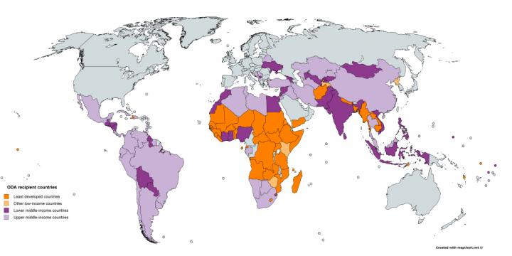
Official Development Assistance (ODA)
ODA DAC list
Notes:
South and Central America, Africa, Asia.
Next review 2020.
Chile, Seychelles and Uruguay have graduated.

Slide 10
Official Development Assistance (ODA)
The OECD defines ODA compliant research activities as :
The main purpose being to promote the economic growth or welfare of developing countries
Only research directly and primarily relevant to the problems of developing countries may be counted as ODA.
This includes research into tropical diseases and developing crops designed for developing country conditions.
The costs may still be counted as ODA if the research is carried out in a developed country

Slide 11
ODA Compliance
Focus upon addressing the economic development and welfare of developing countries as primary purpose of the research
State which countries are involved
Define the challenge in the context of the impact upon local populations
Issues which are global in nature are not ODA compliant unless your research is linked to a specific aspect in a developing country.
Define how your research will seek to address the challenge, and the impact that it will have on the economic development and welfare of local populations
Show a route to impact, and how solutions will be realised.
Whilst capacity building is an important part of ODA research, unless the call has been specifically set up as a capacity building programme then capacity building on its own is not enough to justify ODA compliance
Simply stating that a proposal is ODA compliant, or will lead to economic development and poverty alleviation does not make it so - it is the supporting evidence that you describe which makes it ODA compliant.
Notes:
The ODA statement is intended to be a stand-alone document, and will form the initial evidence base for any DFID/International Development Committee/OECD scrutiny

Slide 12
ODA Compliance
All work funded by GCRF is expected to address the UN Sustainable Development Goals (SDGs) and therefore you should relate your work back to the UN SDGs.
Be aware that each SDG has a set of specific targets to be achieved by 2030.
Be specific and convey exactly how your work will address particular target(s)
Where your work cuts across several SDGs, highlight this
Do not make tenuous connections between your work and SDGs to seem as though you are addressing a higher number of them.
This is likely to come across as though you do not understand the SDGs properly.
You should build ODA into the entire philosophy of your proposal – do not restrict it to certain sections.
Needs to be compliant throughout project - not just at outset

Slide 13
ODA Compliance Statement
When writing the statement consider the following:
Which country/ countries on the DAC list will directly benefit from this proposal and are these countries likely to continue to be ODA eligible for the duration of the research?
How is your proposal directly and primarily relevant to the development challenges of these countries?
How do you expect that the outcome of your proposed activities will promote the economic development and welfare of a country or countries on the DAC list?

Slide 14
GCRF assessment criteria
When drafting the proposal, consider your Research as falling into one or more of these constructs:
Research for Development
undertaking research that addresses the challenges for developing countries – here context and pathway to impact will be key
Research as Development
building capacity with developing countries to solve their own challenges – here partnerships in country will be key
Research on Development
undertaking independent research to critically assess ODA actions, mechanisms and outcomes

Slide 15
GCRF assessment criteria
Beyond ODA compliance, there are four main criteria for assessing GCRF grant applications:
Research excellence
Problem and solution focused
Partnership and capacity building
Likelihood of impact

Slide 16
GCRF assessment criteria
Research excellence:
Same standard of research excellence but not constrained by traditional methodologies or disciplinary silos.
You should aim to demonstrate:
You are bringing together key knowledge and expertise from different research communities. Show your research will involve a mix of perspectives.
Co-creation of research with LMIC partners. Highlight where you have involved LMIC partners who are not researchers (eg. policy makers) in research design and planning for implementation and uptake.
You are bringing together groups who may not traditionally work with each other

Slide 17
GCRF assessment criteria
Problem and Solution Focused:
Problems:
Emphasise the scale of the problem globally
Hone in on why this is a particular problem in your selected LMIC(s)
Reference where your projects fits within the UN SDGs. If it cuts across several, highlight this.
Show an in-depth understanding of why this is a problem in your selected area(s):
Show an understanding of the cultural, social, economic context of the problem
Demonstrate awareness of any existing global or local efforts to tackle the problem
If applicable, state how the research fits into the LMIC’s policies and strategic objectives
If there are aspects of the problem still to understand, address how you will do this within your research
Demonstrate that those on the ground (eg. partners & stakeholders) have helped you identify the problems – it must be clear that you haven’t just assumed something is a problem.

Slide 18
GCRF assessment criteria
Problem and Solution Focused:
Solutions:
Make sure it does not come across as though you are imposing something you think is a solution.
Demonstrate that you have co-created solutions with partners from the LMIC ie. they have been involved in the designing of proposed approaches for seeking the solution
Demonstrate there is a local appetite for finding solutions
Demonstrate stakeholder engagement ie. show evidence that those who will benefit from the project are committed to uptake of solutions
Show that you are aware of potential barriers to uptake of research results in the LMIC.
Partners and relevant stakeholder should be able to help with this.
Highlight any preliminary data or other evidence that demonstrates the proposed research is feasible in the LMIC. Just assuming could imply a lack of knowledge of in-country issues
If you’re targeting a relatively wealthy country on the DACs list, you should make clear how your work will benefit a vulnerable section of the population.

Slide 19
GCRF assessment criteria
Partnerships and Capacity Building:
Partnerships:
A collaborative feel should come across throughout your entire proposal:
Make sure it comes across that partners will be involved in every step, from research design through to dissemination of results
Avoid top-down language or anything with imperialistic tones
Be specific about the role and contribution of the partners.
If you’ve worked together before, highlight any past successes (do you have a track record of delivering?)
If the partnerships are new, explain how they came about, why you are working together, and how you will build the relationship

Slide 20
GCRF assessment criteria
Partnerships and Capacity Building:
Capacity Building:
Think about where you can realistically add value.
Emphasis on not just the research but also the admin and management being ‘shared’ between partners.
Technical and skills development:
Include relevant bespoke training to develop capacity at all career levels
Make sure any proposed skills development has the primary aim of improving LMICs ability to undertake research on the identified challenges.
Where appropriate, provide opportunities for colleagues from LMICs to train in UK labs or present findings in international conferences.
Select the most appropriate colleagues to travel to the LMIC eg. if you are exchanging experimental techniques, it may be more appropriate to send someone with technical expertise, and not the PI.
Do not just address technical skills development – is there a need for professional, soft and transferable skills development? (eg. leadership skills).
Consider training opportunities for UK researchers by LMIC researchers
Notes:
You should demonstrate that capacity building is sustainable, meaning knowledge gained by individuals can be translated to sustainable institutional capacities.
Are there any opportunities to build industrial capacity? Does the project provide routes to commercialisation that could kick-start (or build upon) local industries?
Show an awareness of ‘brain-drain’ and what you will do to counteract this. For example, will the project create any opportunities for post-docs to establish independent careers within their own countries?

Slide 21
GCRF assessment criteria
Likelihood of impact:
Knowledge exchange & dissemination
Who do you need your findings to reach and how to do this
Highlight how you will make findings accessible
Ensuring solution uptake
Demonstrate that you are involving partners who can deliver impact.
Highlight where PIs/CoIs/partners can demonstrate good track record of delivering impact.
Sustainability and translation of results
Explain the extent to which research within the LMIC might be sustainable beyond the lifetime of the research grant, and what approaches will drive this.
Demonstrate how you will ensure these partnerships will endure beyond the life of the project.
Monitoring & evaluation
It is important to demonstrate the efforts you will take to monitor and evaluate your project, throughout its lifetime, to ensure you are on-track to deliver proposed impact.

Slide 22
GCRF assessment criteria
Some examples of the type of impact you may be aiming to have are below:
Developmental impact: societal, economic and environmental impact
Policy impact: influence on key policy processes and evidence-informed decisions
Capacity development: strengthened capacity to produce, communicate and use research in LMICs
Collaborative impact: development of long-lasting, innovative and interdisciplinary collaborations that can advance global development
Practice-level impact: influence on development practice and development practitioners
Knowledge as a global public good: open access to research and data to benefit wider society
Conceptual impact: influence on how people think about development issues

Slide 23
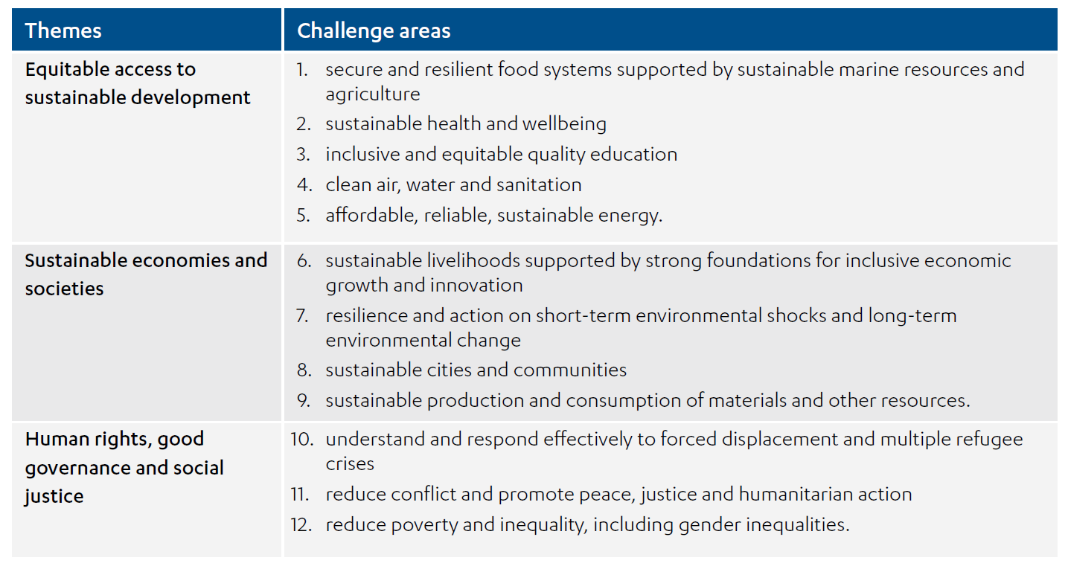
GCRF assessment criteria
Notes:
Research funding criteria are developed by the GCRF’s main delivery partners. UKRI identifies 12 challenge areas, organised under three themes, in accordance with the GCRF Strategy
There is no list of priority countries – but encourage inclusion of Global South in applications.

Slide 24
Summary
ODA Compliance
GCRF assessment criteria
Research excellence
Problem and solution focused
Partnership and capacity building
Likelihood of impact

Slide 25
GCRF Partnership Development Fund
(previously the GCRF Partnership, Workshop and Fortuity funds)
https://research.kent.ac.uk/researchservices/gcrf-partnership-development-fund/

Slide 26
GCRF Partnership Development Fund
Part of our overall GCRF strategy
Facilitate partnerships with colleagues in ODA DAC list countries
Part of our additional QR allocation from Research England.
The fund has a broad remit and is intended to support:
Activity following up on previous partnerships funded via GCRF QR (please note that priority will be given to these projects);
New relationships and collaborative projects;
Activities that require a last-minute, small pot of funding.

Slide 27
GCRF Partnership Development Fund
Eligibility
Open to all academics and Early Career Researchers based at the University.
Must be ODA Compliant
Funding available
For 2019/20: £120,000, and the upper limit per application is £10,000.
Value for money will be an assessment criterion.

Slide 28
GCRF Partnership Development Fund
Key dates
Call opens: Monday, 14 October 2019
Call closes: Monday, 18 November 2019 at 5pm
Outcome communicated: by Monday, 2 December 2019
All expenditure must take place by 1 June 2020
Report due by 1 July 2020
Further information
Please contact the Global Challenges Officer, Grace Grussenmeyer: globalchallenges@kent.ac.uk.
https://research.kent.ac.uk/researchservices/gcrf-partnership-development-fund/

Slide 29
The GCDC team
Dr Beth Breeze
GCDC Director
Centre for Philanthropy
B.Breeze@kent.ac.uk
Dr Frank Grundig
GCDC Deputy Director
School of Politics & International Relations
F.Grundig@kent.ac.uk
Grace Grussenmeyer
GCRF Officer
The Graduate School & Research Services
g.grussenmeyer@kent.ac.uk
kentgcdc@kent.ac.uk

Slide 30
The Vision for Kent’s GCDC
To provide scholarships for doctoral research that helps achieve the UN Sustainable Development Goals by tackling economic and social problems faced by developing countries on the OECD’s Development Assistance Committee (DAC) list.
To provide the best possible academic and pastoral support for our doctoral researchers
To create a welcoming home for all those on our campuses who are aligned with the goals of the GCRF

Slide 31
Ten GCDC PhD scholarships
Staff-led and Student-led competition
Fees and annual stipend for 3.5 years at the UKRI rate (TBC but stipend was £15,009 for 2019/20)
Research Training Supprot Grant £1,500 per year for first three years of study, plus access to ‘top up’ fund.
Specialised interdisciplinary GCDC cohort training activities.
Support from GCDC – events, research methods, social & networking, a doctoral community on campus.
Deadline for GCDC scholarship applications – Sunday 19 Jan 2020

Slide 32
Staff-led GCDC PostDoc awards
Academic staff members are invited to suggest six-month projects suitable for a postdoctoral researcher to conduct.
Projects must adhere to Global Challenges Research Fund (GCRF) stipulations and are intended to enhance the capacity of our academics and their partners to deliver world-class ODA compliant research and impact
Key points:
6 month appointments – must begin by 1 Feb 2020.
Projects must be feasible within the given timeframe and demonstrate strong projected impact and outputs.
The postdoctoral researcher will be expected to participate in and contribute to the development of GCDC activities.
Deadline: Monday 18 November 2019.
Decisions by end of November.
Schools will liaise with HR to advertise and fill the posts.

Slide 33
Other ways to connect with the GCDC
GCDC Hangouts
A monthly, interdisciplinary event that includes lunch and a broad discussion on a global challenge
An opportunity to connect with the GCDC cohort, their supervisors and the larger network of Kent academics working to address global challenges through research
Inaugural GCDC Hangout: Wednesday, 13 November, from 1-2pm in CE329 (third floor of Cornwallis East) led by GCDC director, Dr Beth Breeze. RSVP to Grace Grussenmeyer: kentgcdc@kent.ac.uk.

Slide 34
Any questions?

