Slide 1
Philanthropy & the SDGs: what role for private donors?
Dr Beth Breeze
Director, Global Challenges Doctoral Centre, University of Kent

Slide 2
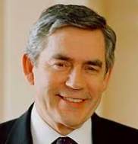
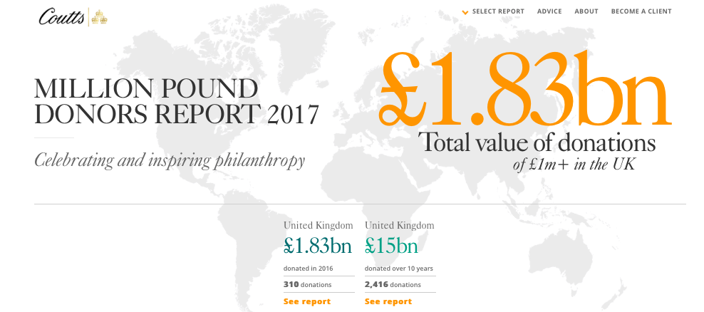
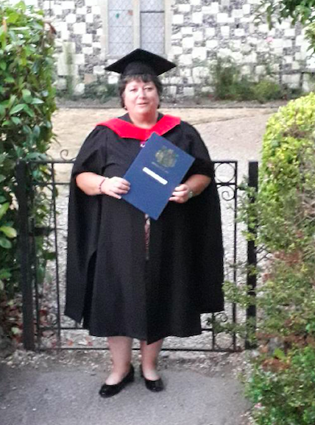
A Bit About Me

Slide 3
A Bit About You
Your name
Your School/discipline/research topic
On balance, do you feel positively or negatively about private philanthropy in general &/or as funders of global challenges?

Slide 4
2030 Agenda for Sustainable Development United Nations, New York 25/9/15

Slide 5
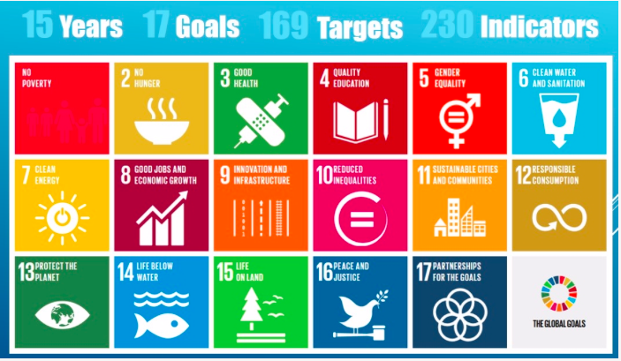

Slide 6
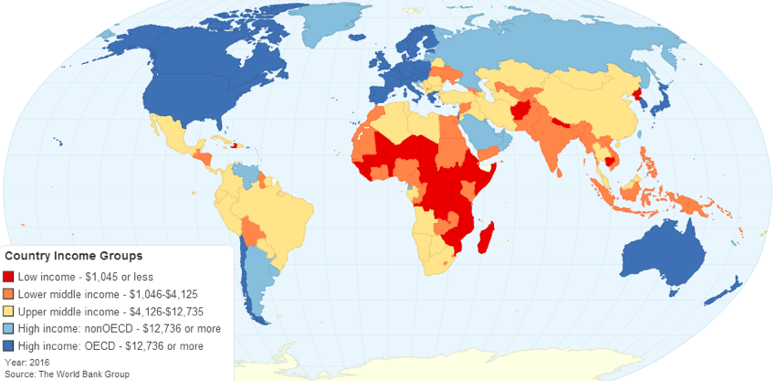
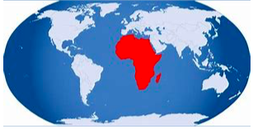
The price of success: funding the SDGs
Total funding gap = $2.5 trillion
2018 OECD DAC countries spent $150 billion
Philanthropic donors spent $24 billion (in 2014)

Slide 7
How about ‘ordinary’ donors?
UK Giving – 11% (£1.1 billion) to International Aid & Disaster Relief
(£m donors 11%-16%, £1.6 billion from 2007-16)
£14.6 billion in 2018
$23 billion – 6%, only cause area that decreased in 2018 report.

Slide 8
What is Philanthropy?
Definition: “Voluntary action for the public good” (Payton, 1988)
Philanthropy exists because “things often go wrong and things could always be better” (Payton & Moody, 2008)
Philanthropy is old as humankind: “An ancient tradition and a hot trend.. [it] has been practised in some form in every human civilization we know of” (Moody & Breeze, 2016)
Philanthropy is a “contested concept” (Daly, 2012)
Versus

Slide 9
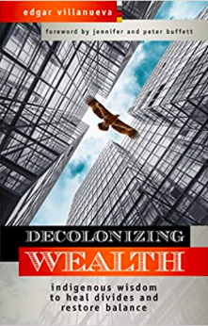
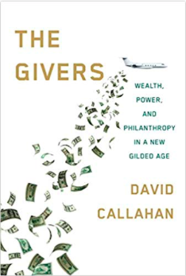
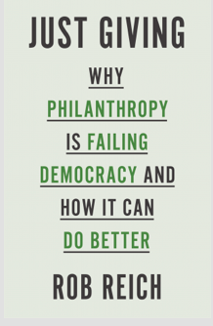
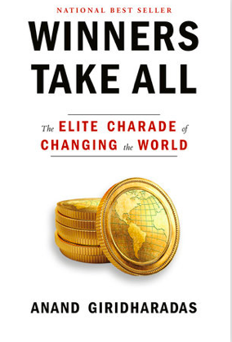
Philanthropy under Scrutiny

Slide 10
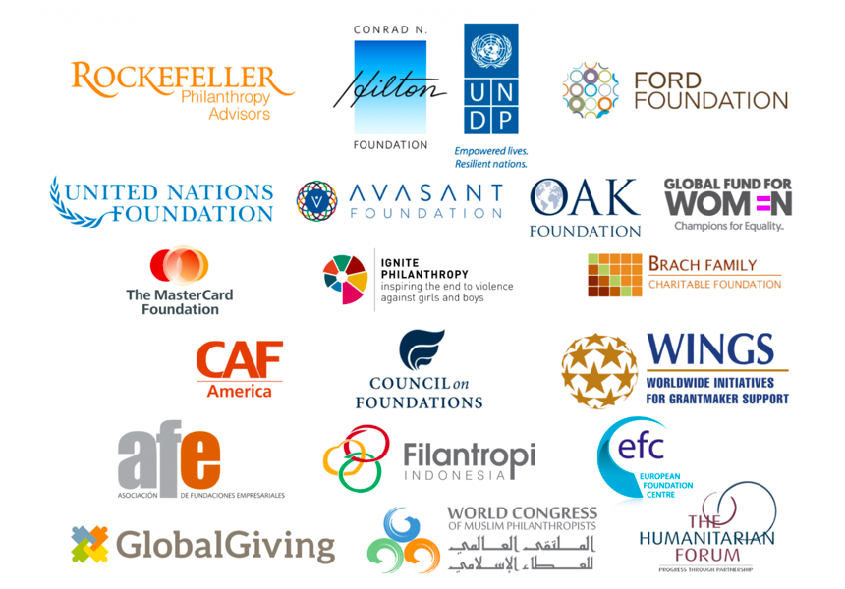
Why do private donors get involved with SDGs?
To help achieve their philanthropic goals.
To find new allies across sectors, issues and borders.
To prompt deep thinking and action on systems change.
To motivate staff, board members, volunteers and partners.
Because innovation / “Big Bets” is their USP

Slide 11
Why might we be wary of private donors?
Philanthropy gives more power and influence to people who already have plenty of both.
Unelected wealthy individuals should not decide what does and doesn’t get funded.
Wealthy donors are responsilbe for the very problems they are now pretending to fix.
“I sit on a man’s back choking him and making him carry me, and yet assure myself and others that I am sorry for him and wish to lighten his load by all means possible… except by getting off his back.”

Slide 12
What do YOU think?
Should the resources of private donors be welcomed alongside public funding?
Should we beware encouraging unelected wealthy elites to extend their power and influence on the global stage?
Are some SDGs more or less suitable for private support?
How would you feel about receiving philanthropic support for your research/organisations?

