Slide 1
Global Challenges
Doctoral Centre (GCDC)
Humanities Briefing
29 October 2019
Dr Beth Breeze
Director, Global Challenges Doctoral Centre, University of Kent
Professor Gordana Fontana-Giusti
Associate Dean for Graduate Studies, Faculty of Humanities

Slide 2
The GCDC team
Dr Beth Breeze
GCDC Director
Centre for Philanthropy
B.Breeze@kent.ac.uk
Dr Frank Grundig
GCDC Deputy Director
School of Politics & International Relations
F.Grundig@kent.ac.uk
Grace Grussenmeyer
GCRF Officer
The Graduate School & Research Services
g.grussenmeyer@kent.ac.uk
kentgcdc@kent.ac.uk

Slide 3
Goals for this briefing
Introducing the GCDC
What opportunities exist for Humanities colleagues?
Staff-led PhD projects
Supervision of Student-led PhD projects
PostDoc awards
The application process
Any questions?

Slide 4
2030 Agenda for Sustainable Development United Nations, New York 25/9/15

Slide 5
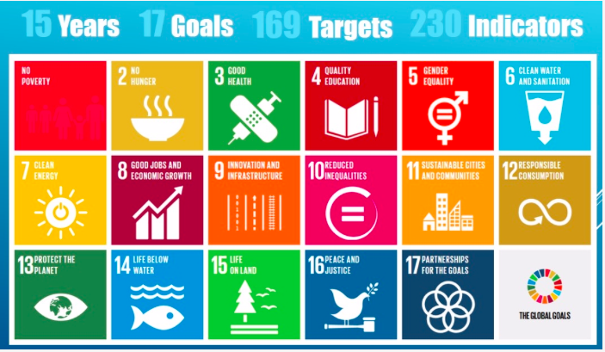

Slide 6
Global Challenges Research Fund
A £1.5 billion fund announced by the UK Government in late 2015 to support cutting-edge research that addresses the economic and social challenges faced by developing countries.
Challenge-led disciplinary and interdisciplinary research, and strengthening of the capacity for research, innovation and knowledge exchange in the UK and developing countries.
Three principal challenges that research projects should address:
1) Equitable access to sustainable development;
2) Sustainable economies and societies; and
3) Human rights, good governance and social justice.
https://www.ukri.org/research/global-challenges-research-fund/

Slide 7
The Vision for Kent’s GCDC
To provide scholarships for doctoral research that helps achieve the UN Sustainable Development Goals by tackling economic and social problems faced by developing countries on the OECD’s Development Assistance Committee (DAC) list.
To provide the best possible academic and pastoral support for our doctoral researchers
To create a welcoming home for all those on our campuses who are aligned with the goals of the GCRF

Slide 8
Ten GCDC PhD scholarships
Staff-led and Student-led competition
Fees for 3.5 years
Stipend: £15,009 per year
Research Training Supprot Grant £1,500 per year for first three years of study, plus access to ‘top up’ fund.
Specialised interdisciplinary GCDC cohort training activities.
Support from GCDC – events, research methods, social & networking, a doctoral community on campus.
Deadline for GCDC scholarship applications – Sunday 19 Jan 2020

Slide 9
Staff-led GCDC PostDoc awards
Academic staff members are invited to suggest six-month projects suitable for a postdoctoral researcher to conduct.
Projects must adhere to Global Challenges Research Fund (GCRF) stipulations and are intended to enhance the capacity of our academics and their partners to deliver world-class ODA compliant research and impact
Key points:
6 month appointments – must begin by 1 Feb 2020.
Projects must be feasible within the given timeframe and demonstrate strong projected impact and outputs.
The postdoctoral researcher will be expected to participate in and contribute to the development of GCDC activities.
Deadline: Monday 18 November 2019.
Decisions by end of November.
Schools will liaise with HR to advertise and fill the posts.

Slide 10
Insights into the application process
Professor Gordana Fontana-Giusti
Associate Dean – Graduate Studies
Member of the review panel for GCDC applicatins

Slide 11
Any questions?

