Slide 1
From the obvious to the unmentionable. A discourse-analytical approach to the unsaid
Patricia von Münchow
Université de Paris
laboratoire EDA

Slide 2
Outline
Introduction: From discourse analysis to the unsaid
Aim
Why is there silence in discourse?
Conceptualizing (the detection of) absence (and presence) in discourse
Example 1: (Almost) all categories of representations in a nutshell
Example 2: Different layers of (contradictory) representations through presence and absence
Conclusion

Slide 3
Introduction: From discourse analysis to the unsaid

Slide 4
Introduction: From discourse analysis…
Pêcheux, Michel. 1990. L’inquiétude du discours. Textes de Michel Pêcheux choisis et présentés par Denise Maldidier. Paris: Éditions des Cendres.
Moirand, Sophie. 2006. “Textes/discours et co(n)textes. Entretien.” Pratiques 129-130: 43-49.
Maingueneau, Dominique. 1995. “Présentation.” Langages 117: 5-11.
Maingueneau, Dominique. 2014. “L’analyse du discours et l’espace européen. Quelques réflexions.” In Les Sciences du langage en Europe : tendances actuelles, edited by Aude Grezka, Malory Leclère and Malika Temmar, 15-22. Paris: Lambert Lucas.

Slide 5
Introduction: … to the unsaid
The unsaid from a discourse-analytical point of view

Slide 6
Introduction: … to the unsaid
The unsaid from a discourse-analytical point of view
van Dijk, Teun A. 2009. Society and discourse. How social contexts influence text and talk. Cambridge: Cambridge University Press.
van Dijk, Teun A. 2014. Discourse and knowledge. A sociocognitive approach. Cambridge: Cambridge University Press.
Schröter, M. 2013. Silence and Concealment in Political Disourse, Amsterdam/Philadelphia, John Benjamins
Pêcheux, Michel. 1981. “L’énoncé : enchassement, articulation et déliaison.” In Matérialités discursives, edited by Bernard Conein, Jean-Jacques Courtine, Françoise Gadet, Jean-Marie Marandin and Michel Pêcheux, 143-8. Lille: Presses Universitaires de Lille.
Pêcheux, Michel. 1990 [1975]. Les Vérités de la Palice. Linguistique, sémantique, philosophie. Paris: Maspero. Partly reproduced In L’inquiétude du discours. Textes de Michel Pêcheux choisis et présentés par Denise Maldidier, 175-244. Paris: Éditions des Cendres.
Pêcheux, Michel. 1990. L’inquiétude du discours. Textes de Michel Pêcheux choisis et présentés par Denise Maldidier. Paris: Éditions des Cendres.
Sériot, Patrick. 1982. “Langue de bois et discours de vent.” Essais sur le discours soviétique 2: 5-39.
Authier-Revuz, Jacqueline. 1984. “Hétérogénéité(s) énonciative(s).” Langages 73: 98-111.
Orlandi, Eni. 1996 [1994]. Les formes du silence. Dans le mouvement du sens. Paris: Editions des Cendres.
Brès, Jacques. 1998. “Entendre des voix : de quelques marqueurs dialogiques en français.” In L’autre en discours, edited by Jacques Brès, Régine Delamotte-Legrand, Françoise Madray-Lesigne and Paul Siblot, 191-212. Université Paul Valéry-Montpellier 3, Praxling and Université de Rouen, Dylang.
Brès, Jacques. 1999. “Vous les entendez ? Analyse du discours et dialogisme.” Modèles linguistiques 40: 71-86. http://ml.revues.org/1411.

Slide 7
Introduction: From discourse analysis to the unsaid
The unsaid from a discourse-analytical point of view
“Discursive cultures” within “discursive communities”

Slide 8
A discursive culture lies in the relationship between 1) a layered set of social representations, on the one hand, and 2) discursive representations, on the other hand, that take into account, convey, construct and transform the content as well as the status of the social representations through specific levels of linguistic marking or non-marking.

Slide 9
A discursive culture lies in the relationship between 1) a layered set of social representations, on the one hand, and 2) discursive representations, on the other hand, that take into account, convey, construct and transform the content as well as the status of the social representations through specific levels of linguistic marking or non-marking.
A discursive culture can be defined by what can and cannot, must and need not be said and how it can/cannot/must/need not be said in a discursive community.

Slide 10
A discursive culture lies in the relationship between 1) a layered set of social representations, on the one hand, and 2) discursive representations, on the other hand, that take into account, convey, construct and transform the content as well as the status of the social representations through specific levels of linguistic marking or non-marking.
A discursive culture can be defined by what can and cannot, must and need not be said and how it can/cannot/must/need not be said in a discursive community.
Members of a discursive community know about representations and take them into account in their discursive production and comprehension.

Slide 11
Aim
How can the unsaid be understood AND put to work in discourse analysis?

Slide 12
Why is there silence in discourse?

Slide 13
Why is there silence in discourse?
Because there can be

Slide 14
Why is there silence in discourse?
Because there can be
Sociocognitive framework: speakers and recipients share “mental models”
[van Dijk, Teun, 2009. Society and Discourse. How Social Contexts Influence Text and Talk. Cambridge: Cambridge University Press]

Slide 15
Why is there silence in discourse?
Because there can be
Sociocognitive framework: speakers and recipients share “mental models”
[van Dijk, Teun, 2009. Society and Discourse. How Social Contexts Influence Text and Talk. Cambridge: Cambridge University Press]
Because there must be

Slide 16
Why is there silence in discourse?
Because there can be
Sociocognitive framework: speakers and recipients share “mental models”
[van Dijk, Teun, 2009. Society and Discourse. How Social Contexts Influence Text and Talk. Cambridge: Cambridge University Press]
Because there must be
A “possible space of singularity” for speakers
[Orlandi, Eni. 1996 [1994]. Les formes du silence. Dans le mouvement du sens. Paris: Editions des Cendres, p. 73]

Slide 17
Why is there silence in discourse?
Because there can be
Sociocognitive framework: speakers and recipients share “mental models”
[van Dijk, Teun, 2009. Society and Discourse. How Social Contexts Influence Text and Talk. Cambridge: Cambridge University Press]
Because there must be
A “possible space of singularity” for speakers
[Orlandi, Eni. 1996 [1994]. Les formes du silence. Dans le mouvement du sens. Paris: Editions des Cendres, p. 73]
Coherence despite heterogeneous positions

Slide 18
Why is there silence in discourse?
Because there can be
Sociocognitive framework: speakers and recipients share “mental models”
[van Dijk, Teun, 2009. Society and Discourse. How Social Contexts Influence Text and Talk. Cambridge: Cambridge University Press]
Because there must be
A “possible space of singularity” for speakers
[Orlandi, Eni. 1996 [1994]. Les formes du silence. Dans le mouvement du sens. Paris: Editions des Cendres, p. 73]
Coherence despite heterogeneous positions
Types of silence under scrutiny

Slide 19
Why is there silence in discourse?
Because there can be
Sociocognitive framework: speakers and recipients share “mental models”
[van Dijk, Teun, 2009. Society and Discourse. How Social Contexts Influence Text and Talk. Cambridge: Cambridge University Press]
Because there must be
A “possible space of singularity” for speakers
[Orlandi, Eni. 1996 [1994]. Les formes du silence. Dans le mouvement du sens. Paris: Editions des Cendres, p. 73]
Coherence despite heterogeneous positions
Types of silence under scrutiny
What is “already said” or obvious

Slide 20
Why is there silence in discourse?
Because there can be
Sociocognitive framework: speakers and recipients share “mental models”
[van Dijk, Teun, 2009. Society and Discourse. How Social Contexts Influence Text and Talk. Cambridge: Cambridge University Press]
Because there must be
A “possible space of singularity” for speakers
[Orlandi, Eni. 1996 [1994]. Les formes du silence. Dans le mouvement du sens. Paris: Editions des Cendres, p. 73]
Coherence despite heterogeneous positions
Types of silence under scrutiny
What is “already said” or obvious
What is unacceptable or would make a text incoherent

Slide 21
Conceptualizing (the detection of) absence (and presence) in discourse

Slide 22
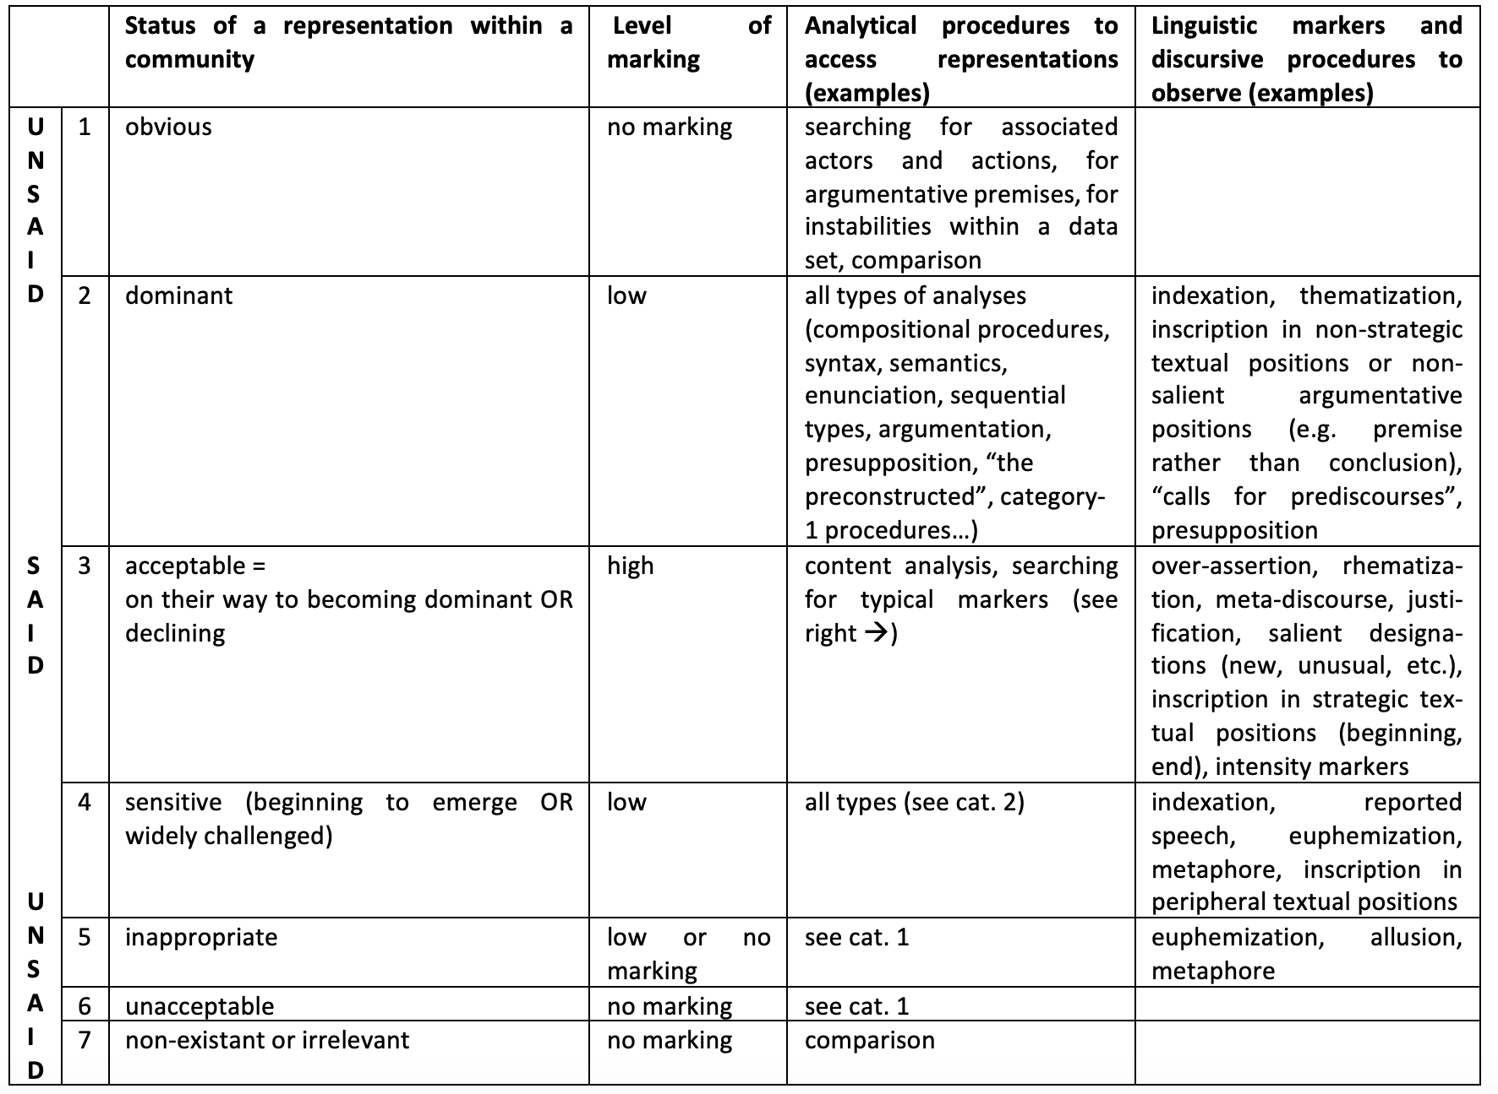

Slide 23
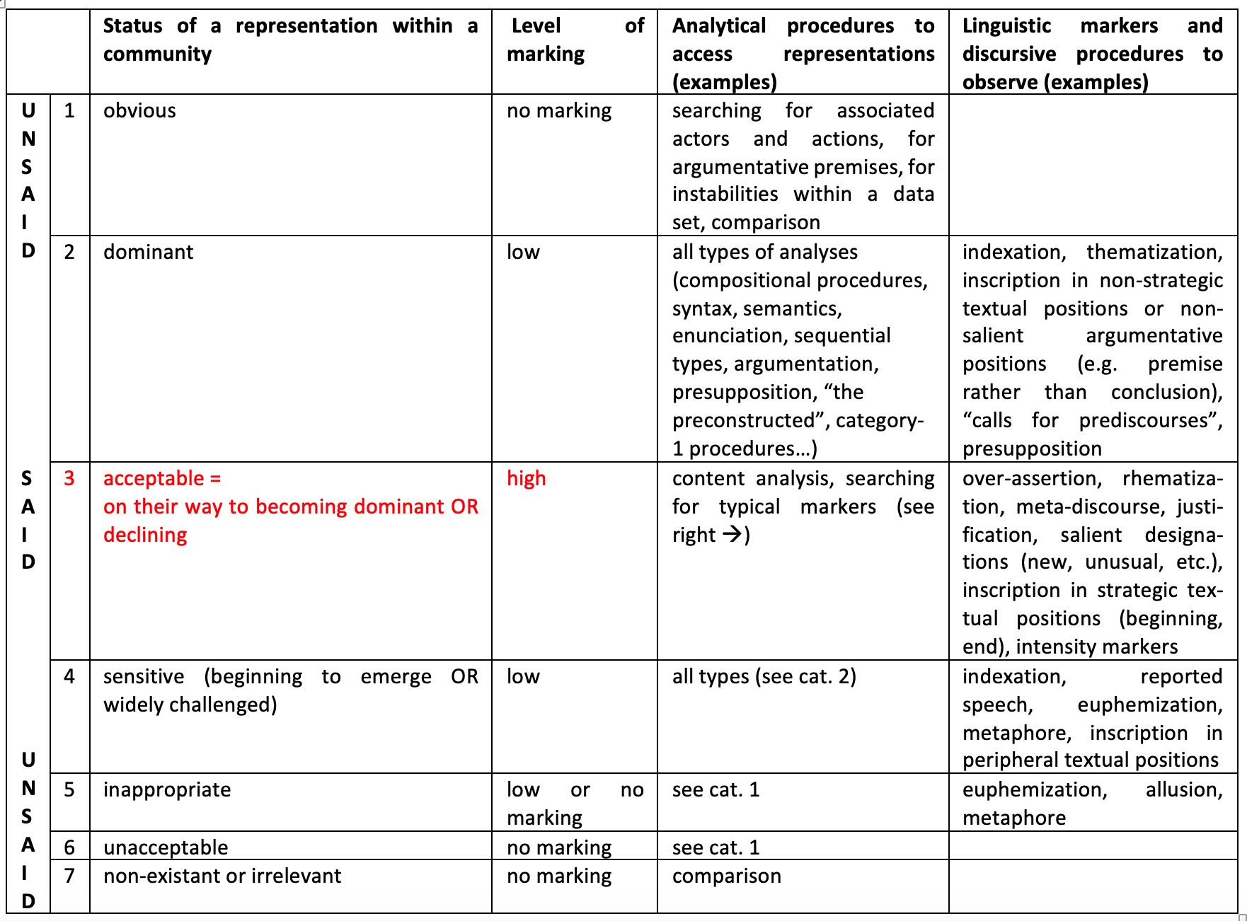

Slide 24
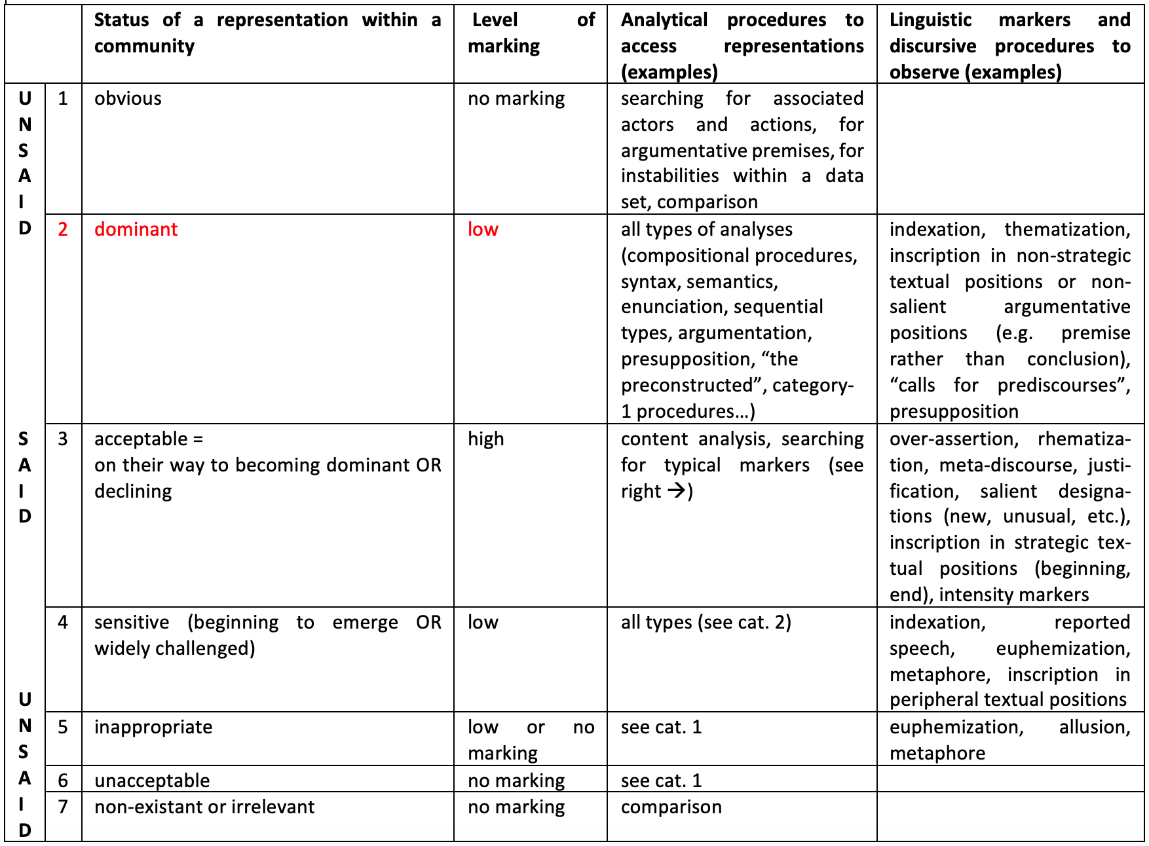

Slide 25
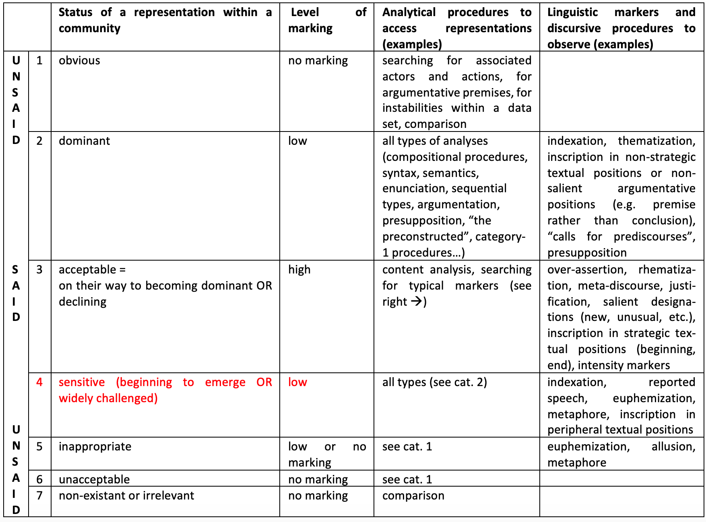

Slide 26
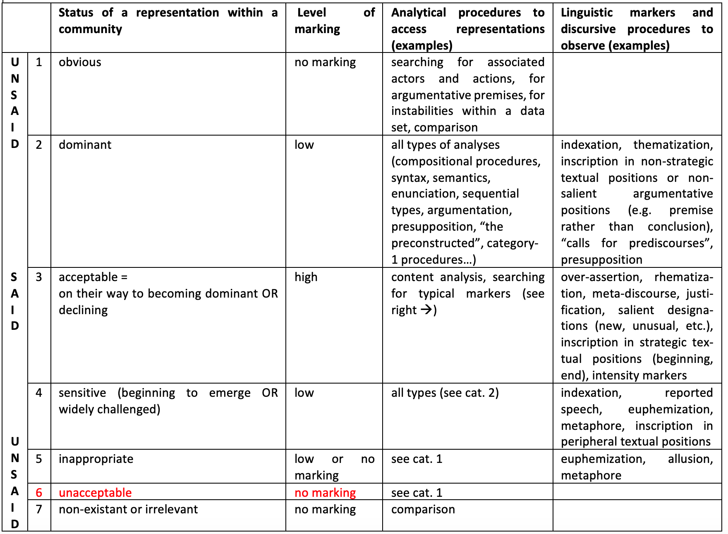

Slide 27
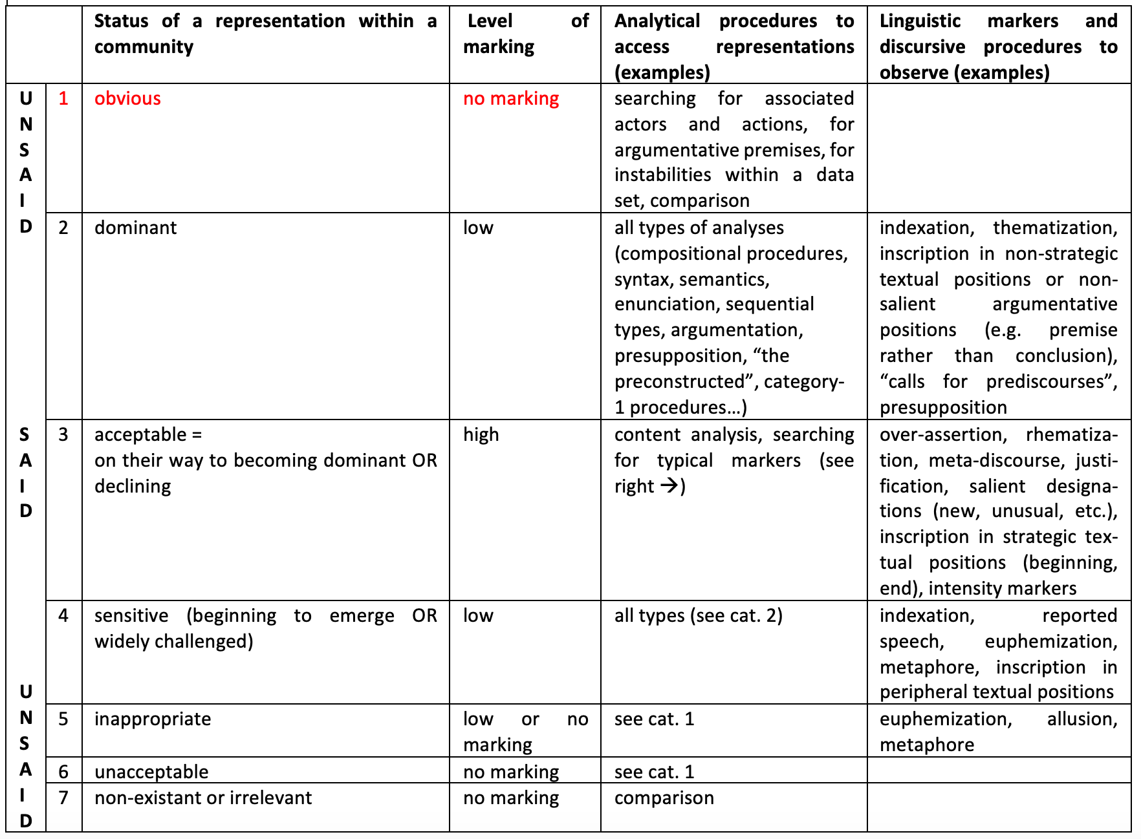

Slide 28
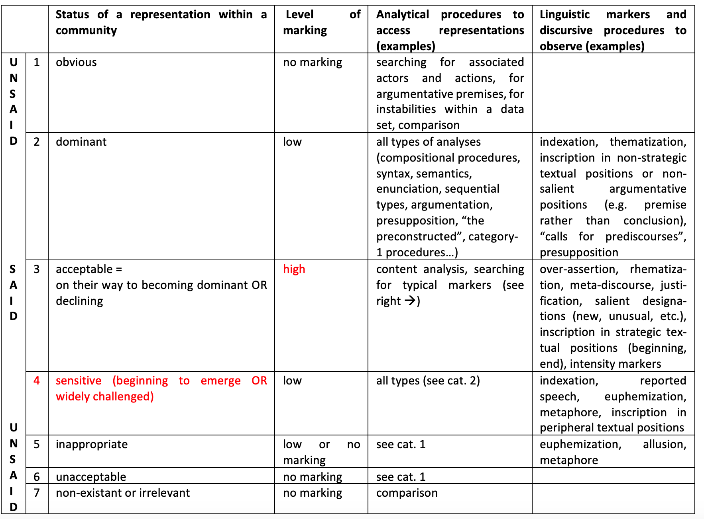

Slide 29
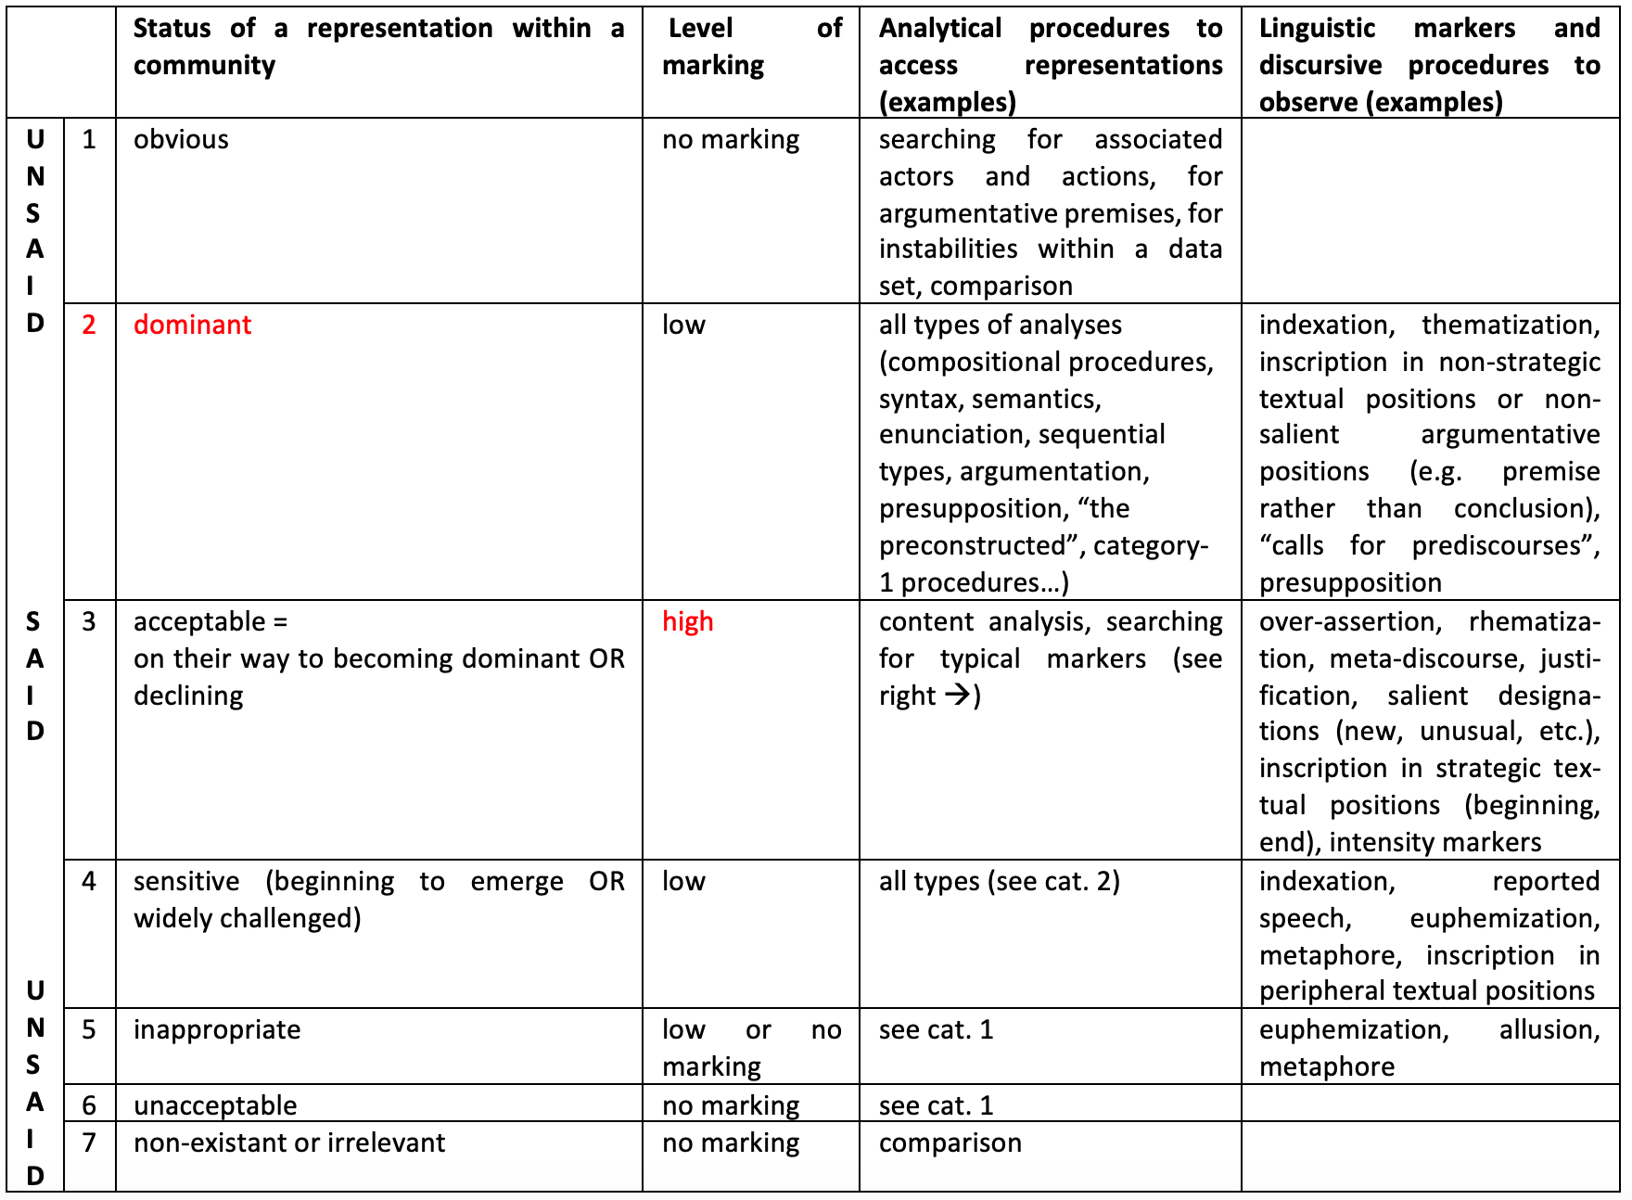

Slide 30
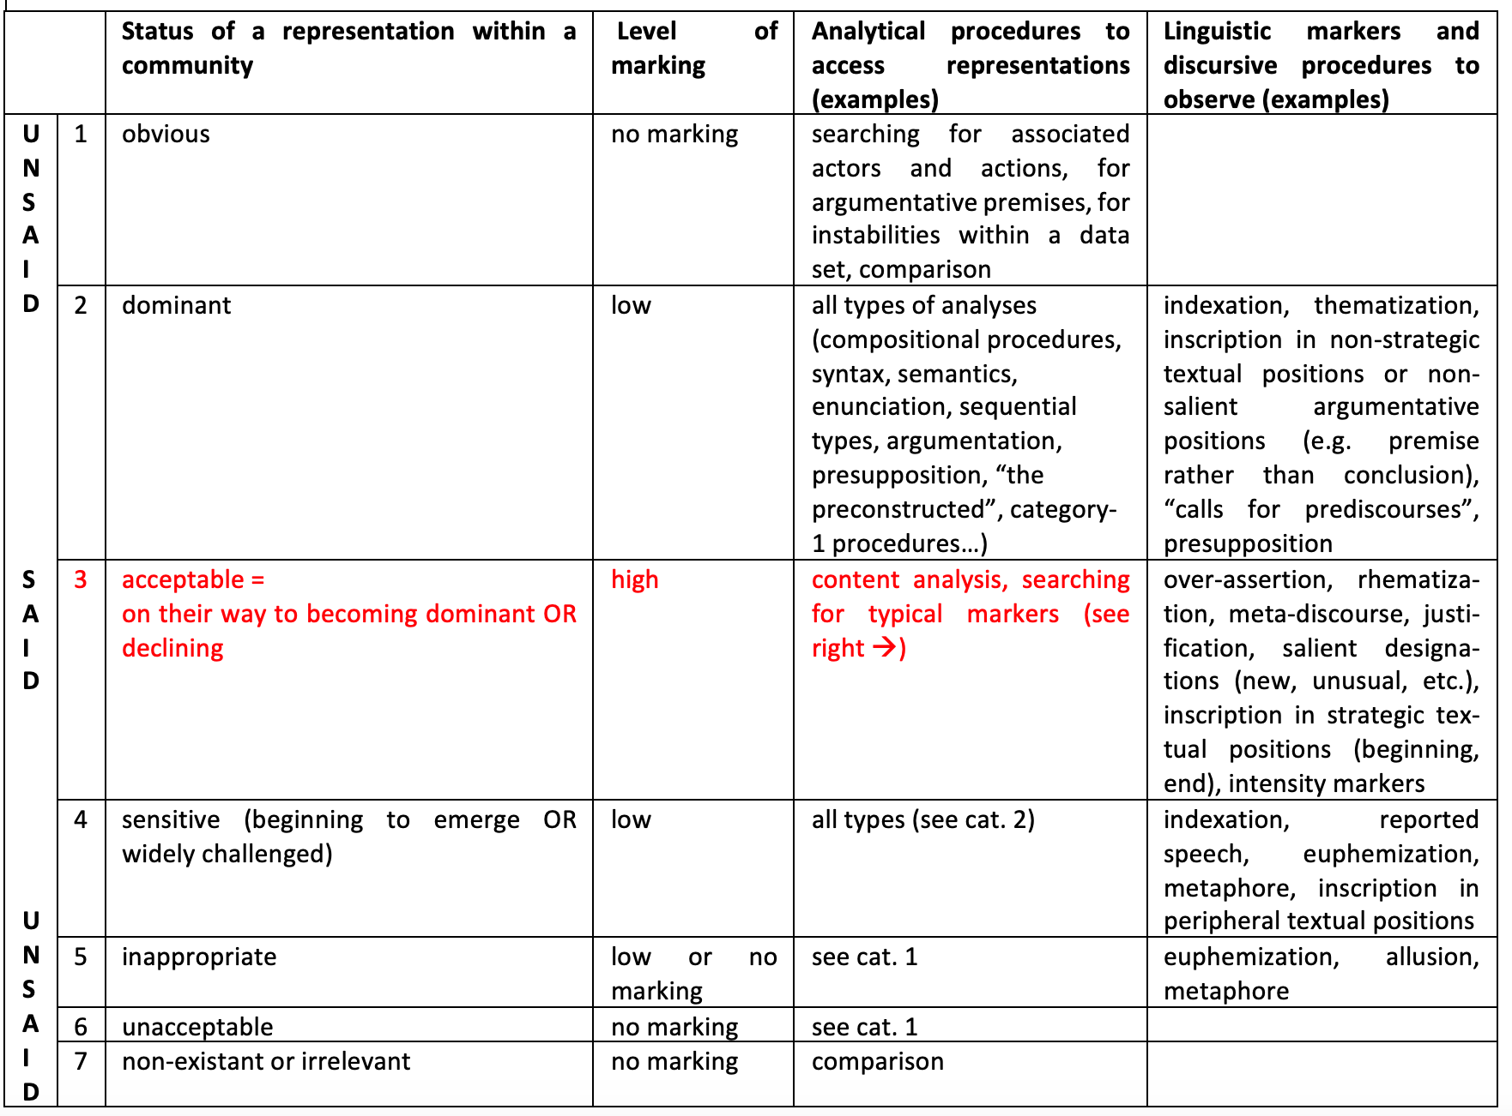

Slide 31
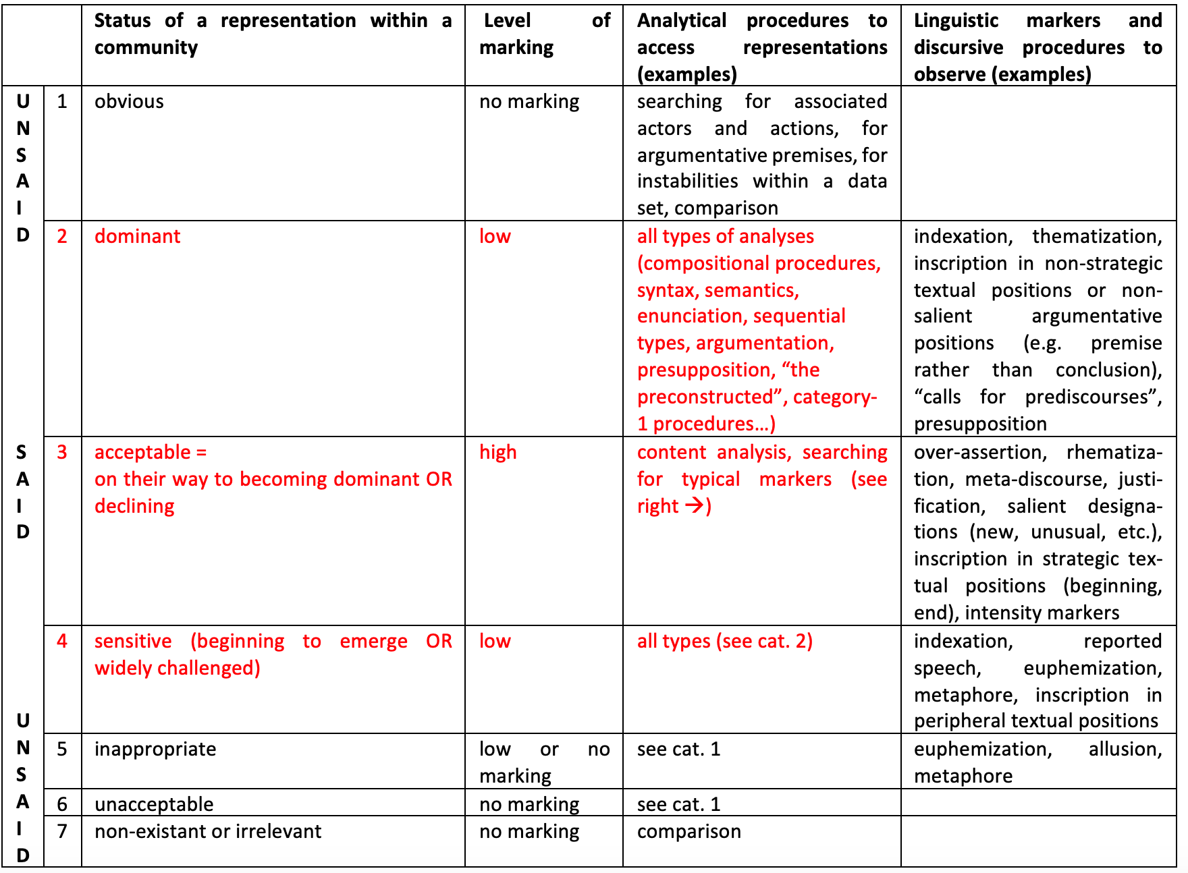

Slide 32
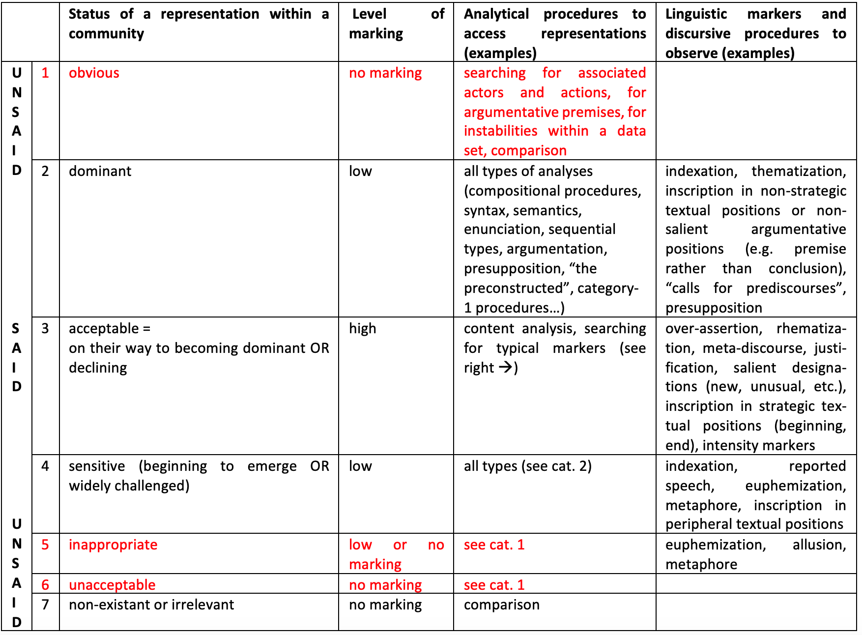

Slide 33
Almost all categories of representations in a nutshell

Slide 34
Almost all categories of representations in a nutshell
Massenverführung und Überwältigung
„Aber die vielen Feiern“ – „die herrlichen KdF-Reisen“ – „die Gemeinschaft auf den Parteitagen“. Viele Menschen verbanden nach 1945 auch positive Erinnerungen mit der NS-Zeit, obwohl nicht bestritten werden konnte, dass die Herrschenden ihr System auf Unterdrückung, Verfolgung und Terror gegründet hatten.
[Regenhardt, Hans-Otto and Claudia Tatsch, ed. 2009. Forum Geschichte. Band 4: Vom Ersten Weltkrieg bis heute. Berlin: Cornelsen, p. 100]
[Mass seduction and overpowering “But all the celebrations”–“the wonderful KdF trips”–“the communion on the party conventions”. Many people also associated positive memories to the Nazi era after 1945, although it could not be denied that the rulers had based their system on oppression, persecution and terror.]

Slide 36
Almost all categories of representations in a nutshell
Massenverführung und Überwältigung
„Aber die vielen Feiern“ – „die herrlichen KdF-Reisen“ – „die Gemeinschaft auf den Parteitagen“. Viele Menschen verbanden nach 1945 auch positive Erinnerungen mit der NS-Zeit, obwohl nicht bestritten werden konnte, dass die Herrschenden ihr System auf Unterdrückung, Verfolgung und Terror gegründet hatten.
[Regenhardt, Hans-Otto and Claudia Tatsch, ed. 2009. Forum Geschichte. Band 4: Vom Ersten Weltkrieg bis heute. Berlin: Cornelsen, p. 100]
[Mass seduction and overpowering “But all the celebrations”–“the wonderful KdF trips”–“the communion on the party conventions”. Many people also associated positive memories to the Nazi era after 1945, although it could not be denied that the rulers had based their system on oppression, persecution and terror.]

Slide 37
Almost all categories of representations in a nutshell
Massenverführung und Überwältigung
„Aber die vielen Feiern“ – „die herrlichen KdF-Reisen“ – „die Gemeinschaft auf den Parteitagen“. Viele Menschen verbanden nach 1945 auch positive Erinnerungen mit der NS-Zeit, obwohl nicht bestritten werden konnte, dass die Herrschenden ihr System auf Unterdrückung, Verfolgung und Terror gegründet hatten.
[Regenhardt, Hans-Otto and Claudia Tatsch, ed. 2009. Forum Geschichte. Band 4: Vom Ersten Weltkrieg bis heute. Berlin: Cornelsen, p. 100]
[Mass seduction and overpowering “But all the celebrations”–“the wonderful KdF trips”–“the communion on the party conventions”. Many people also associated positive memories to the Nazi era after 1945, although it could not be denied that the rulers had based their system on oppression, persecution and terror.]

Slide 38
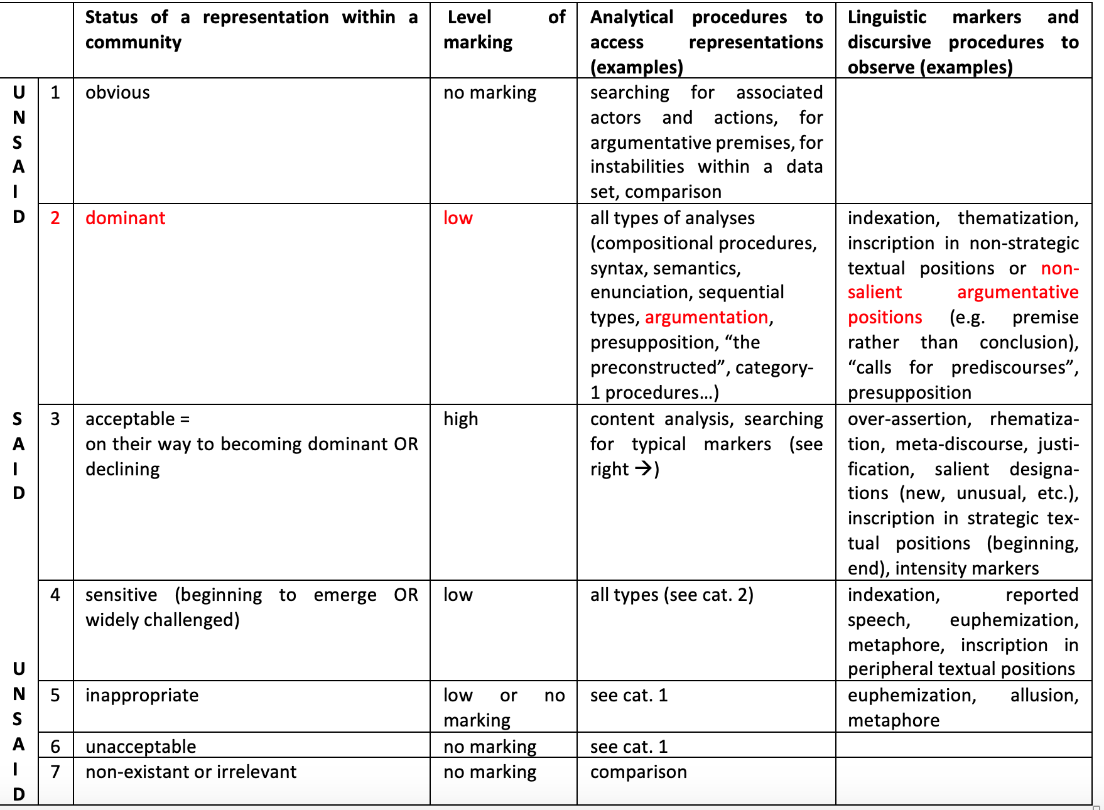

Slide 39
Almost all categories of representations in a nutshell
Massenverführung und Überwältigung
„Aber die vielen Feiern“ – „die herrlichen KdF-Reisen“ – „die Gemeinschaft auf den Parteitagen“. Viele Menschen verbanden nach 1945 auch positive Erinnerungen mit der NS-Zeit, obwohl nicht bestritten werden konnte, dass die Herrschenden ihr System auf Unterdrückung, Verfolgung und Terror gegründet hatten.
[Regenhardt, Hans-Otto and Claudia Tatsch, ed. 2009. Forum Geschichte. Band 4: Vom Ersten Weltkrieg bis heute. Berlin: Cornelsen, p. 100]
[Mass seduction and overpowering “But all the celebrations”–“the wonderful KdF trips”–“the communion on the party conventions”. Many people also associated positive memories to the Nazi era after 1945, although it could not be denied that the rulers had based their system on oppression, persecution and terror.]

Slide 40
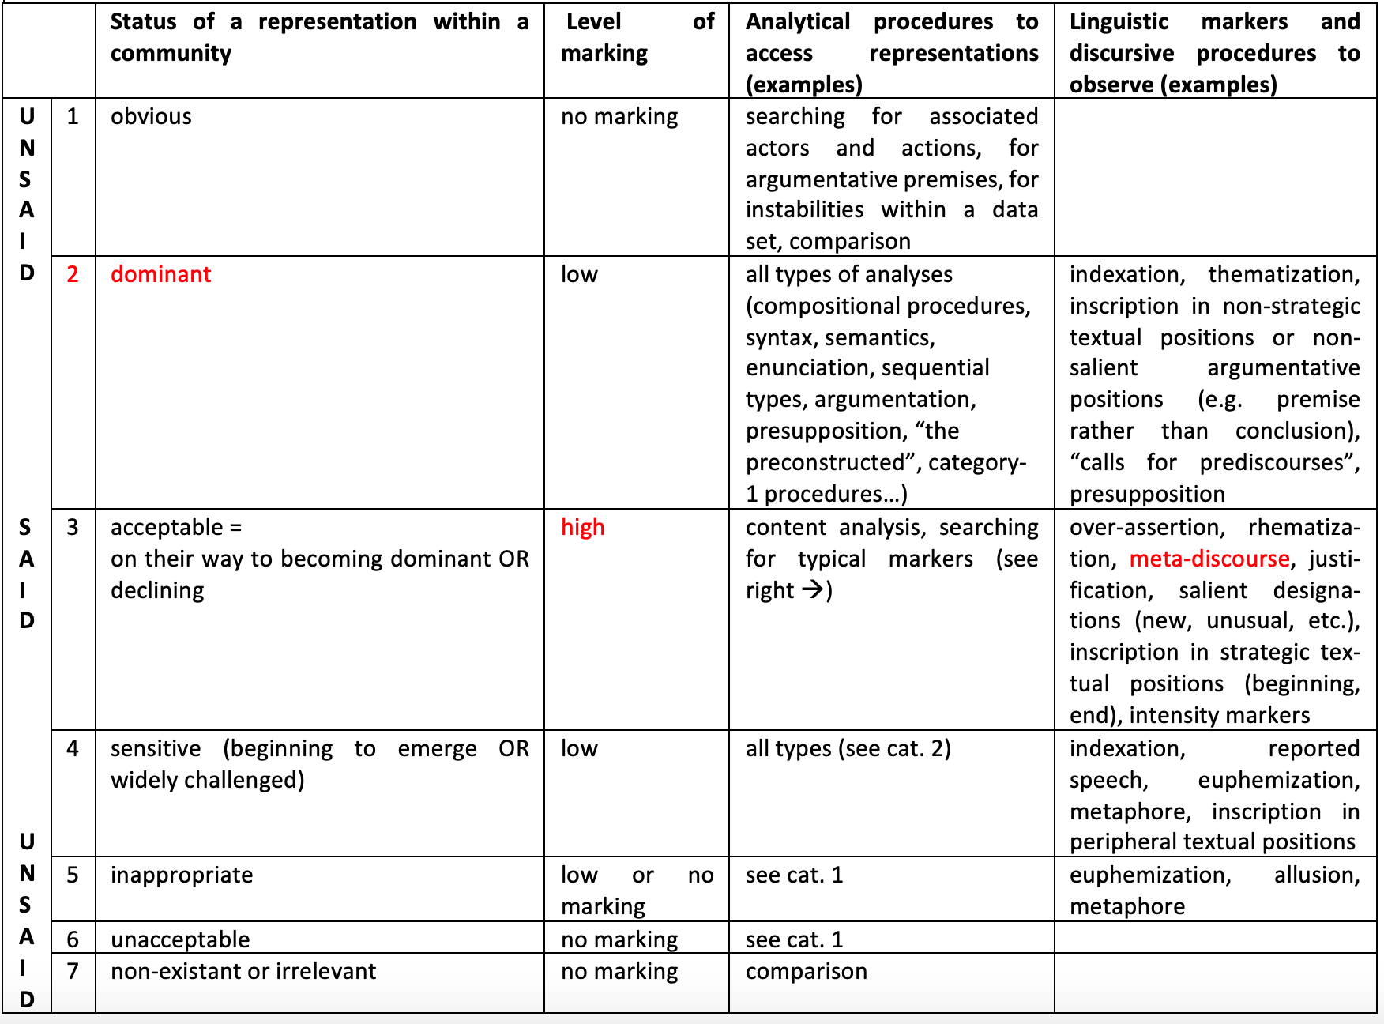

Slide 41
Almost all categories of representations in a nutshell
Massenverführung und Überwältigung
„Aber die vielen Feiern“ – „die herrlichen KdF-Reisen“ – „die Gemeinschaft auf den Parteitagen“. Viele Menschen verbanden nach 1945 auch positive Erinnerungen mit der NS-Zeit, obwohl nicht bestritten werden konnte, dass die Herrschenden ihr System auf Unterdrückung, Verfolgung und Terror gegründet hatten.
[Regenhardt, Hans-Otto and Claudia Tatsch, ed. 2009. Forum Geschichte. Band 4: Vom Ersten Weltkrieg bis heute. Berlin: Cornelsen, p. 100]
[Mass seduction and overpowering “But all the celebrations”–“the wonderful KdF trips”–“the communion on the party conventions”. Many people also associated positive memories to the Nazi era after 1945, although it could not be denied that the rulers had based their system on oppression, persecution and terror.]

Slide 45
Different layers of (contradictory) representations through presence and absence

Slide 46
Different layers of (contradictory) representations through presence and absence
van Leeuwen, Theo. 2008. Discourse and Practice. New Tools for Critical Discourse Analysis. Oxford: Oxford University Press.

Slide 47
Different layers of (contradictory) representations through presence and absence
Am 1. September 1939 griffen deutsche Truppen Polen an. /.../ Frankreich und Großbritannien erklärten /.../ am 3. September Deutschland den Krieg /.../. Nach der raschen Niederlage Polens Anfang Oktober wurde unter Federführung der SS ein Besatzungsregiment errichtet, das alle Regeln des Völkerrechts missachtete. Viele Polen wurden zur Zwangsarbeit verschleppt und die systematische Ermordung von Juden, aber auch von nichtjüdischen Polen – Adeligen, Geistlichen, Wissenschaftlern – begann. Die gesamte polnische Elite sollte vernichtet werden. [Sauer, Michael, ed. 2011. Geschichte und Geschehen 6. Stuttgart/Leipzig: Ernst Klett Verlag, p. 44]

Slide 48
[On September 1, 1939 German troops attacked Poland. /.../ France and Great Britain declared war on Germany on September 3 /.../. After Poland’s quick defeat in the beginning of October an occupation rule disregarding all rules of international law was put in place under the leadership of the SS. Many Poles were deported for forced labor and the systematic murder of Jews, but also of non-Jewish Poles–aristocrats, clergymen, scientists–began. The complete Polish elite was supposed to be destroyed.]

Slide 49
[On September 1, 1939 German troops attacked Poland. /.../ France and Great Britain declared war on Germany on September 3 /.../. After Poland’s quick defeat in the beginning of October an occupation rule disregarding all rules of international law was put in place under the leadership of the SS. Many Poles were deported for forced labor and the systematic murder of Jews, but also of non-Jewish Poles–aristocrats, clergymen, scientists–began. The complete Polish elite was supposed to be destroyed.]

Slide 50
[On September 1, 1939 German troops attacked Poland. /.../ France and Great Britain declared war on Germany on September 3 /.../. After Poland’s quick defeat in the beginning of October an occupation rule disregarding all rules of international law was put in place under the leadership of the SS. Many Poles were deported for forced labor and the systematic murder of Jews, but also of non-Jewish Poles–aristocrats, clergymen, scientists–began. The complete Polish elite was supposed to be destroyed.]

Slide 51
Verantwortlich für die millionenfachen Morde „im Hinterland”, also in den von Deutschland eroberten Gebieten, waren die SS und der Polizeiapparat, aber auch reguläre Einheiten der Wehrmacht. [op. cit., p. 45]
[It was the SS and the police, but also regular army units that were responsible for the millions of murders in the “back country”, meaning in the territories that had been conquered by Germany.]

Slide 52
...not only x, (but also) y
Brès, Jacques. 1999. “Vous les entendez ? Analyse du discours et dialogisme.” Modèles linguistiques 40: 71-86. http://ml.revues.org/1411, §39

Slide 53
Verantwortlich für die millionenfachen Morde „im Hinterland”, also in den von Deutschland eroberten Gebieten, waren die SS und der Polizeiapparat, aber auch reguläre Einheiten der Wehrmacht. [op. cit., p. 45]
[It was the SS and the police, but also regular army units that were responsible for the millions of murders in the “back country”, meaning in the territories that had been conquered by Germany.]

Slide 56
Conclusion

Slide 57
Conclusion
Different levels of linguistic marking lead to representations of different statuses

Slide 58
Conclusion
Different levels of linguistic marking lead to representations of different statuses
Competing representations within the same text thanks to different levels of linguistic marking

Slide 59
Conclusion
Different levels of linguistic marking lead to representations of different statuses
Competing representations within the same text thanks to different levels of linguistic marking
Table helps to understand
how the unsaid works in discourse and interacts with what is said

Slide 60
Conclusion
Different levels of linguistic marking lead to representations of different statuses
Competing representations within the same text thanks to different levels of linguistic marking
Table helps to understand
how the unsaid works in discourse and interactions with what is said
how the unsaid can be detected

Slide 61
Conclusion
Different levels of linguistic marking lead to representations of different statuses
Competing representations within the same text thanks to different levels of linguistic marking
Table helps to understand
how the unsaid works in discourse and interactions with what is said
how the unsaid can be detected
Discourse analysis as an important contribution to researching the unsaid

Slide 62
von Münchow, Patricia. 2016. “Quand le non-dit n’est pas l’implicite : comment rendre visibles les silences dans le discours ?” Signes, discours et sociétés 17. http://revue-signes.gsu.edu.tr/?article=79.
von Münchow, Patricia. 2018a. “Theoretical and methodological challenges in identifying meaningful absences in discourse.” In Exploring silence and absence in discourse. Empirical approaches, edited by Melani Schröter and Charlotte Taylor, 215-40. London: Palgrave Macmillan.
von Münchow, Patricia. 2018b. “Penser le non-dit en Critical Discourse Analysis, Analyse du Discours Française et Analyse du Discours Contrastive.” In Texte et discours en confrontation dans l’espace européen, edited by Driss Ablali, Sandrine Reboul-Touré and Malika Temmar, 431-46. Berne: Peter Lang.
von Münchow, Patricia. 2019. “National Socialism and World War II in German and French history textbooks. Learning through words and through silence.”, In Studies in Comparative Pragmatics, edited by Harmut Lenk, Juhani Härmä, Sanromán, Begoña & Elina Suomela-Härma, 19-44. Cambridge: Cambridge Scholars Publishing.
von Münchow, Patricia. 2021. L’analyse du discours contrastive. Théorie, méthodologie, pratique. Limoges: Lambert Lucas

Slide 63
Thank you!
patricia.vonmunchow@parisdescartes.fr

