Slide 1


Year in Professional Practice (YPP)

Slide 2
Why do a placement?

Slide 3

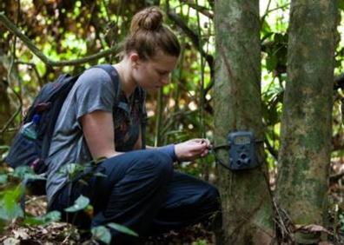

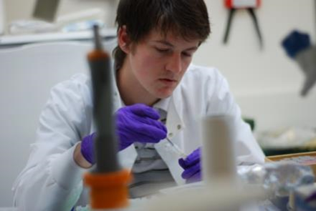
What do employers want?
Graduates that are able to map skills acquired from their studies onto generic skills in the workplace
Initiative
Tap into their social capital to the
benefit of the job & employer
Notes:
https://www.theguardian.com/money/2013/apr/22/top-10-things-employers-looking-for
https://targetjobs.co.uk/careers-advice/career-planning/273051-the-top-10-skills-thatll-get-you-a-job-when-you-graduate

Slide 4
What is the Kent Year in Professional Practice?
A placement/internship in between stages 2 & 3 (Stage S)
A 1 year additional year = [S] for all SAC programmes
Pass/Fail
Actually 24 weeks minimum duration
  Equivalent to 120 FT days,
  or 6 months full time
  So, 4 days per week = 30 weeks
  Or, 3 days per week = 40 weeks

Slide 5
How is it assessed?
Brief written appraisal by your Line Manager(s) (10%)
  Marks averaged if more than one
Written report (4000 words, excluding references)
reflecting on the work undertaken) (80%) Synthesise the key experiences you acquired during your placement & match them to the learning outcomes of the degree programme
Short presentation about your placement, in the Autumn term of Stage 3 (10%)
5 minutes to present a summary of your work on placement to a group of your peers & academic staff. Stage 2 students preparing for their YPP will be invited
Overall the module is a Pass/Fail

Slide 6
What does SAC expect from the placement?
It must complement learning outcomes from you degree:
Knowledge & understanding of specific areas of theory, policy or practice relevant to the host organisations & agreed placement task(s)
Application of intellectual or subject-specific skills from Stages 1 & 2 of the degree programme from the perspective of their chosen employer
Ability to work in a professional setting & demonstrate enhanced inter-personal skills

Slide 7
What does SAC expect from the placement?
Examples include, but are not limited to:
A piece of research
A management plan or other management tool
A policy report, a piece of law or policy, or its implementation
An exercise related to the storage & systematisation of data sets
Facilitation, planning & coordination of a consultation process or an event
Development of educational, awareness-raising or advocacy materials or activities

Slide 8








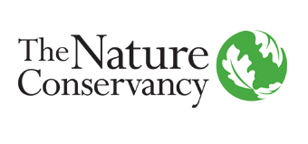
Year in Professional Practice Organisations

Slide 9
Conditions
A clean disciplinary record
Contractual agreement between employer & university (at Stage 2)
you are registered on the programme!

Slide 10
The onus is on you!
Placements aren’t guaranteed
~50% of students find one
Other options might be more suitable for you:
  PT volunteering
Academic Advisor
HSS Placements
SAC
UG
Employer
STUDENT
CES – Careers and Employability Service
Contracts

Slide 11
Where do I find out more about the YPP?
DP237325 Preparing for a SAC Year in Professional Practice (this moodle page is available to all Stage 2 students)
WCON5321 (DI533) Year in Professional Practice Moodle
Contact HSS Placements Team hssplacements@kent.ac.uk
Dr David Roberts
Academic Lead for Year in Professional Practice
d.l.roberts@kent.ac.uk

Slide 12
Overview of the placement system
Stage 2
Pre- placement
Stage S
During placement
Stage 3
Post- placement
Outline talk stage 1
Stage 2: Autumn-Spring
Students apply
Return formal offer letter
Verify, liaise, confirm
Commit to contract
Contracts signed
Stage 2: Summer
Confirm roles
Training
Visa compliance for tier4
Monitoring
Monthly blogs (min. 6)
2x catch up calls with Academic Advisor
    at start
    at end
Evaluation with employer
4000 word report (due week before Week 0)
Presentation to SAC (during Week 3/ new Week 11)
Manager’s report (due end of Sept)
Award pass/fail
Student evaluation
Board of Examiners
Academic Advisor
HSS
UG
Academic Advisor
HSS
UG
Academic Advisor
HSS Placements
HSS Placements
HSS Placements
HSS
UG
Careers
Employer
Employer
Contracts

Slide 13
What to do now at Stage 2?
Confirm what you are interested in
If you are not on the YPP DO NOT rush out to complete a course transfer, find a placement first!
Read the moodle page DP237325
Visit Careers & Employability for…
  Sessions to improve your visibility
  CV check & other assistance
HSS Placements also offer appointments to help with CVs, cover letters, applications, etc. Book an appointment here: https://outlook.office365.com/owa/calendar/HSSPlacementsandEmployability11Meetings@live.kent.ac.uk/bookings/
Consult with your Academic Adviser
*Don’t forget your studies!*

Slide 14
Our deadlines – Stage 2 undertaking placements
ABSOLUTE DEADLINES
UK Placement: Last working day of July
International Placement: Last working day of May
But try & complete everything sooner rather than later!!!

Slide 15
Final paperwork
Placement Approval Form, including Offer Letter
from organisation. Health & Safety and Insurance
Checklist
International Placements requires extra paperwork including:
  Medical clearance
  Risk Assessment
  University Travel Insurance
Placement Checklist Form
Any required training
Visa compliance for tier4

Slide 16
Take home message for Stage 2 students
Contact hssplacements@kent.ac.uk if you are interested in a YPP
Talk to your Academic Advisors
Only submit a change of course form once you have a placement
Read the Moodle page – DP237325
Start looking now!
Last day of July is absolute deadline to have everything in place

